Slide 1


Slide 2

👋 Welcome to The Productivity Playbook Use Your Time Better. Achieve More. Feel Lighter.
The main objective of today is to:
Provide you with a System for Protecting and Managing your time!
Notes:
Thank you for the opportunity to present this workshop. This isn’t about squeezing more into your day or hustling harder - It’s about learning to use your time with intention so you can get more done, feel less overwhelmed, and focus on what truly matters.
The main objective of today is to:
provide you with a System for Managing your time!
To help you Save / regain 90 minutes per day That’s 7.5 hours per week, or more than 6.5 weeks per year reallocated to what truly matters.

Slide 3

But it’s about more than just Saving Time!
Its about:
Enjoying your work more
Ensuring you have time to engage with your customers, team, Friends and Family,
Achieving more of your goals with less stress
Optimising your workflows, Reducing Distractions
Overall making you more productive happier and more connected with your team, Friends and Family
Notes:
But it's not just about doing more; it's about enjoying your work more, ensuring you have the time to engage with your participants and team members, and ultimately achieving your goals with less stress
By optimizing workflows and reducing distractions, we aim to make you more productive, happier, and more connected with your team

Slide 4
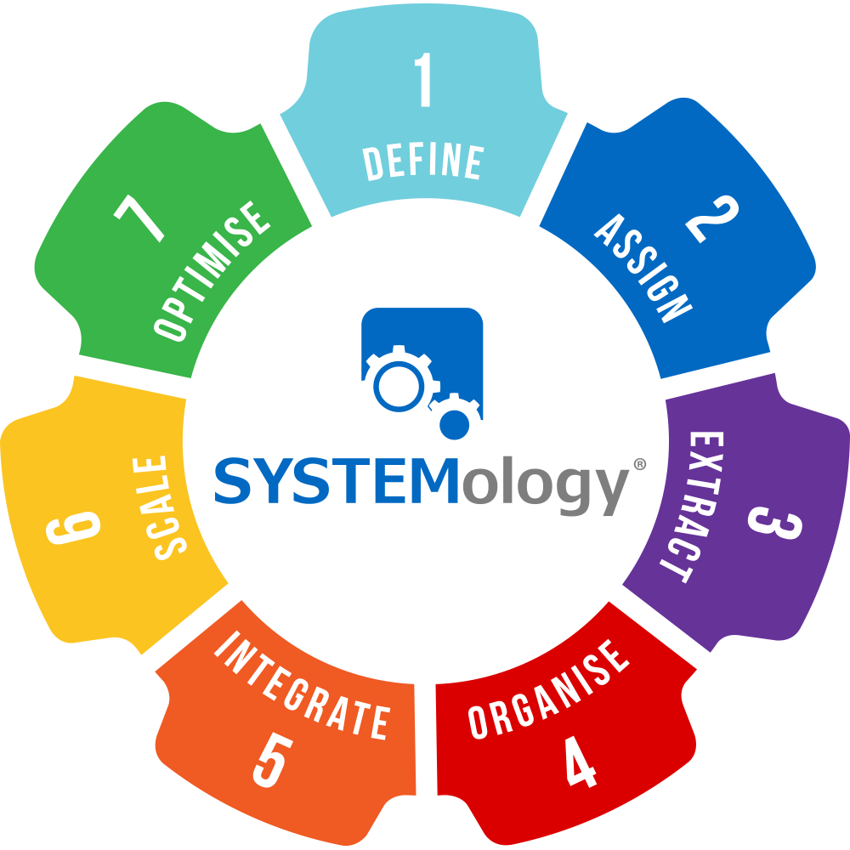

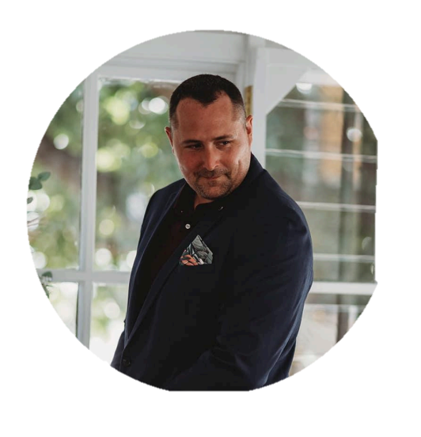

My Name is Greg Roworth, a Systemologist and Microsoft 365 productivity specialist.
Notes:
I am Greg Roworth, a SYSTEMologist and Operations and Productivity Specialist with nearly two decades of experience building high-performing teams and Scaling business.
I have learnt to leverage Microsoft 365 to optimise business systems, simultaneously increasing productivity and operational output across multiple projects.
I have become incredibly passionate about helping Businesses and Teams become more productive through the correct use of Modern Technology and Microsoft 365
Disclaimer ** I do suffer from Dyslexia - although whilst this means that I often misspell words – it does however give me the unique ability to see every situation, opportunity, and problem with a unique perspective, and I see things that most people don’t, to do things that most people can’t, because they can’t see what I can.
So please forgive me if there are any misspelled words within this presentation.

Slide 5
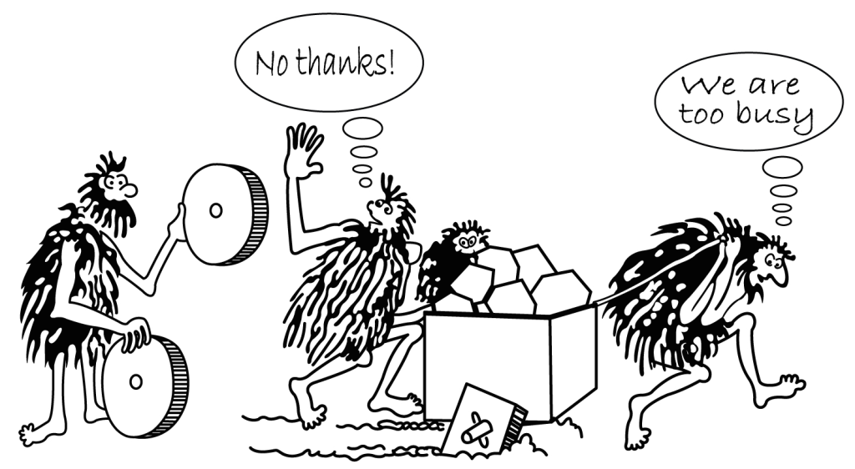
Notes:
We consume more information than ever - around 34 GB of data daily.
We’re always reachable, always reacting.
Input sources have exploded: from just email and paper to messenger apps, CRMs, sticky notes, project boards, and more.
Add to that the hundreds of ideas we generate ourselves each day.
The result? We’re constantly busy, but rarely focused.
We spend our days firefighting, reacting to noise, and doing tasks that feel urgent but aren’t meaningful.

Slide 6
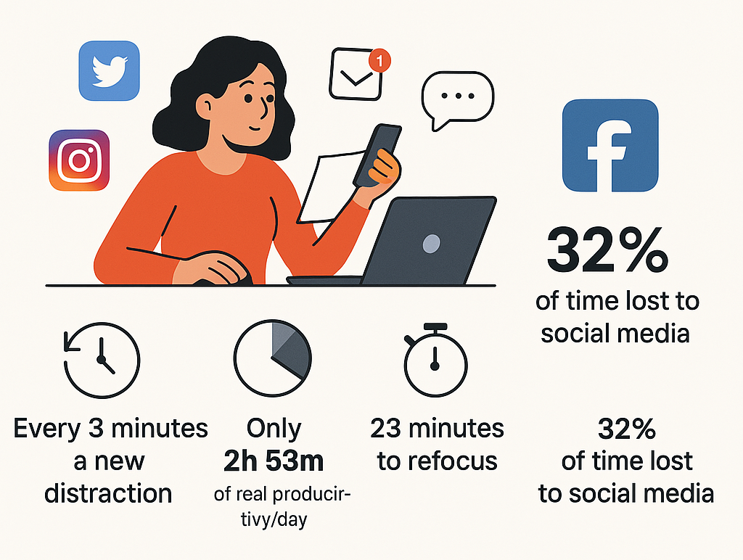
“Distraction is the default.”
Notes:
The average employee is interrupted every 3 minutes—that’s 20 times an hour.
After each distraction, it takes over 23 minutes to regain focus.
Social media alone can consume up to 32% of work time.
The result? Most people are only truly productive for less than 3 hours a day.
This is why environment design is critical - it’s not just about willpower, it’s about reducing friction and distractions.

Slide 7
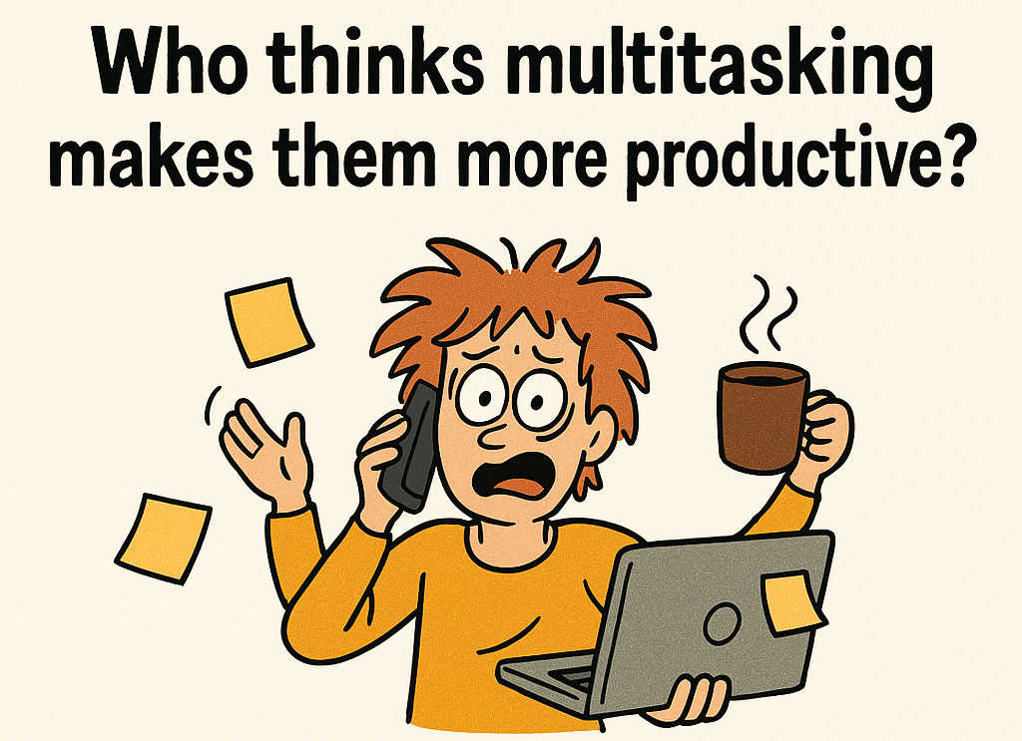
🙋‍♂️🙋‍♀️ “I’m great at multitasking!”
🧪 Science: “No, you’re not! studies show that multitasking can reduce efficiency by up to 40%.
Notes:
Ask the audience: “Who here thinks they’re great at multitasking?”
Then deliver the punchline: “Studies show that’s a myth.”
Multitasking is really just rapid task switching.
It leads to mental fatigue, reduced efficiency, and lower quality.
It creates the illusion of productivity, but the output suffers.
This is why systems and focus are so important.
Set the tone: “We’ve got a lot to cover, so let’s get into it.”

Slide 8

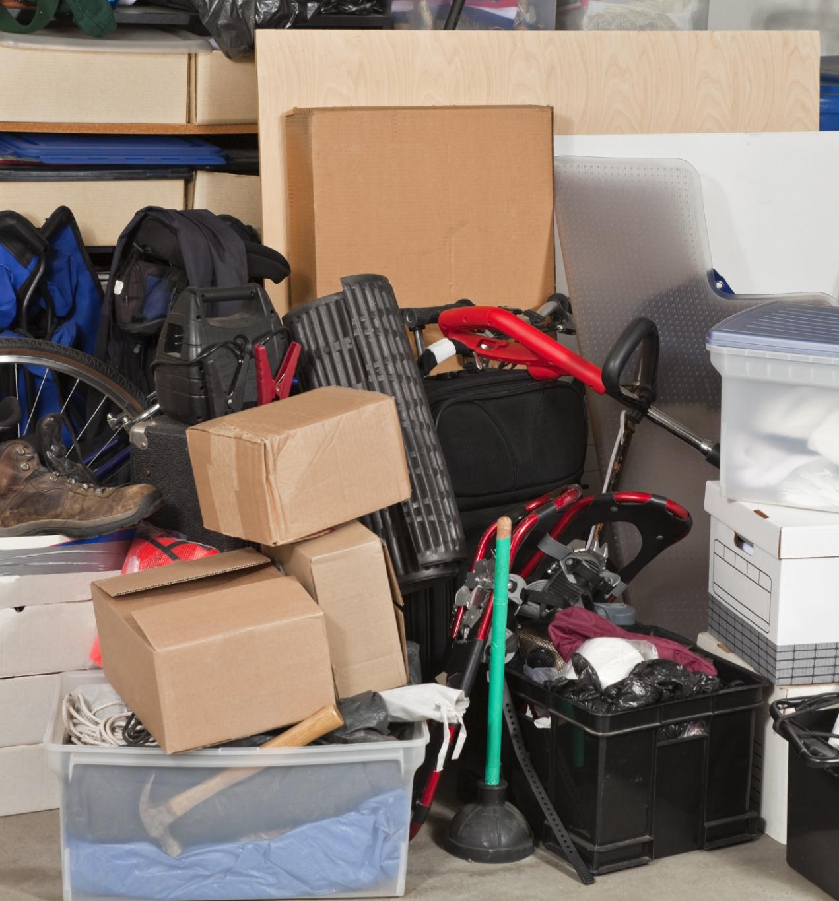
Why Are You Really Here! You Feel Overwhelmed?
😫 You’re Not Alone If You Feel…
Overwhelmed by everything coming at you
Like you're working hard - but not moving forward
Buried under emails, tasks, and meetings
Constantly reacting instead of executing
Staring down a to-do list that never gets smaller
Starting each day already behind
Ending each day exhausted and unclear on what you achieved
This isn’t a motivation problem. It’s a systems problem
Notes:
“Let’s name the problem. If this feels familiar you’re not broken, and you’re not alone.
What you’re experiencing isn’t a motivation problem. It’s not even a time problem. It’s a system problem. Or more accurately—a lack of system.
Your calendar is overloaded. You’re firefighting all day. You’re doing everything—except the things that truly matter. And that leads to the most frustrating feeling: working hard, but not moving forward.”
“The truth is, I can look at your calendar today and predict where your business - or career - will be in a year. Unless you change it

Slide 9
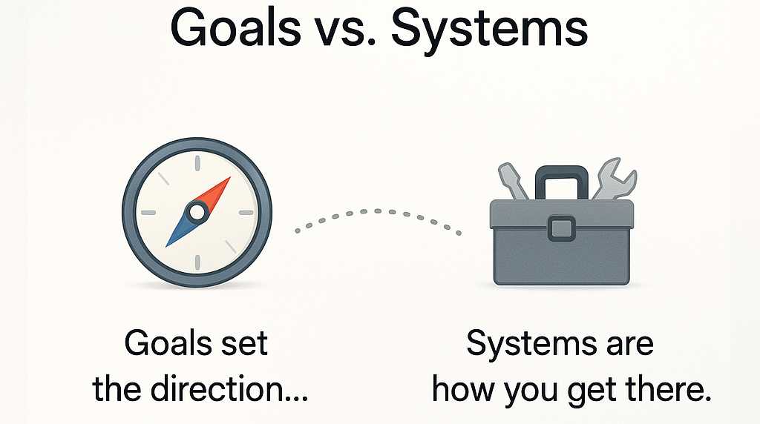
Notes:
“So where do we go wrong?
Most people I meet have the goal of being more productive. That’s a great starting point -but here’s the catch: they often jump straight into trying a new app, a habit tracker, or a time management hack, hoping it’ll be the silver bullet.
But here’s the truth: Having a goal is not the same as having a system.
Think about it -every runner in a race has the same goal: to win. But the one who actually wins? They’re the one with the best system - their training routine, their diet, their sleep schedule, their daily and weekly habits. That’s what makes the difference.
So if your goal is to be more productive or to save time, you need more than just the intention. You need a system that supports that goal.
And systems aren’t magic -they’re built. They take time, consistency, and iteration. Research shows it can take around 90 days to form a new behaviour. The treadmill doesn’t make you fit. Using it consistently does

Slide 10

Why You Need a System
🔥 Because… 💥 Without one, you’re always reacting 🧠 Your brain isn’t built for chaos—it’s built for clarity ⛓ Without a system, you become the system (and the bottleneck) ⏱ You waste time on low-value tasks instead of your highest-value work 🧩 Hard work doesn’t scale - but structure does 🧭 A system turns instinct into intention - and motion into momentum
📣 “You don’t need more time. You need a better way to use the time you already have.”
👊 That’s what The Productivity Playbook is here to give you.
Notes:
“Most people think the answer is more effort. Hustle harder. Stay later. Try another to-do app.
But here’s the truth: You can’t outwork a broken structure. And your brain wasn’t built to carry your entire workflow in your head.
A system relieves that pressure. It helps you decide what matters. It helps you focus your time and energy with purpose. And most importantly - it helps you build momentum, consistently.”
📣 “You don’t need more hours. You need a system that multiplies the ones you already have.”

Slide 11
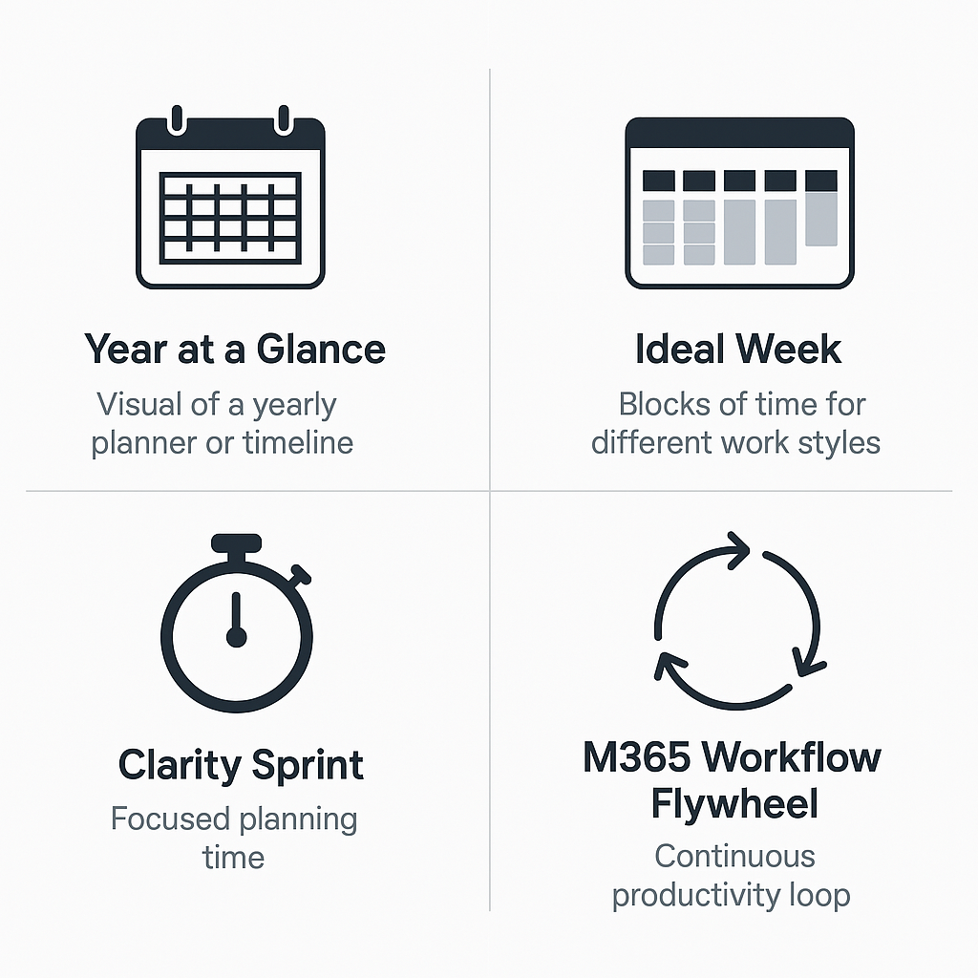
Productivity Playbook
Notes:
Now that we understand the importance of having a system, let me introduce you to the Productivity Playbook—a set of interconnected components designed to help you stay focused, organized, and in control of your time.
Let’s break it down:
Year at a Glance: This is your big-picture view. It helps you map out key goals, events, and priorities across the year so you’re not just reacting week to week—you’re planning with intention.
Ideal Week: Everyone works differently. Some of us need long, uninterrupted blocks of time, while others thrive on variety. The Ideal Week helps you design a schedule that matches your natural rhythm and work style.
Clarity Sprint: This is your weekly reset. A dedicated hour to plan, review, and realign. It’s where you step back, check your priorities, and make sure your week is set up for success.
M365 Workflow Flywheel: This is the engine that keeps everything moving. It’s inspired by systems like Getting Things Done and Building a Second Brain. You capture everything in one place, process it regularly, and use your Ideal Week and Clarity Sprint to stay on track.
Each of these parts supports the others. When they work together, they create a system that helps you stay focused, reduce stress, and make meaningful progress—consistently.

Slide 12
🗓️Year at a Glance
Time isn’t managed—it’s designed

Slide 13
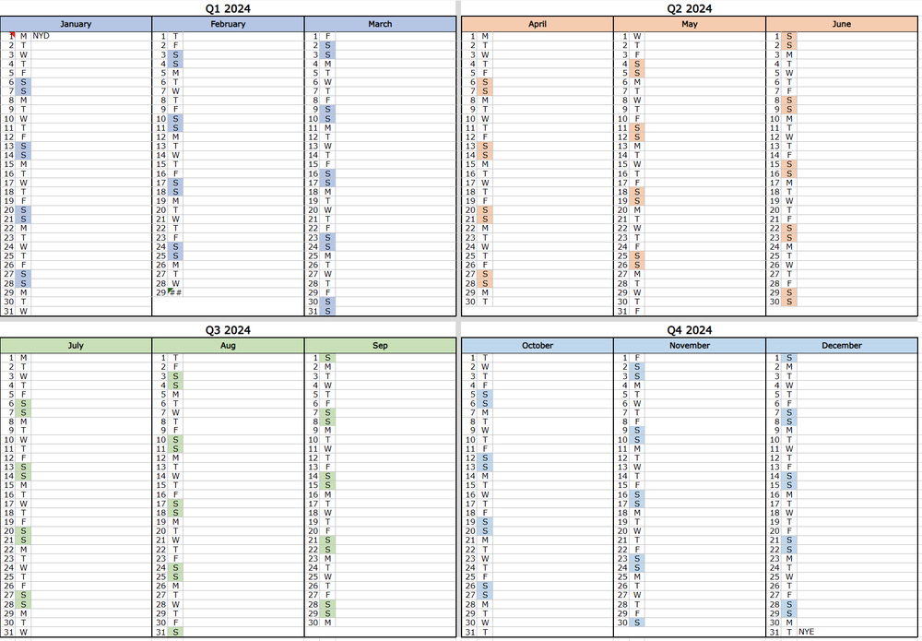
Year at a Glance
A visual, high-level overview of the entire year.
Helps in long-term planning for individuals and teams.
Provides clarity on key events, deadlines, and goals.
Can be created using digital tools (Excel, Google Sheets) or physical formats (bullet journals, printed planners).
Notes:
Let’s start with the big picture—literally.
The Year at a Glance Calendar is a powerful planning tool that lets you see your entire year on one page. Unlike a weekly or monthly view, this gives you clarity across the full year—so you can plan proactively, not reactively.
It’s used by professionals, teams, and businesses to track:
Key deadlines
Major projects
Holidays
Personal commitments
It helps you spot busy seasons, plan ahead, and avoid last-minute chaos.
We’ll walk through how to create, use, and maintain this calendar so it becomes a living part of your productivity system.
And if you’ve ever heard of Jesse Itzler, entrepreneur and author - he created something similar called the Big A.S.S. Calendar. Same idea: zoom out, get perspective, and make sure your year reflects what actually matters to you.”

Slide 14
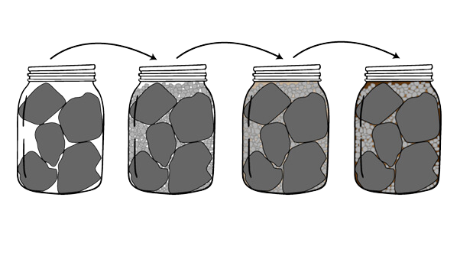
Important people and events
Career and Business
Family
Big Rocks First
Gravel Second
Sand Third
There’s Always room for a coffee with a friend
Notes:
“Before we dive into building your Year at a Glance, I want to share a powerful metaphor about how we schedule our time.
Imagine your time is like a jar.
The big rocks represent your most important priorities—family, health, personal goals.
The gravel stands for important but less critical things—meetings, events, responsibilities.
The sand is everything else—emails, admin tasks, social media, the busy work.
If you fill the jar with sand first, there’s no room for the big rocks. But if you start with the big rocks, then add gravel, and finally pour in the sand—it all fits.
And the best part? There’s always room for a coffee with a friend—a reminder that even with structure, we need space for connection and spontaneity.
This is exactly what the Year at a Glance helps you do: Put the big rocks in first

Slide 15
Step-by-Step Guide to Creating the Calendar
Gather Key Dates – Holidays, deadlines, events, projects, personal plans.
Choose a Format – Google Sheets, Excel, Notion, Bullet Journal, or printed planner, Big Ass wall Calendar
Set Up Structure – 12 columns (months), 1-31 rows (days).
Add & Colour-Code Events – Use different colours for work, personal, and major deadlines.
Review & Share – Ensure accuracy, optimize layout, and distribute to the team.
Notes:
“Now let’s talk about how to actually build your Year at a Glance calendar.
Step one is to gather all your important dates—this includes public holidays, school breaks, business events, launches, and personal commitments. Anything that could impact your time or focus.
Next, choose your format.
If you prefer flexibility and easy updates, go digital.
If you like a quick visual reference, a printed version or wall calendar works great.
Then, set up the structure.
In a spreadsheet, create 12 columns for months and 31 rows for days.
Or, if you’re using a bullet journal, draw a simple grid layout.
Colour coding is key. Use different colours for work, personal, and critical deadlines. This makes it easy to scan and spot what’s coming up.
Finally, review your calendar. Look for conflicts, overlaps, or gaps. Then, share it with your team or family to make sure everyone’s aligned.
This tool becomes your yearly dashboard—a single source of truth that helps you stay ahead, not just keep up.

Slide 16
Benefits of Using a Year at a Glance Calendar
✔ Clarity & Organization - See the big picture and avoid scheduling conflicts.
✔ Better Planning - Helps plan ahead for major projects, vacations, and goals.
✔ Improves Productivity - Reduces last-minute stress by scheduling important dates early.
✔ Easy to Update & Share - Keep teams aligned and informed.
Notes:
“So, why does the Year at a Glance calendar matter?
It gives you clarity—you’re far less likely to miss a deadline or double-book yourself when you can see everything laid out in one place.
It supports long-term planning—vacations, launches, major projects—you can plan with confidence and avoid last-minute scrambles.
For teams, it’s a game changer. Everyone knows what’s coming up, so they can prepare and align their work.
Now, while digital formats are great for flexibility and sharing, they do have one downside: It’s hard to get that full-year, at-a-glance view on a screen.
That’s why I recommend either printing a large wall version or keeping a link to your Excel spreadsheet handy. It gives you the best of both worlds—visibility and flexibility.”

Slide 17
🧑‍💼 /👨‍🎨
Manager / Maker
Not all work requires the same kind of energy
Notes:
“Before we talk about designing your ideal week, let’s take a step back and ask: What kind of worker are you?
There are two main types of work schedules—and understanding which one fits you best is key to building a system that actually works.

Slide 18

The Manager's Schedule
This schedule revolves around 30 blocks
Managers typically perform various tasks throughout the day, often switching contexts frequently
Meetings are a natural part of the manager's schedule
This schedule is about command and control
Program Manager, Training Manager, Program Manager
Notes:
“Let’s start with the Manager’s Schedule.
This schedule is built around 30-minute blocks—just like a traditional appointment book. It’s structured, segmented, and designed for constant context switching.
Managers typically juggle a wide range of tasks throughout the day—meetings, phone calls, emails, and putting out fires as they arise. Their day is often packed from start to finish.
In this world, meetings are the default. Finding time to meet isn’t about protecting focus—it’s just a matter of logistics. If there’s a free slot, it gets filled.
This schedule is all about command and control—managing time and resources to drive organizational outcomes. For a manager, a fully booked calendar often feels like a fully invested day.
You’ll see this style in roles like Program Managers, Training Managers, and other coordination-heavy positions

Slide 19

The Maker's Schedule
This schedule Favors large, uninterrupted chunks of time, ideally half a day or more
Makers thrive when they can immerse themselves in a task or project for extended periods
Meetings are highly disruptive to the maker's schedule
This schedule is about producing output that requires sustained attention and focus
Data analyst, Business Analyst, Accountant, Content Developer, E-learning Specialist, Trainer/Facilitator
Notes:
“Now let’s look at the Maker’s Schedule—and it’s a completely different world.
This schedule is built around large, uninterrupted blocks of time—ideally half a day or more. Makers need this space to do what’s called deep work—the kind of work that requires intense focus and creativity.
Makers thrive when they can fully immerse themselves in a task or project. This could be:
Writing code
Designing a product
Creating content
Conducting research
Developing training materials
Here’s the challenge: meetings are the enemy of the Maker’s Schedule. Even one meeting in the middle of the day can split it into two unusable chunks—too short for meaningful progress. And switching from a state of flow to a meeting and back again comes with a huge cognitive cost.
This schedule is all about protecting focus. It’s about creating space to produce high-quality output—even if that means being less available or responsive.
You’ll see this work style in roles like Data Analysts, Business Analysts, Accountants, Content Developers, E-learning Specialists, and Facilitators.”

Slide 20

Hybrid
3rd the less common
Hybrids normally alternate between both Manager and maker, either, day to day, week to week or month to month.
The Hybrid burden is that he needs to balance the managing and the making
Hybrid – CEO, Entrepreneur, Visionary type
Notes:
‘I’m not fully a Manager… but I’m not quite a Maker either.’
That’s totally normal—especially at first.
You might identify as a Hybrid, someone who shifts between both modes depending on the day or the season. And that’s okay. Many roles require a bit of both.
But here’s the catch: Hybrid is often a temporary state, not a sustainable one.
If you don’t intentionally manage your schedule—protecting deep work time while still handling coordination—you risk falling into a trap: The 16-hour workday loop.
You’re constantly switching, constantly catching up, and never fully focused. It’s exhausting—and it’s avoidable.
As you work through this system over the coming weeks, you’ll likely find yourself aligning more clearly with either the Maker or the Manager style. And once you do, you can start designing your week to support that rhythm—rather than fighting against it.”

Slide 21
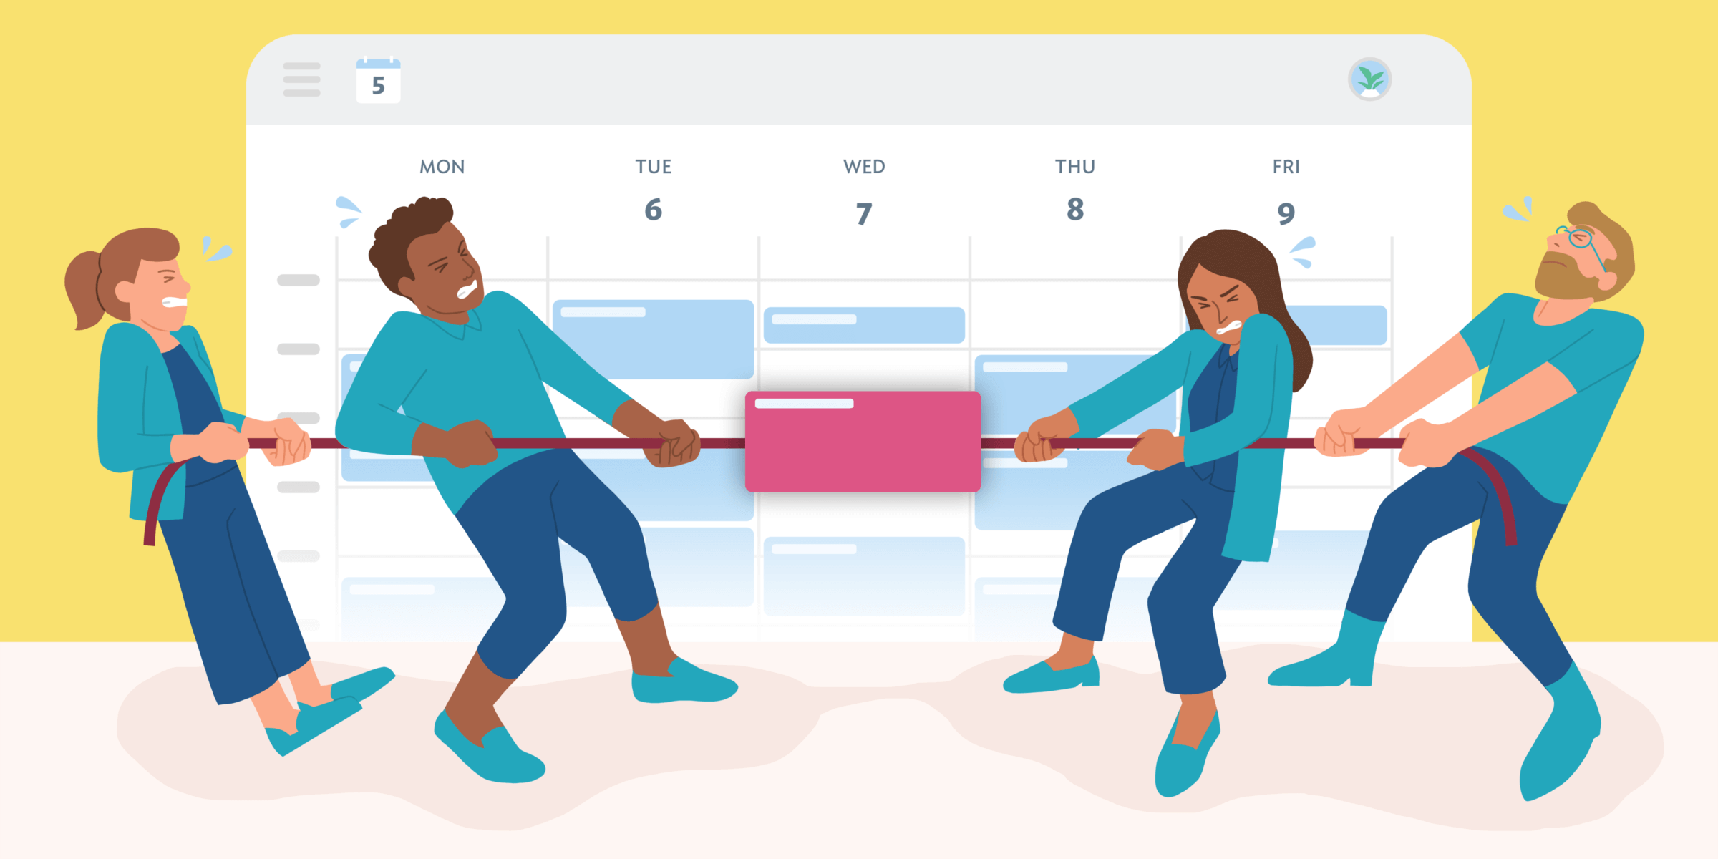
Problems arise when these schedules collide
Manager’s and the Maker’s schedules are highly effective approaches to time management.
Notes:
“While both the Manager’s and Maker’s schedules are effective in their own right, they’re also fundamentally incompatible.
And that’s where the problems begin.
The world tends to run on Manager Time—because managers often hold positions of authority and control the calendar. Meanwhile, much of the Maker’s work—deep, focused, creative work—is categorized as important but not urgent.
So what happens?
A manager drops a 30-minute meeting into a Maker’s calendar. For the manager, it’s just a quick check-in. But for the Maker, it breaks a 3-hour block of deep work—and that one meeting can derail their entire afternoon.
This is the hidden cost of schedule collisions. It’s not just about time—it’s about focus, flow, and momentum.
If we don’t recognize and protect these different modes of work, we risk burning out our Makers and frustrating our Managers.”

Slide 22
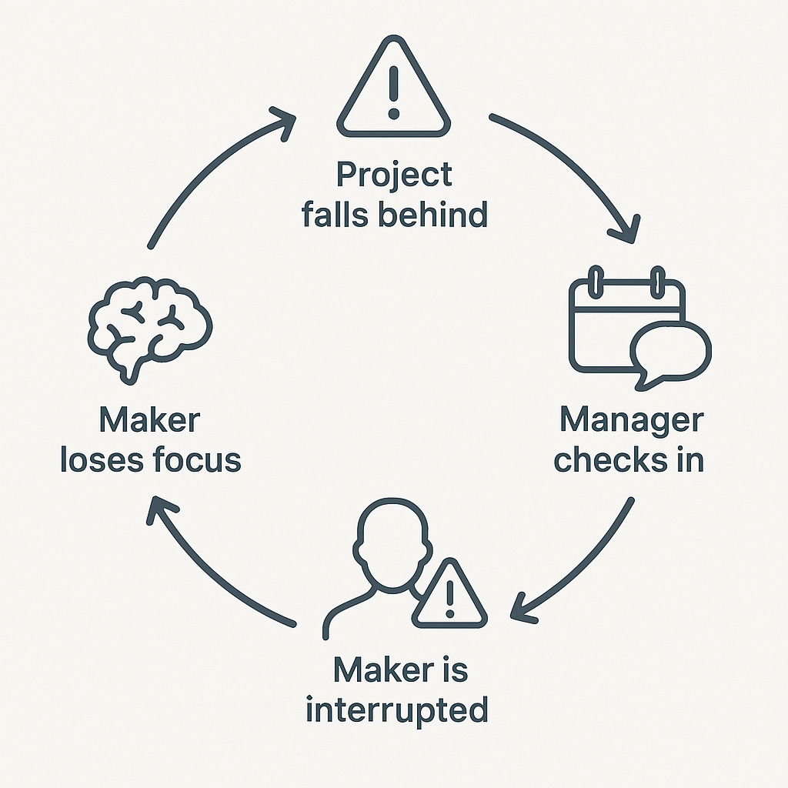
Common Scenario:
Notes:
“Imagine this situation:
A project is falling behind schedule. The manager, feeling the pressure, starts checking in more frequently with the Maker to get updates.
But here’s the unintended consequence: Each of those check-ins interrupts the Maker’s focused work time, which causes even more delays.
The manager sees it as a quick 15- or 30-minute meeting. But for the Maker, it breaks their flow—and that one meeting can derail an entire afternoon of deep work.
As the project continues to slip, the manager increases the frequency of check-ins, hoping to regain control. But instead, it creates a vicious cycle:
More interruptions
Less progress
More stress
And even tighter deadlines
Both sides are trying to do the right thing—but without understanding each other’s work rhythms, they end up working against each other.

Slide 23

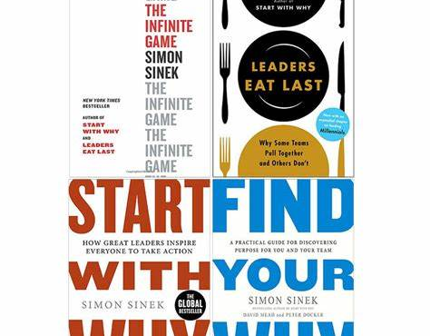
Commitment to Creating a High-performance environment
“Leaders are not responsible for the results; leaders are responsible for the people who are responsible for the results. And the best way to drive performance in an organisation is to create an environment in which information can flow freely, Problems can be highlighted, and help can be offered and received”
Simon Sinek
To avoid these collisions, we need ground rules
Notes:
“To avoid the kind of schedule collisions we just saw, we need to be intentional about how we work together.
The goal is to design a working environment that supports the type of work we do—without restricting or disrupting the work of others.
Because let’s be honest: There’s nothing worse than looking back on your day and feeling like you achieved nothing.
By understanding the underlying dynamics of Manager and Maker schedules, we can take proactive steps to create a more harmonious and productive environment.
That starts with two things:
Organizational Ground Rules – Clear expectations around when and how to schedule meetings, protect deep work time, and communicate.
Individual Ideal Week Calendars – So each person can align their schedule with their work style and responsibilities.
When we do this well, we reduce friction, protect focus, and make collaboration smoother for everyone

Slide 24

Ideal Ground Rules To avoid Collision’s
Create Internal Meeting Hours for the Organisation
Make It Known That You Have Maker Time
Schedule Meetings from the Bottom Up
Commit to a Manager Day
Commit to a Maker Day
Buffer Time: Communicate!
Notes:
“To avoid schedule collisions and create a more productive environment, we need to establish some ground rules—both at the organizational and individual level.
These rules help us protect focus time, reduce friction, and make collaboration smoother.
Here are some ideal ground rules to consider:
Set internal meeting hours – Define specific times during the day or week when meetings can happen. This minimizes disruption.
Make your Maker time visible – Block it out on your calendar and communicate it clearly.
Schedule meetings from the bottom up – Respect existing commitments and deep work blocks.
Commit to a Manager Day – Designate a day (like Monday) for meetings and coordination.
Commit to a Maker Day – Reserve days (like Wednesday or Friday) for uninterrupted deep work.
Build in buffer time – Leave space for the unexpected.
And most importantly: Communicate. Share calendars and expectations to stay aligned.
Also, it’s important to recognize that Managers sometimes need to do Maker work, like:
Strategic planning
System reviews
Report writing
Creative problem solving
And Makers often need to do Manager tasks, like:
Team meetings
Client communications
Performance reviews
So these ground rules aren’t about rigid roles—they’re about creating flexibility with structure, so everyone can do their best work.”

Slide 25

Individual Rules for Managers
Stick to Dedicated Internal Meeting Blocks
Understand the Cost for the Maker
Make Interruptions Worth It
Respect the “No
Remember: Even minor interruptions can cost up to 40% of the productivity for that block
Notes:
“Now let’s talk about what managers can do individually to support a more productive environment—especially when working with Makers.
Here are a few key ground rules:
Stick to dedicated internal meeting blocks – Respect the agreed-upon times for meetings. Avoid dropping in last-minute check-ins during deep work periods.
Understand the cost for the Maker – A quick interruption for you might mean a 40% productivity loss for them. Makers need time to get into flow—and every disruption has a cost.
Make interruptions worth it – Only break the rules for truly critical issues. If it can wait, let it wait.
Respect the “No” – If a Maker declines a meeting or asks to reschedule, it’s not a refusal to collaborate—it’s a commitment to doing their best work.
These small shifts in behavior can make a huge difference in team performance and morale

Slide 26

Individual Rules for Makers
Communicate Your Schedule
Don’t Be Afraid to Say “No
Commit to yourself and your Schedule
Work When You Say You’re Working
Procrastination is a really threat to the maker
Notes:
“Just like managers have a role to play in protecting focus time, so do makers. Here are a few key ground rules to help you stay productive and aligned with your team:
Communicate your schedule – Make sure your team knows when you’re in deep work mode. Block out your focus time on your calendar and be visible about it. Also, respect manager days—use them to help move collaborative tasks forward.
Don’t be afraid to say ‘no’ – If a meeting request threatens your focus, explain why you need to decline or reschedule. For example: ‘I’m working on Project X, and if I don’t complete it today, it could delay delivery by 2–3 days.’ That’s not being difficult—it’s being responsible.
Work when you say you’re working – If you’ve blocked time for deep work, honor it. Avoid distractions and procrastination. That time is your most valuable asset.
Because let’s be honest—procrastination is one of the biggest threats to a Maker’s productivity. If you don’t protect your time, no one else will

Slide 27

Rules for the Hybrid Worker
Theme Your Days
Daily or weekly Highlight
Over-communicate your schedule
Notes:
“Hybrid workers often have the most complex schedules—balancing both deep focus and high collaboration. To stay productive and avoid burnout, they need to be especially intentional.
Here are a few key ground rules:
Theme your days – Designate certain days for Manager-style tasks (like meetings and coordination) and others for Maker-style work (like writing, designing, or problem-solving). Refresh your schedule weekly to reflect shifting priorities.
Have a daily or weekly highlight – Choose one thing each day or week that, if completed, will make you feel accomplished. This helps you stay grounded and ensures you’re making meaningful progress.
Over-communicate – Let your team—and even your family—know what you’re working on and when you need focus time. Transparency builds trust and reduces friction.
By understanding the type of worker you are—and aligning your schedule accordingly—you can create a more productive, balanced, and harmonious work environment.

Slide 28

Who are you?
Notes:
As we wrap up this section, I want to leave you with an important reminder:
Being a Manager now doesn’t mean you can’t be a Maker later—and vice versa.
Your role, your workload, and even your organization’s strategic direction can shift. You might find yourself operating in one mode this quarter, and a completely different one the next.
That’s normal. What matters is that you’re aware of how you work best—and that you’re intentional about designing your schedule to support that.
And remember: No one works in isolation. Even with the best personal productivity practices, your environment plays a huge role in your success.
The people around you, the systems you use, and the culture you’re part of can either enhance your productivity—or quietly undermine it.
So the real question isn’t just ‘Who are you now?’ It’s: ‘How can you design your environment to support who you need to be?

Slide 29
🧾Your Ideal Week
If you don’t control your week, your week will control you
Notes:
“Now that we’ve explored the different types of work styles—Manager, Maker, and Hybrid—it’s time to bring that insight into your calendar.
This is where the Ideal Week comes in.
Your Ideal Week is a template for how you want to spend your time—not a rigid schedule, but a flexible framework that helps you align your energy, priorities, and responsibilities.
It’s about being intentional. Instead of reacting to your calendar, you design it to support your best work.
Whether you’re a Maker who needs long blocks of focus, a Manager juggling meetings, or a Hybrid balancing both—your Ideal Week helps you:
Protect what matters most
Reduce decision fatigue
And build momentum, week after week
Let’s walk through how to create yours

Slide 30
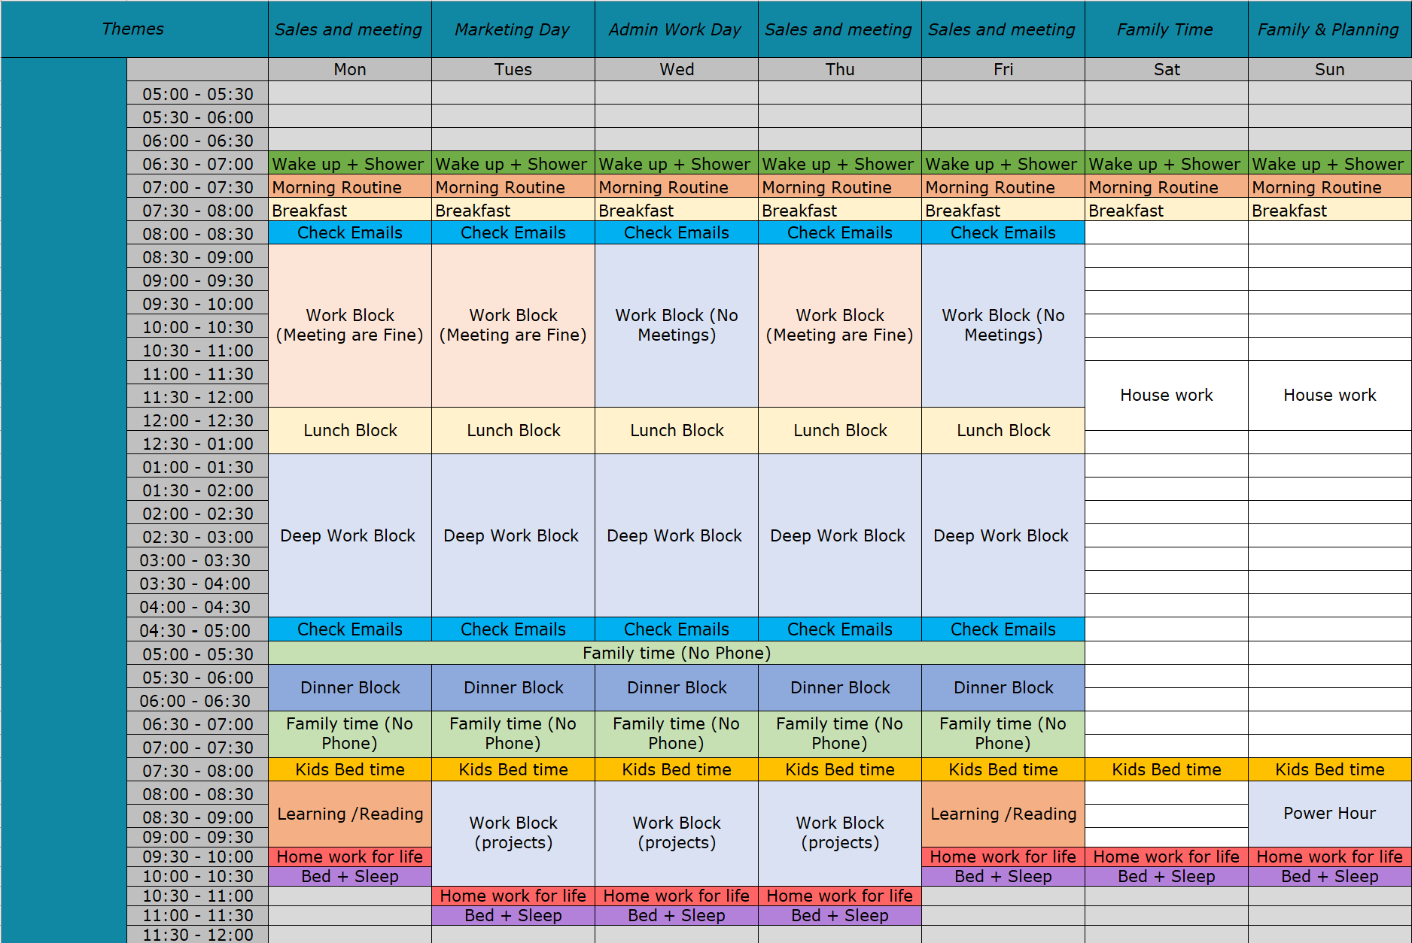
Ideal Week
Notes:
The Ideal Week is one of the most powerful tools in your productivity system.
Its purpose is simple: To help you manage your time intentionally, allocate focus for your highest-priority tasks, and strike the right balance between Manager and Maker responsibilities.
It’s not about perfection—it’s about having a template that reflects how you want to spend your time, so you’re not constantly reacting to the demands of others.
This system integrates seamlessly with tools like Microsoft Outlook, To Do, and OneNote, making it easy to schedule, track, and execute your tasks in one place.
And most importantly, it supports proactive planning. You’re not just filling your calendar—you’re designing your week to reflect your goals, your energy, and your values.
This is how you start living on purpose, not just on autopilot.”

Slide 31
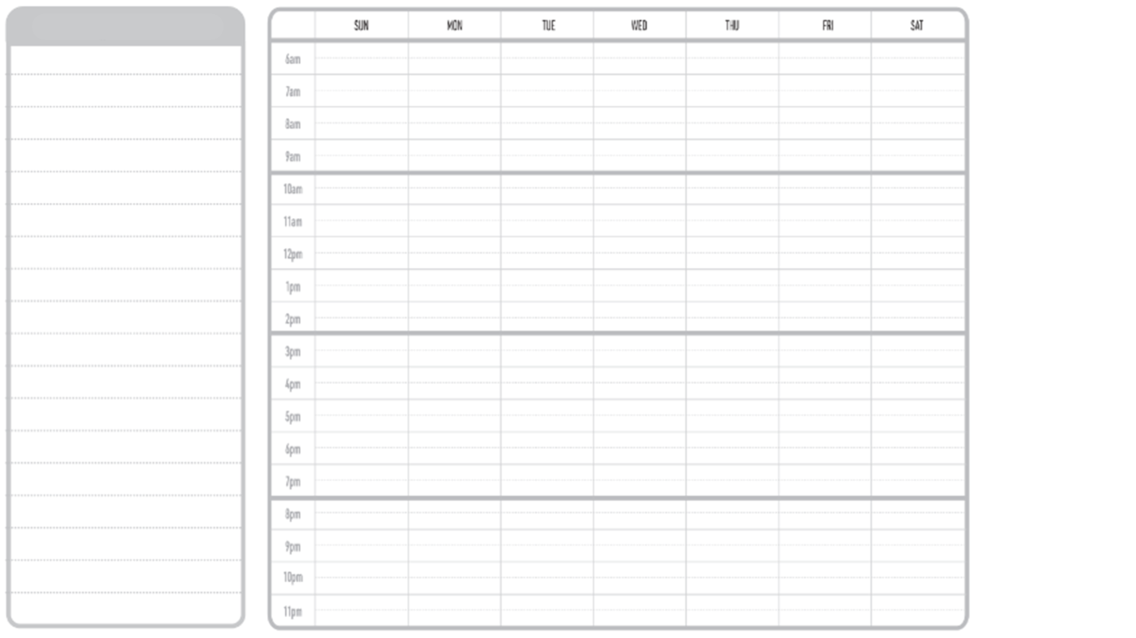
Steps to Create Your Ideal Week
Clarity Sprint
Buffer Blocks
Strategic Blocks
School Pickup
Check Email/Teams
Check Email/Teams
Notes:
“Now let’s walk through how to actually build your Ideal Week.
This isn’t about creating a rigid schedule—it’s about designing a flexible framework that reflects your priorities and work style.
Here’s how to get started:
Define Your Priorities Start by identifying what truly matters—both professionally and personally. What are the non-negotiables? What work moves the needle?
Visualize the Week Create a visual layout of your week. Block time for your top priorities first—before the noise fills in. This helps you see how your time is really being spent.
Balance Your Roles Recognize the difference between Manager tasks (reactive, collaborative) and Maker tasks (deep, focused work). Allocate time for both, based on your role and rhythm.
Implement the Plan Use tools like Outlook, To Do, and OneNote to block time, set reminders, and stay organized. Don’t forget to include buffer time—because life happens.
Review Regularly At the end of each week, take 10 minutes to reflect. What worked? What didn’t? Adjust your Ideal Week so it evolves with your goals and responsibilities.
This process helps you move from reactive to intentional—so you’re not just busy, you’re effective.

Slide 32
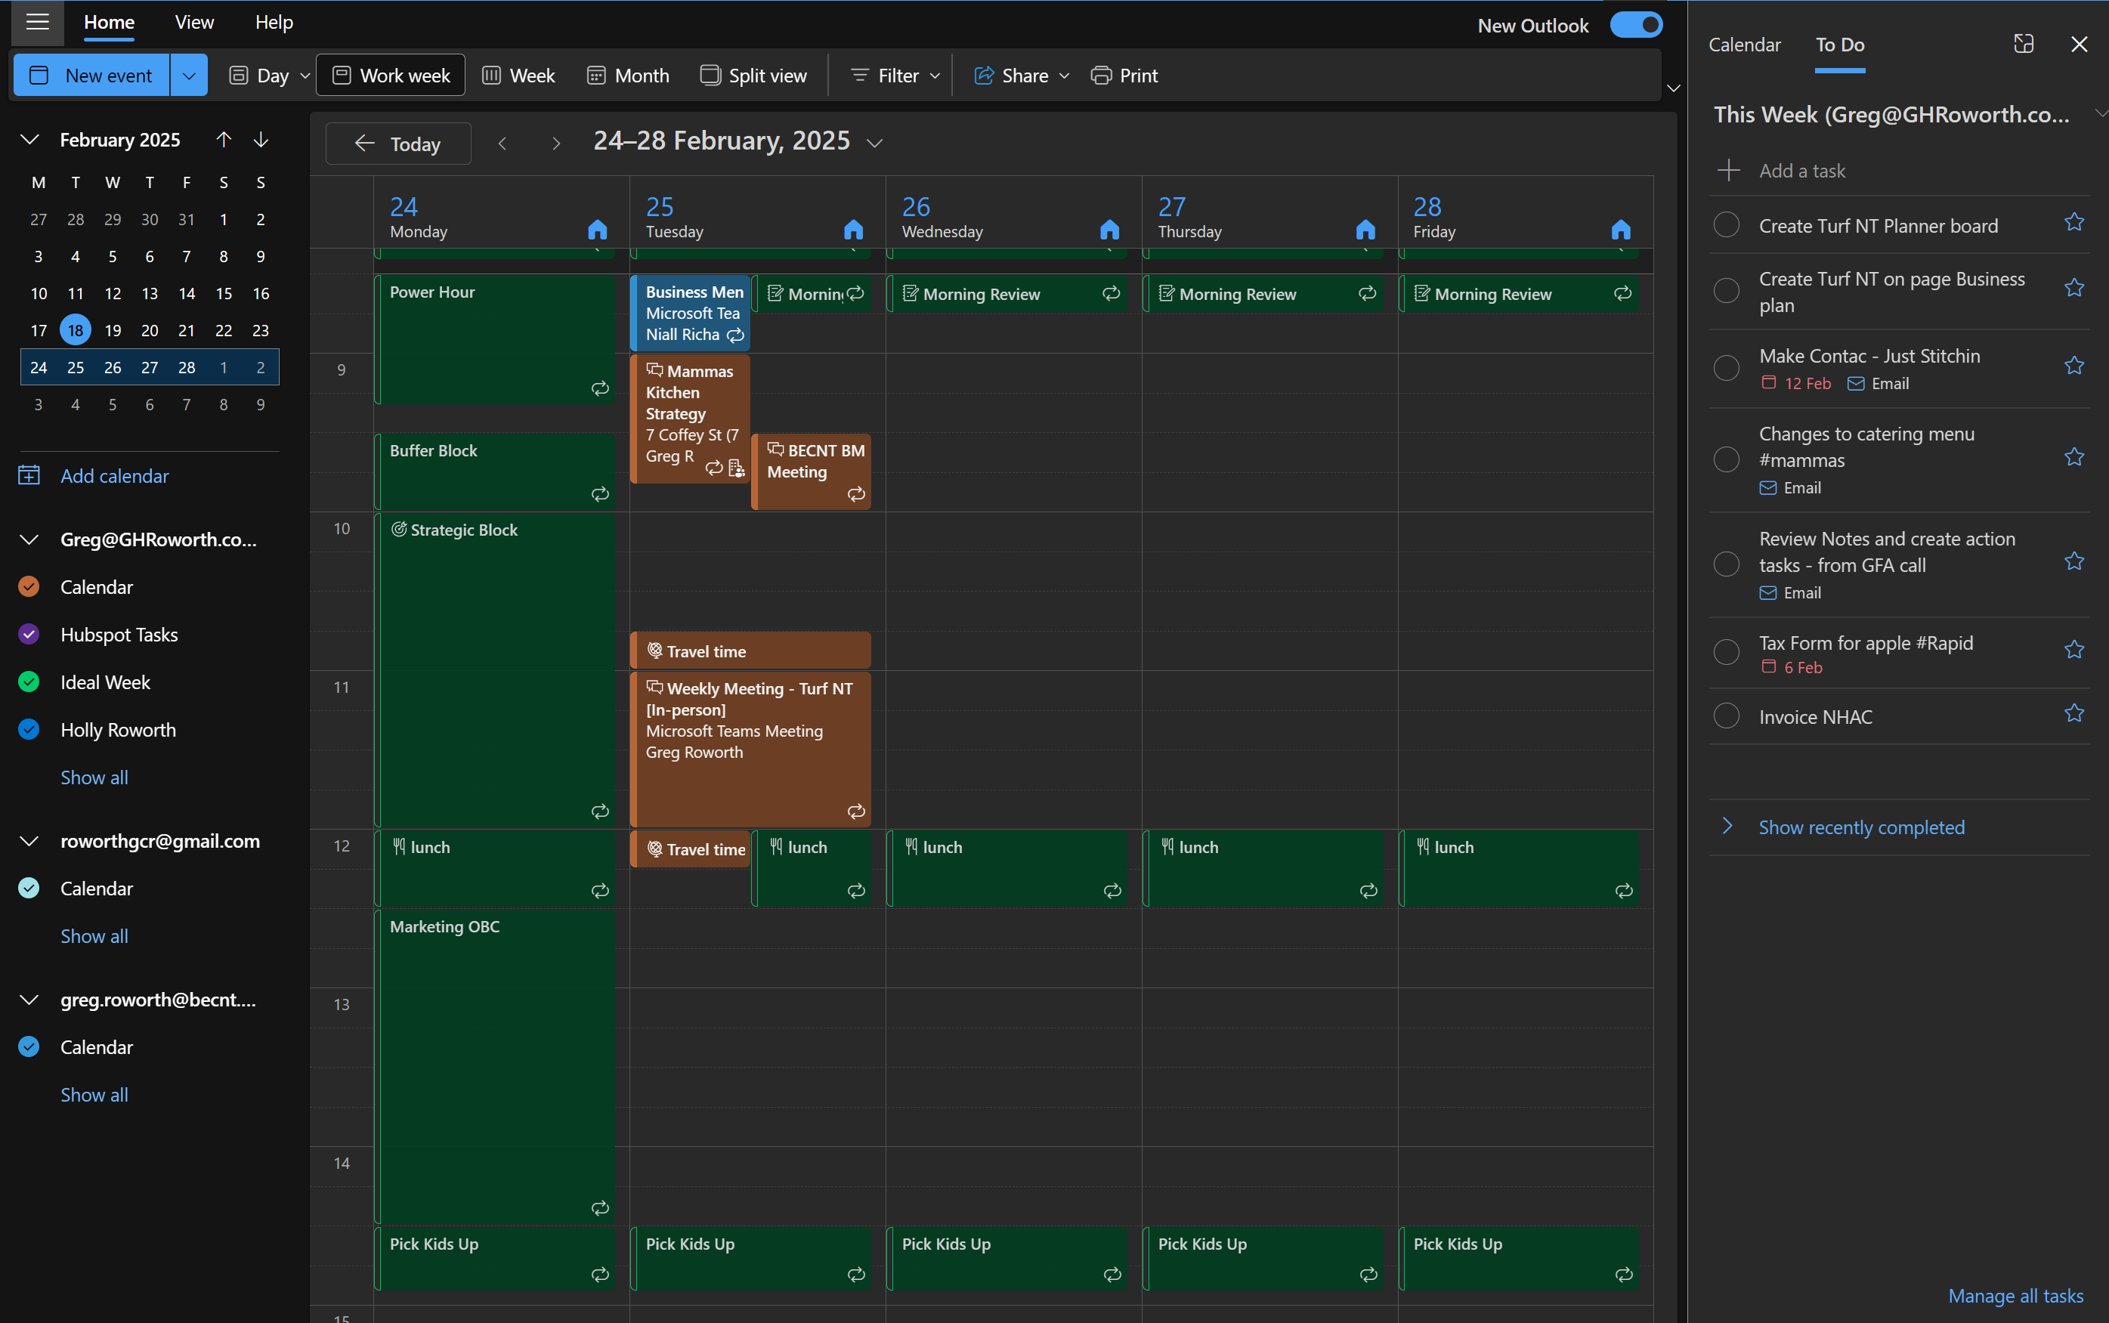
Digital Overlay
Digital Calendars: Microsoft Outlook, Google Calendar
Notes:
“Once you’ve created your Ideal Week, the next step is to bring it to life—and the best way to do that is by using your digital calendar.
Here’s the trick: Create a second calendar layer—one that shows your Ideal Week as a visual overlay on top of your actual schedule.
This gives you a powerful side-by-side view:
What you planned to do
Versus what you’re actually doing
It helps you spot patterns, identify where your time is slipping, and make better decisions about how to adjust.
Most calendar tools—like Microsoft Outlook or Google Calendar—let you create multiple calendars and toggle them on or off. Use this to your advantage.
This isn’t about perfection—it’s about awareness. When you can see the gap between your ideal and your reality, you can start closing it.”

Slide 33
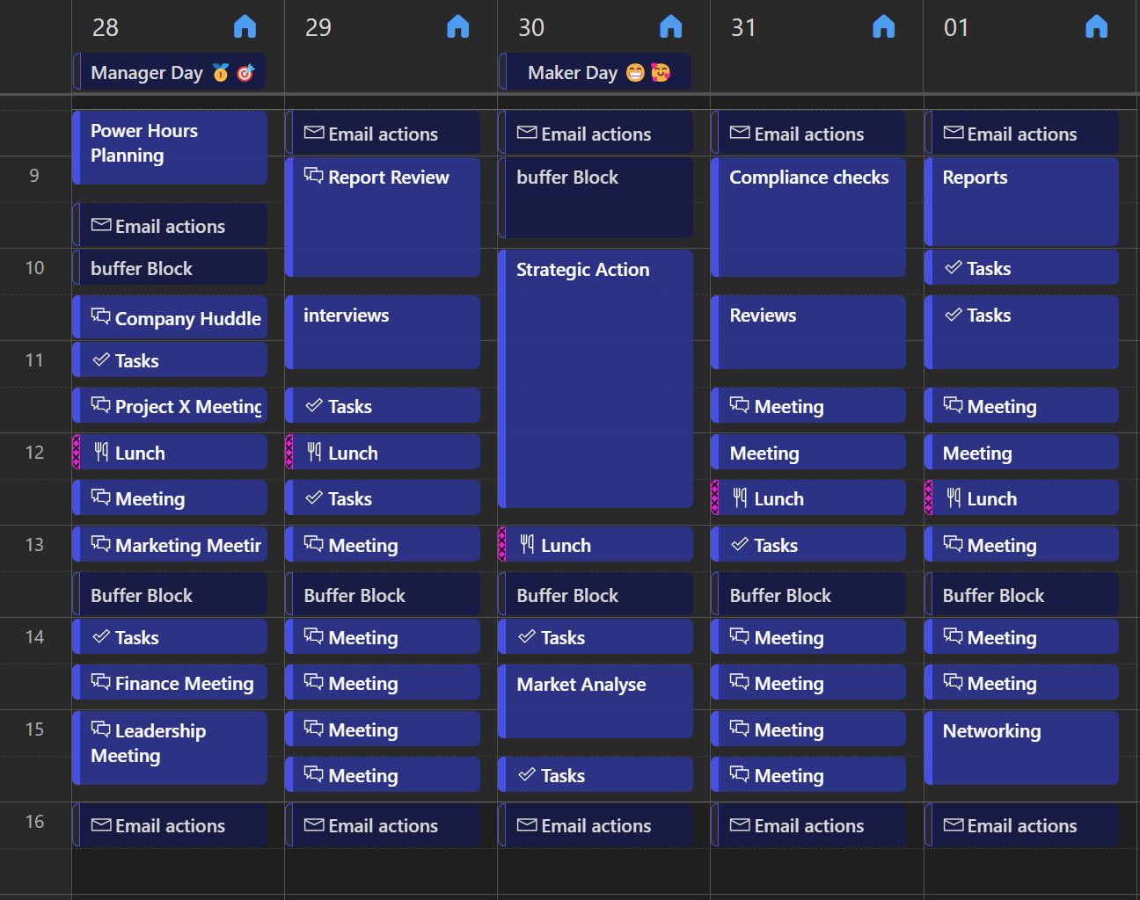
IDEAL WEEK MANAGER
Notes:
“This is an example of what an Ideal Week might look like for someone working primarily in a Manager role.
You’ll notice the schedule is built around structured blocks—typically in 30- to 60-minute increments. It includes:
Regular team meetings
One-on-ones
Project check-ins
Email and admin time
Strategic planning sessions
There’s also buffer time built in—because in a Manager’s world, unexpected issues are part of the job.
The key here is intentionality. Even though the schedule is full, it’s not chaotic. It’s designed to support the Manager’s responsibilities while still leaving space for focused work and decision-making.
This kind of structure helps Managers stay responsive without becoming reactive.

Slide 34
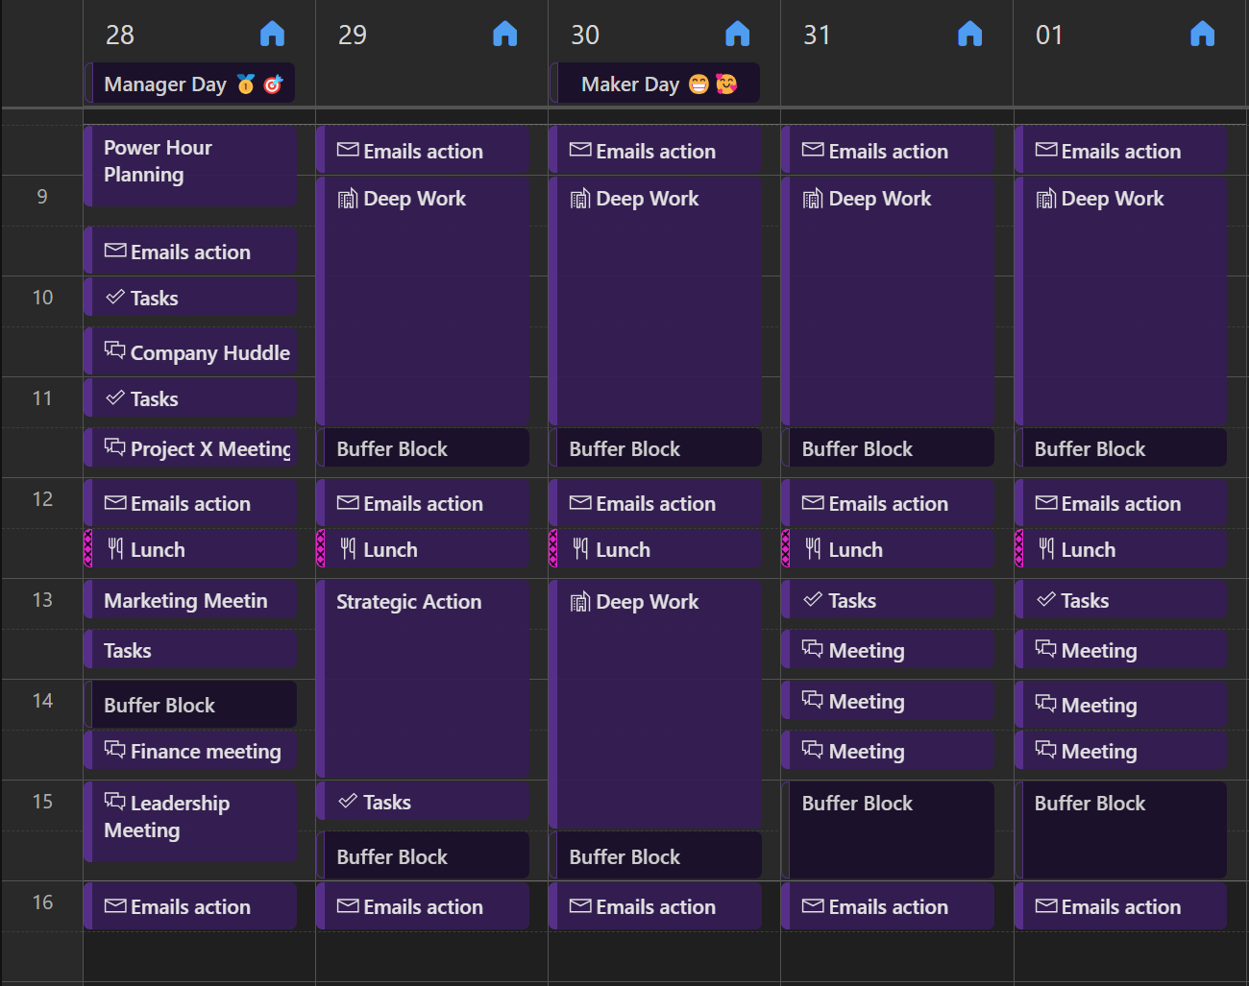
IDEAL WEEK MAKER
Notes:
“This is an example of what an Ideal Week might look like for someone in a Maker role.
You’ll notice the schedule is built around large, uninterrupted blocks of time—typically 2 to 4 hours. These blocks are essential for deep work like:
Writing
Designing
Coding
Research
Problem-solving
There are fewer meetings, and when they do happen, they’re grouped together—usually at the start or end of the day—to protect the middle of the day for focused work.
You’ll also see buffer time and breaks built in. These aren’t just nice to have—they’re necessary to maintain energy and avoid burnout.
This kind of schedule helps Makers get into flow, stay there longer, and produce high-quality work without constant context switching.”

Slide 35
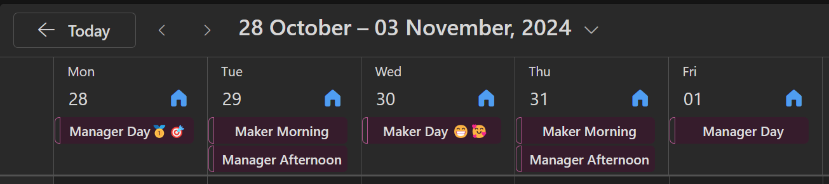
IDEAL WEEK HYBRID
Notes:
What an Ideal Week may look like for a Hybrid (CEO, Entrepreneur)

Slide 36
🧾The Clarity Sprint
Most people fail at execution because they don’t plan for it
Notes:
“Now that we’ve looked at how to structure your Ideal Week, let’s talk about the habit that helps you actually stick to it

Slide 37

What is The Clarity Sprint
Definition: ONE hour (usually less) of planning that saves you 10-12 hours the rest of the week.
Purpose: Pre-plan your working hours to ensure task and project completion, and accommodate unexpected items.
Timing:
Friday afternoon, Sunday evening, or Monday morning
Notes:
Think of it as your weekly strategic planning session—a short, focused block of time that helps you take control of your week before it takes control of you.
Here’s the definition: One hour (or less) of planning that can save you 10–12 hours of wasted time, rework, and indecision.
The purpose of the Clarity Sprint is to:
Pre-plan your working hours
Ensure your key tasks and projects are accounted for
And create space for the unexpected—because it always shows up
It’s about living on purpose, not in reaction mode.
As for timing, you’ve got options:
Friday afternoon – close the week with clarity
Sunday evening – set the tone for the week ahead
Monday morning – kickstart your week with intention
There’s no one-size-fits-all. The key is consistency.
This one habit can dramatically improve your focus, reduce stress, and help you build momentum week after week.”

Slide 38
Why Implement The Clarity Sprint?
Transparency: Ensures clear visibility of workloads.
Balanced Workload: Prevents overloading or underloading team members.
Efficient Resource Allocation: Facilitates effective distribution of tasks.
Proactive Planning: Anticipates and accommodates unexpected items.
Notes:
“The Clarity Sprint isn’t just about personal productivity—it also plays a key role in team alignment and transparency.
When everyone on the team takes time to plan their week, it becomes easier for managers to monitor workloads. You can see who’s at capacity, who has room to support others, and where potential bottlenecks might arise.
This promotes a balanced workload, which is essential for maintaining both morale and productivity. When people feel overloaded or unclear about priorities, performance drops. But when expectations are visible and realistic, teams thrive.
And here’s the real power: Because you’ve already mapped out your week, you’re better equipped to handle the unexpected. A last-minute request or urgent task doesn’t throw everything off—it gets absorbed into a plan that already has structure and breathing room.
So the Clarity Sprint isn’t just a planning session—it’s a strategic safeguard that helps individuals and teams stay focused, flexible, and aligned.

Slide 39
Power Hour: Step-by-Step Process
Create
Create a "This Week" Priority List
Identify and list tasks for the upcoming week.
Review
Review Previous Week ("Look Back")
Assess incomplete tasks and carry them forward.
Action
Clear Action Items & Update Communications
Address pending emails and messages.
Preview
Preview Upcoming Month ("Look Forward")
Prepare for future projects and deadlines.
Assess
Assess End-of-Week Reports
Identify and plan to resolve any constraints.
Notes:
“Let’s break down the steps of a successful Clarity Sprint—your weekly planning session that sets the tone for everything else.
Compile Your Priority List Start by identifying your most important tasks and projects. What absolutely needs to get done this week? This helps you focus on what matters most.
Look Back Reflect on the past week. What worked? What didn’t? Were there any unfinished tasks or lessons learned? This step helps you adjust and improve continuously.
Clear Action Items Go through your inboxes—email, task manager, sticky notes—and clear out lingering action items. This keeps your workflow clean and ensures nothing slips through the cracks.
Look Forward Anticipate what’s coming. Are there deadlines, meetings, or events you need to prepare for? Allocate time for these now so you’re not caught off guard later.
Review End-of-Week Reports If you use reporting tools or dashboards, take a few minutes to review them. This helps you spot trends, track progress, and make smarter decisions moving forward.
This process doesn’t take long—but it creates clarity, reduces stress, and helps you start the week with confidence and contro

Slide 40
Effective Scheduling & Time Management
Block Personal Time First
Schedule breaks and downtime to ensure well-being.
Allocate Work Blocks for Tasks
Use tools like Outlook and To-Do lists.
Set Regular Checks & Meeting Times
Designate specific times for emails and meetings.
Include Buffer for Ad Hoc Requests
Reserve 30-60 minutes daily for unexpected tasks.
Visual Indicators
Use emojis or colour-coding for quick reference when reviewing .
Notes:
“Now that you’ve identified your priorities and planned your week, it’s time to bring it all into your calendar.
Here’s how to do it effectively:
Prioritize ‘This Week’ Tasks Start by identifying your high-value tasks. These are the things that will move the needle—mark them clearly as priorities.
Block Time in Outlook Before anything else, schedule your personal breaks, buffer blocks, and downtime. Protect your energy first.
Schedule Work Blocks Drag and drop your tasks into your calendar. Start with the high-priority ones and match them to the time of day when you’re most focused.
Set Regular Checks & Meeting Blocks Schedule daily check-ins and leave open blocks for meetings. This keeps your calendar flexible but still structured.
Allocate Time for Ad Hoc Requests Build in 30–60 minutes each day for unexpected tasks. These buffer blocks help you stay on track without getting derailed.
Now, to make this process more engaging and visual, try gamifying your calendar:
Use emojis or icons to represent different types of tasks—like 💻 for deep work, 📞 for calls, or 🧠 for thinking time.
Apply color-coding to categorize events. You can even mark them as “✅ Complete” or “❌ Didn’t Complete” to track your progress—just skip this for recurring events.
This approach makes your calendar not just a tool—but a dashboard for your week.”

Slide 41
🔁M365 Workflow Flywheel
Not all tasks are created equal—prioritize them before executing

Slide 42
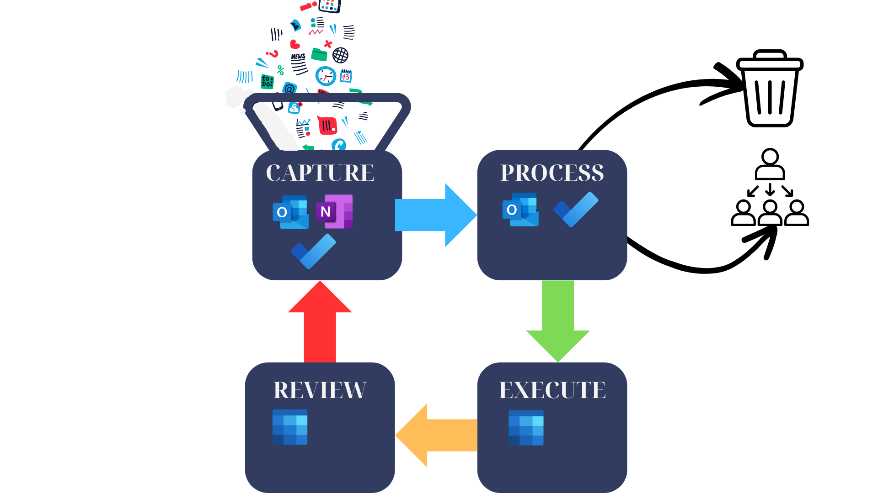
M365 – Workflow Flywheel
Notes:
“Before we dive into the specifics of setting up Microsoft tools like Outlook, To Do, and OneNote, it’s important to understand the workflow mindset that ties it all together.
This is what we call the M365 Workflow Flywheel—a simple, repeatable process that keeps your tasks moving and your mind clear.
It’s built on four core principles:
Capture Always capture your ideas, tasks, and information in a reliable system. Don’t rely on memory. This clears mental clutter and ensures nothing important slips through the cracks. → We’ll use Outlook, To Do, and OneNote for this.
Process Regularly review and organize what you’ve captured. Sort tasks, set priorities, and decide on next actions. This is where clarity starts.
Execute Do the work—based on your priorities and your Ideal Week. This is where your planning meets action.
Review Use your Clarity Sprint to reflect, reset, and plan the next week. This keeps you aligned with your goals and helps you continuously improve.
This flywheel keeps your system moving. It’s not about doing more—it’s about doing the right things, at the right time, with less stress.”

Slide 43


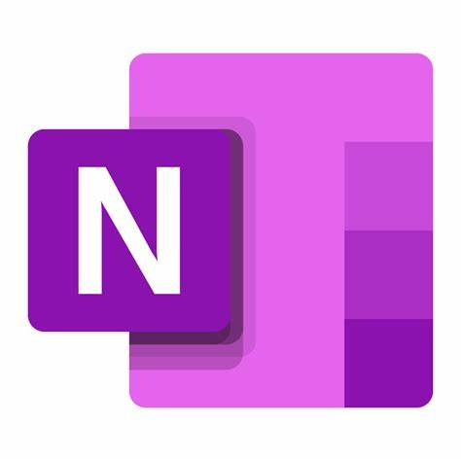
The core Apps within this Productivity System
Outlook – Capture tool
OneNote – Capture All tool
ToDo – Process and Execute
Outlook Calander – Execute and Review
Notes:
“Now that we’ve covered the workflow mindset, let’s look at the four essential tools that bring it to life in the Microsoft 365 ecosystem.
Each tool plays a specific role in helping you manage your time, tasks, communication, and knowledge:
📅 Outlook Calendar – This is your time control center. It helps you schedule with intention, block focus time, and align your week with your Ideal Week template.
✅ Microsoft To Do & Planner – These are your task execution tools. Use them to capture, prioritize, and track your work—whether it’s personal tasks or team projects.
📨 Outlook & Teams – These tools manage your communication and inbox processing. They help you stay responsive without letting messages derail your focus.
🗂️ OneNote – This is your knowledge management system. It’s where you store reference material, meeting notes, and ideas—so your brain doesn’t have to.
Together, these tools form a structured, integrated system that supports everything from daily execution to long-term planning.

Slide 44
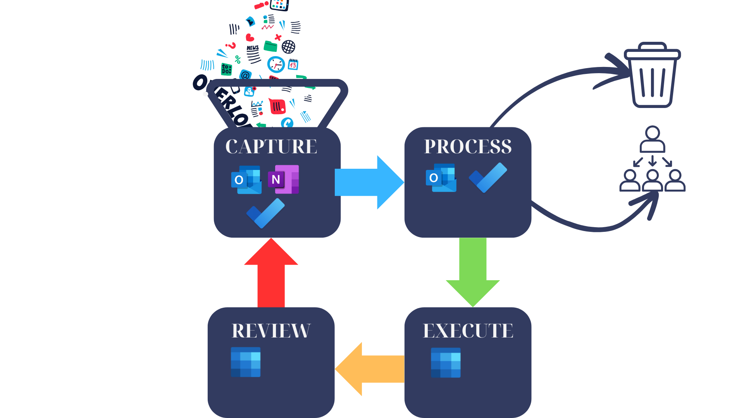
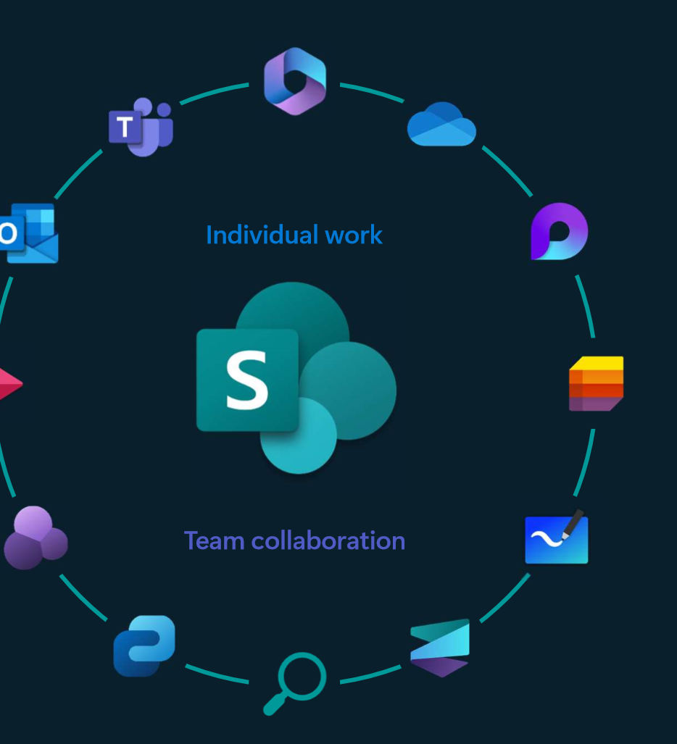
How do we use Microsoft

Slide 45
Email Is a productivity vampire!
It’s important to understand that emails are often someone else’s agenda. We’ve all received emails that we actioned immediately, even though we had more important tasks to focus on.
The average knowledge worker spends 2.6 hours daily checking and responding to emails as they come in.
Notes:
Email Is a productivity vampire!
It’s important to understand that emails are often someone else’s agenda. We’ve all received emails that we actioned immediately, even though we had more important tasks to focus on.
The average knowledge worker spends 2.6 hours daily checking and responding to emails as they come in.

Slide 46
Outlook
Definition: Outlook is a capture tool not a task manager
GOAL: To get your inbox down to zero emails, so you can focus on other important tasks
Benefits: The technique I am about to show you has two big benefits: You won't be distracted by emails you've already dealt with, and you won't miss important emails
Notes:
“Raise your hand if you have ever missed an important email because it got buried in your inbox.”
“Raise your hand if you have a whole bunch of flagged emails?”
Definition: Today, Outlook is a capture tool, not a task manager
GOAL: To get your inbox down to zero emails, so you can focus on other important tasks
Benefits: The technique I am about to show you has two big benefits: You won't be distracted by emails you've already dealt with, and you won't miss important emails
This process we are going to go through now will help you achieve Inbox Zero! Remember, email is a capture tool, not a task manager. With new search capabilities, you no longer need to file emails away like a digital magpie!

Slide 47
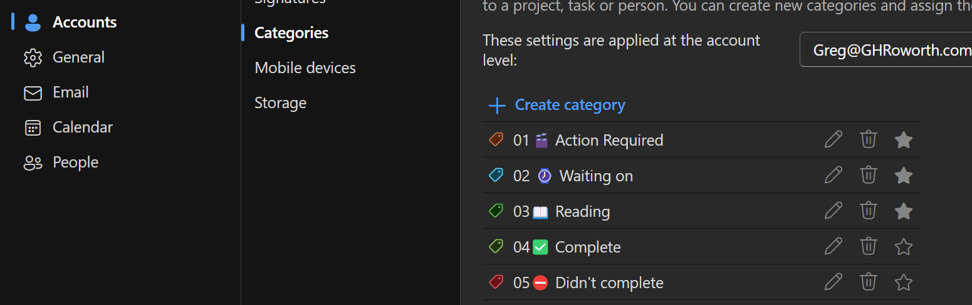
Setup Outlook Categories
Action Required
Waiting on
Reading
Notes:
Setup 3 Categories
Action Required - You are responsible for the outcome, and only you can take action
Waiting on - You are responsible for the outcome, but you need someone else to take action
Reading - Emails you want to consistently refer back to in the future.
Favourite all three categories by checking the Star

Slide 48
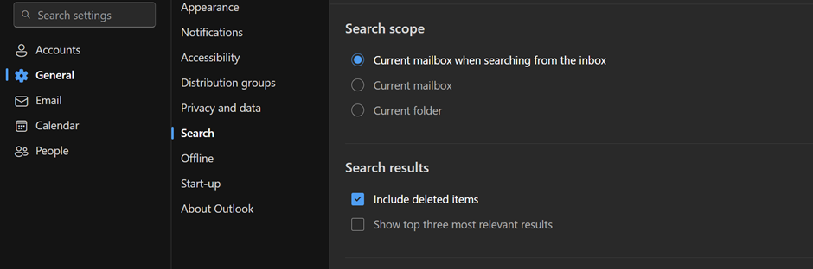
Next setting to Adjust is Search, Ensure:
Current mail when Searching form inbox - Checked
Include Deleted Items - Checked
Show top three - Unchecked
Notes:
Next setting to Adjust is Search, Ensure:
Current mail when Searching form inbox - Checked
Include Deleted Items - Checked
Show top three - Unchecked

Slide 49
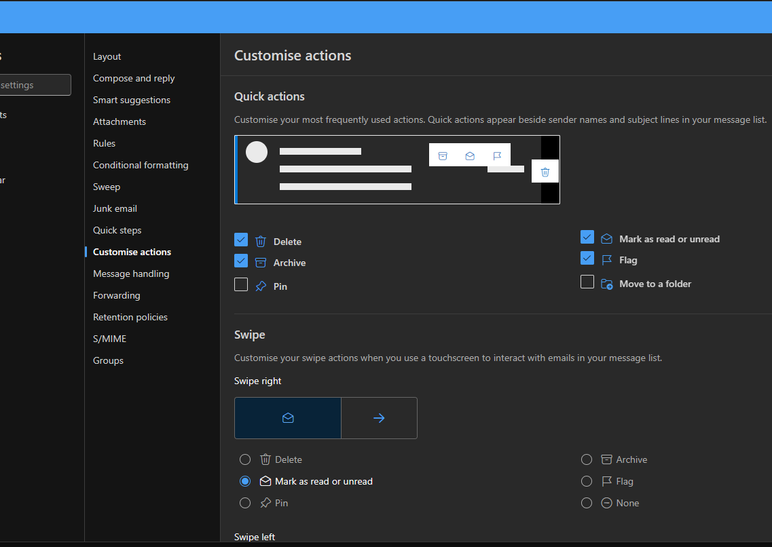
Next Setting to Adjust is Customised Actions
Ensure that the Archive button Is selected in the Quick actions

Slide 50
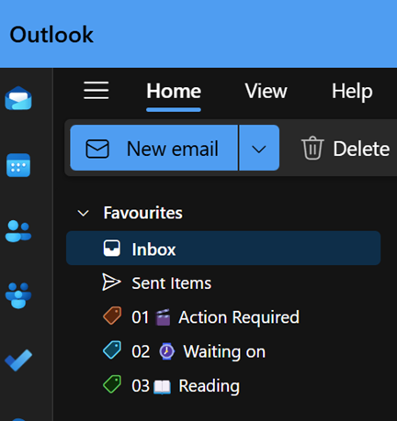
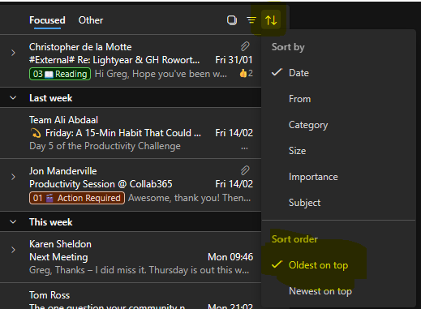

Daily Workflow Email Routine
Set specific times during the day to check and process your emails. Avoid keeping your inbox open all day to minimize distractions.
When you first start out, you may need to put 4 processing blocks in per day, but you will soon get that down to 1 or 2
Notes:
Daily Workflow Email Routine:
Set specific times during the day to check and process your emails. Avoid keeping your inbox open all day to minimize distractions.
When you first start out you may need to put 4 processing blocks in per day, but you will soon get that down to 1 or 2
When you open up Outlook you want to start from the bottom and work your way up. (To avoid Scrolling down to the bottom to deal with your oldest email – change the filter setting to have the oldest email on top)

Slide 51
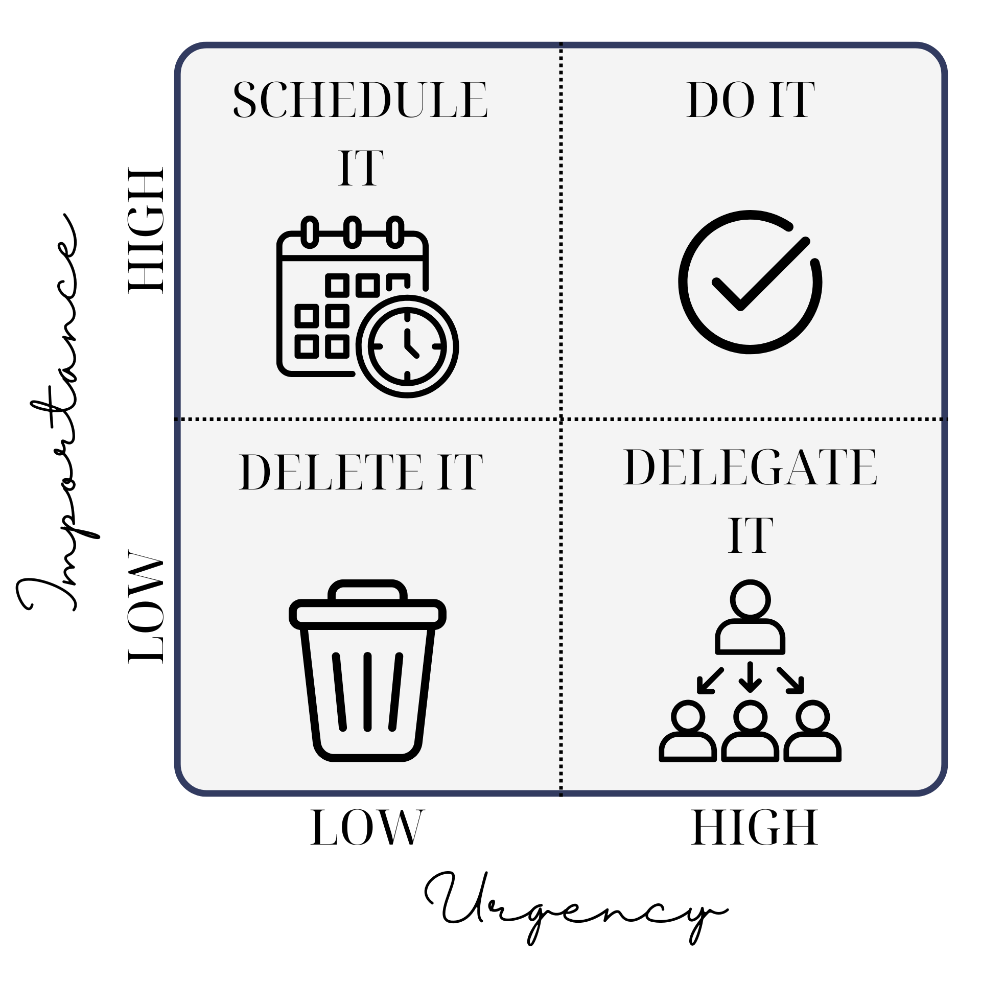
Using the Eisenhower Matrix for Email Processing
Notes:
Email Processing Rules!
Quick Decisions: When you open an email, decide immediately what to do with it:
Delete: If the email is not needed, delete it.
Delegate: If the email can be handled by someone else, Send it to the appropriate person. (Tag "Waiting on" and Archive)
Defer: If the email requires more time, tag is as “Action Required” drag over to ToDo, then Archive it folder and schedule time to address it.
Do: If the email can be handled in less than two minutes, do it immediately

Slide 52

Less than 2 mins
If the email needs your direct action and the action can be taken in 2 minutes or less, take care of it right away
Once actioned archive
Notes:
Less then 2 mins
If the email needs your direct action and the action can be taken in 2 minutes or less, take care of it right away. Once actioned archive.

Slide 53

Longer then 2 mins
If it will take longer than 2 minutes, add category “Action Required."
Drag it into Todo and Archive
Notes:
Longer then 2 mins
If it will take longer than 2 minutes add category "Action Required" and drag it into Todo. (ensure the task name is appropriate) then archive the email
Once a Tag is no longer applicable to that email, you can un-categorise the email and it will be removed from that category List, Do this within your next processing block
It's important to note that archived doesn't mean deleted or mean Archive in the same way Outlook used to –
You can always find archived emails in the archived folder or search for archived emails in the search bar, this is now just a default folder to store your emails.

Slide 54
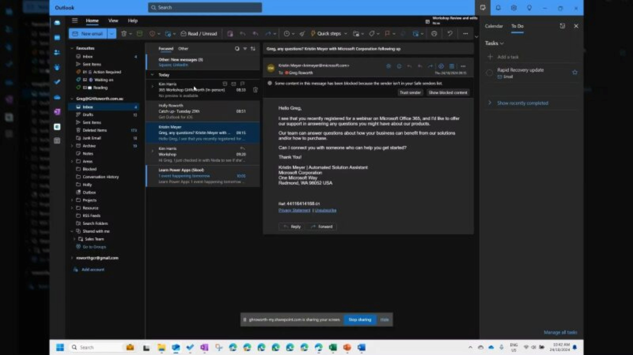

Slide 55
Any Question About the Outlook Process?
Notes:
Who has a Million Flagged Emails?
Who leave all there emails in there inbox?
Who spends the time to File them away in to the correct location?
Who has a filing system that is more then on file Deep?

Slide 56
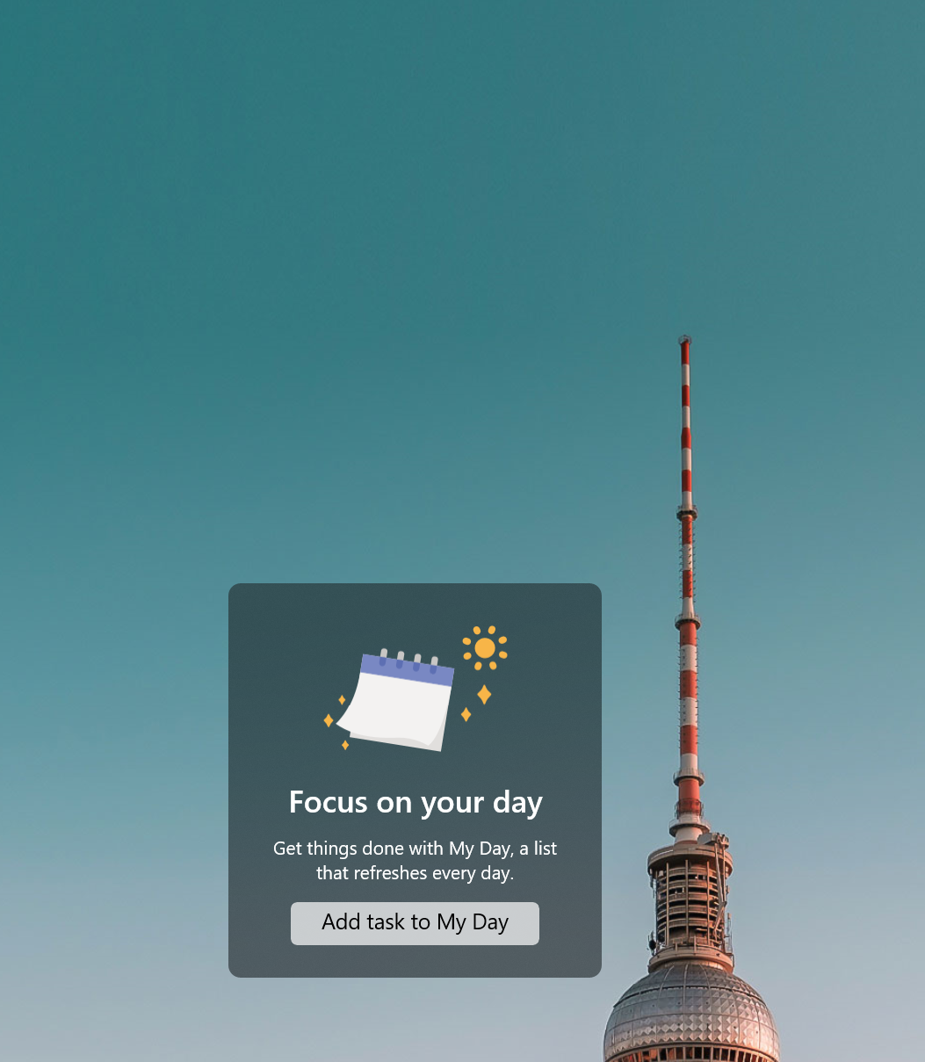
Task To DO
Definition is a Capture, Process and Execution tool
GOAL: To organise and execute
Benefits: Seamlessly integrate with other capture tools like outlook, OneNote, Teams and Planner
Notes:
One place for all your task both personal and Team
Definition is a Capture, Process and Execution tool
GOAL: To organise and execute
Benefits: Seamlessly integrate with other capture tools like outlook, OneNote and Planner

Slide 57
Default List
Tasks: The "Tasks" list, also referred to as an "inbox," is a default in To Do and can be used to collect unprocessed items before deciding on the next action
Flagged Email: the Flagged email list is also an "Inbox" and is the default location in ToDo for Emails that were flagged, can be used to collect unprocessed items before deciding on the next action
Planned: This list displays upcoming items with due dates

Slide 58
Default List
Assigned to you: This list aggregates tasks assigned to you through Microsoft Planner
Important: This list filters items that have been marked as important using the "starring" feature
My Day: This is a dynamic list that resets each day and includes items you've tagged to work on that day

Slide 59
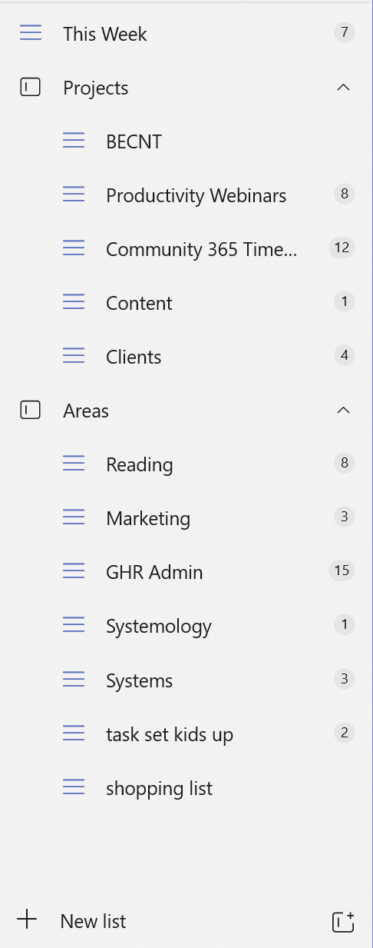
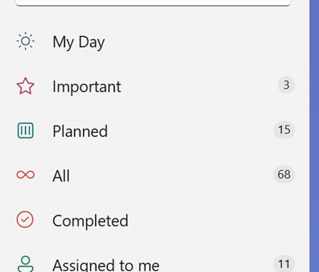
Create New List Groups
Notes:
Create a New Lists and Groups
First list you will need is This Week!
You will need groups call Projects, Areas
You may have other Groups of lists but Project and Area
Examples of some lists under these Groups
Areas - Someday/maybe list, Office List, Errands list, Shopping List, Home List, Agendas, Travel, Expenses, Quotes and Thinking
Projects - Project x, Project y, Project Z

Slide 60
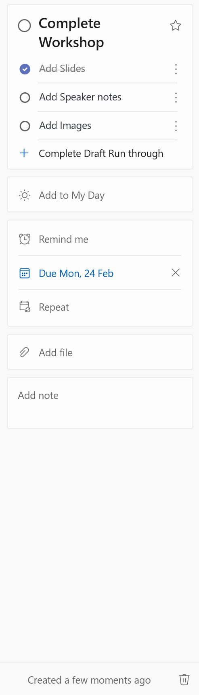
Sorting inbox 1 and 2
Similar to running through your Outlook inbox, we are going to go through Inbox 1(TASKS) and 2 (FLAGGED EMAILS) and sort them by drag-and-drop into the more specific list we have created to better characterise these tasks
Notes:
Sorting inboxes 1 and 2
Just like sorting through your Outlook inbox, we will go through Inbox 1 and 2, organizing tasks by dragging and dropping them into more specific lists for better categorization.
As we categorize each task, we should assign due dates for any that need to be completed within a specific time frame. Additionally, we can prioritize critical tasks by marking them as "Important" ⭐ to ensure they receive attention first.
If a task requires multiple steps, break it down into smaller, manageable action items using checklists. Doing this upfront during the inbox sorting process allows us to plan ahead, avoiding the need to rethink the steps later when we are executing tasks.
With our inboxes now fully sorted and at zero, we can move on to the review stage to finalize our weekly plan

Slide 61
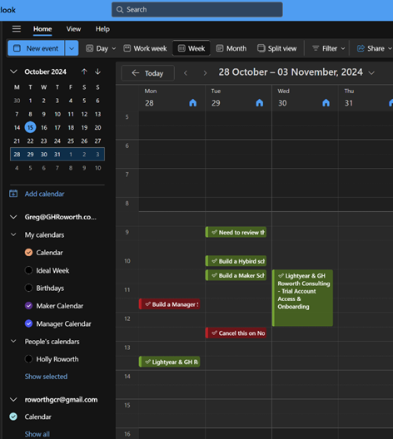
POWER HOUR: (WEEKLY REVIEW)
Create a Weekly Priority List – Identify top tasks for the upcoming week.
Look Back & Review – Assess completed vs. incomplete tasks.
Clear Action Items – Respond to emails, messages, and outstanding to-dos.
Look Forward – Plan for upcoming deadlines, projects, and commitments.
Review Reports & Adjust – Identify gaps and refine your planning approach.
Mark completed tasks as "Complete" in the Task Manager for tracking.
Use "Didn’t Complete" & "Complete" Categories to gamify your review process.
Notes:
Create a Weekly Priority List – Identify top tasks for the week.
Look Back – Review and carry forward incomplete tasks.
Clear Action Items – Respond to emails and outstanding communications.
Look Forward – Plan for upcoming deadlines and projects.
Review Reports – Identify and resolve potential roadblocks

Slide 62
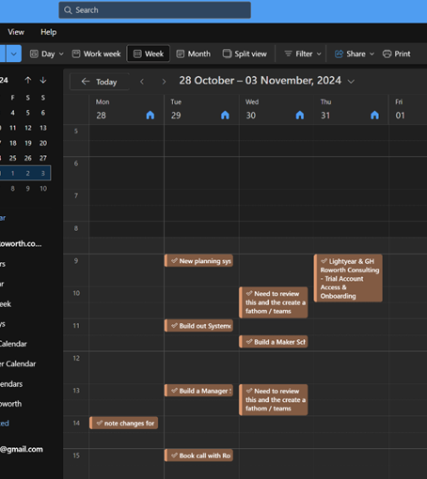
Daily Review:
✔ Review Your Calendar – Ensure all available time is allocated for productive work.
✔ Process New Emails & Tasks – Sort them into the appropriate lists/categories.
✔ Adjust & Prioritize – Move tasks into open time slots in your calendar for the day.
✔ Ensure Focus – Make sure high-priority tasks are scheduled first.
Notes:
Review Your Calendar
Start by checking your calendar for the day to ensure all available time is allocated effectively.
Look for gaps or unassigned time that can be used for productive work.
Process New Emails & Tasks
Go through your inbox and sort new emails into their respective lists/categories.
Add due dates and priorities for any new tasks that require action.
Adjust & Prioritize Tasks
Move or schedule important tasks into open time slots in your calendar.
Make sure that critical work is assigned time, rather than left floating on a to-do list.
Ensure Focus for the Day
Confirm that high-priority tasks are scheduled first and that your plan is realistic.
If necessary, shift lower-priority items to another day to avoid overload.

Slide 63
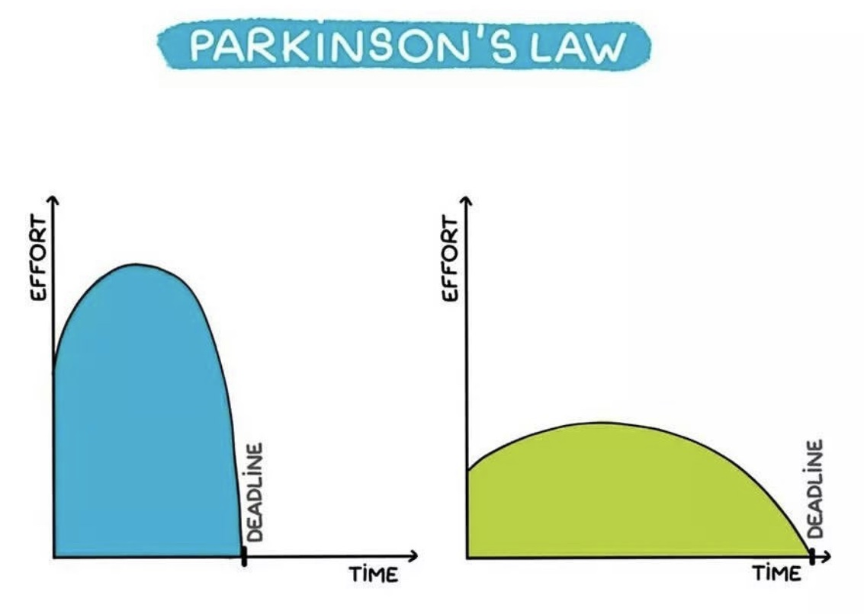
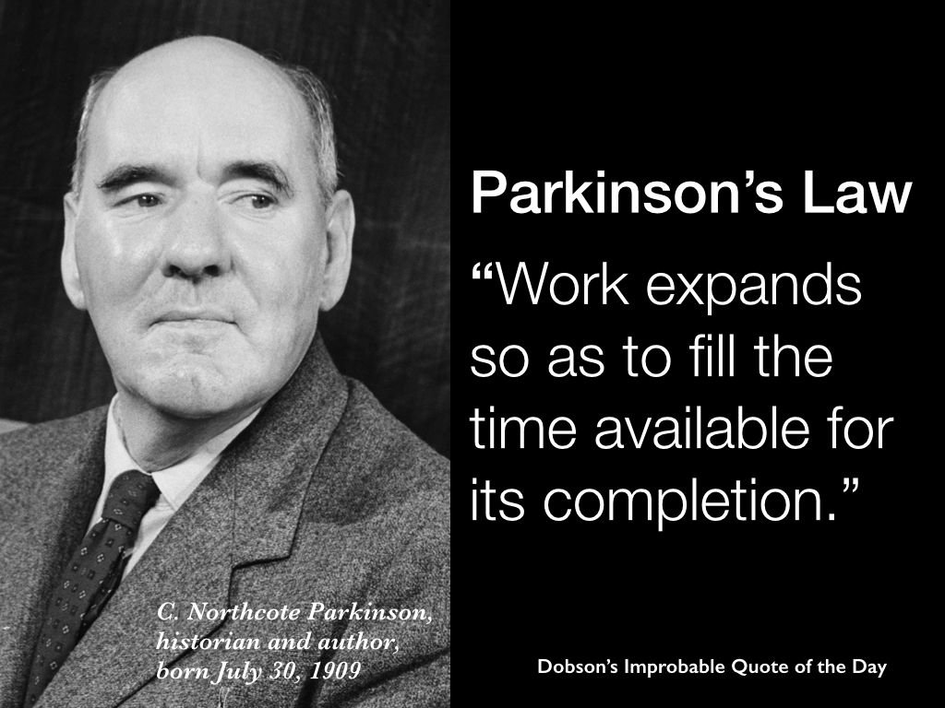
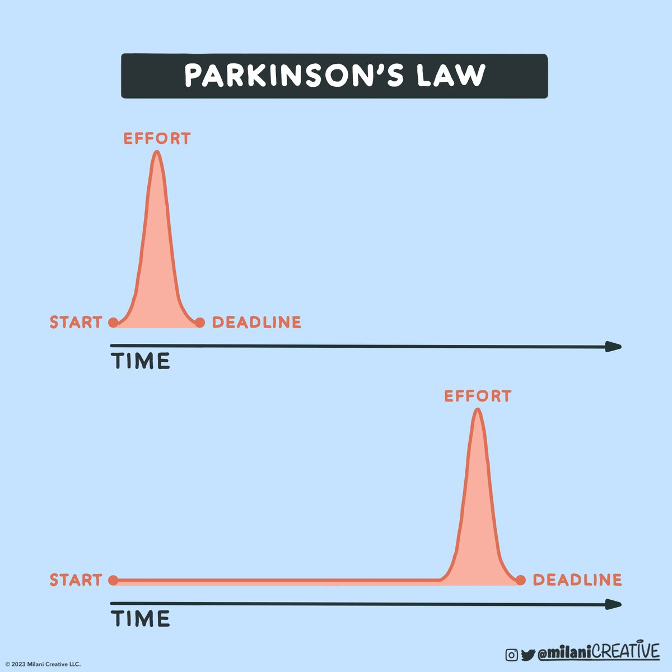
Notes:
Why Bringing Tasks onto Your Calendar Works – Parkinson’s Law states that work expands to fill the time available, often leading to procrastination and inefficiency. By scheduling tasks directly into your calendar, setting strict deadlines, and using time blocking, you create a sense of urgency, stay focused, and complete work more efficiently.

Slide 64
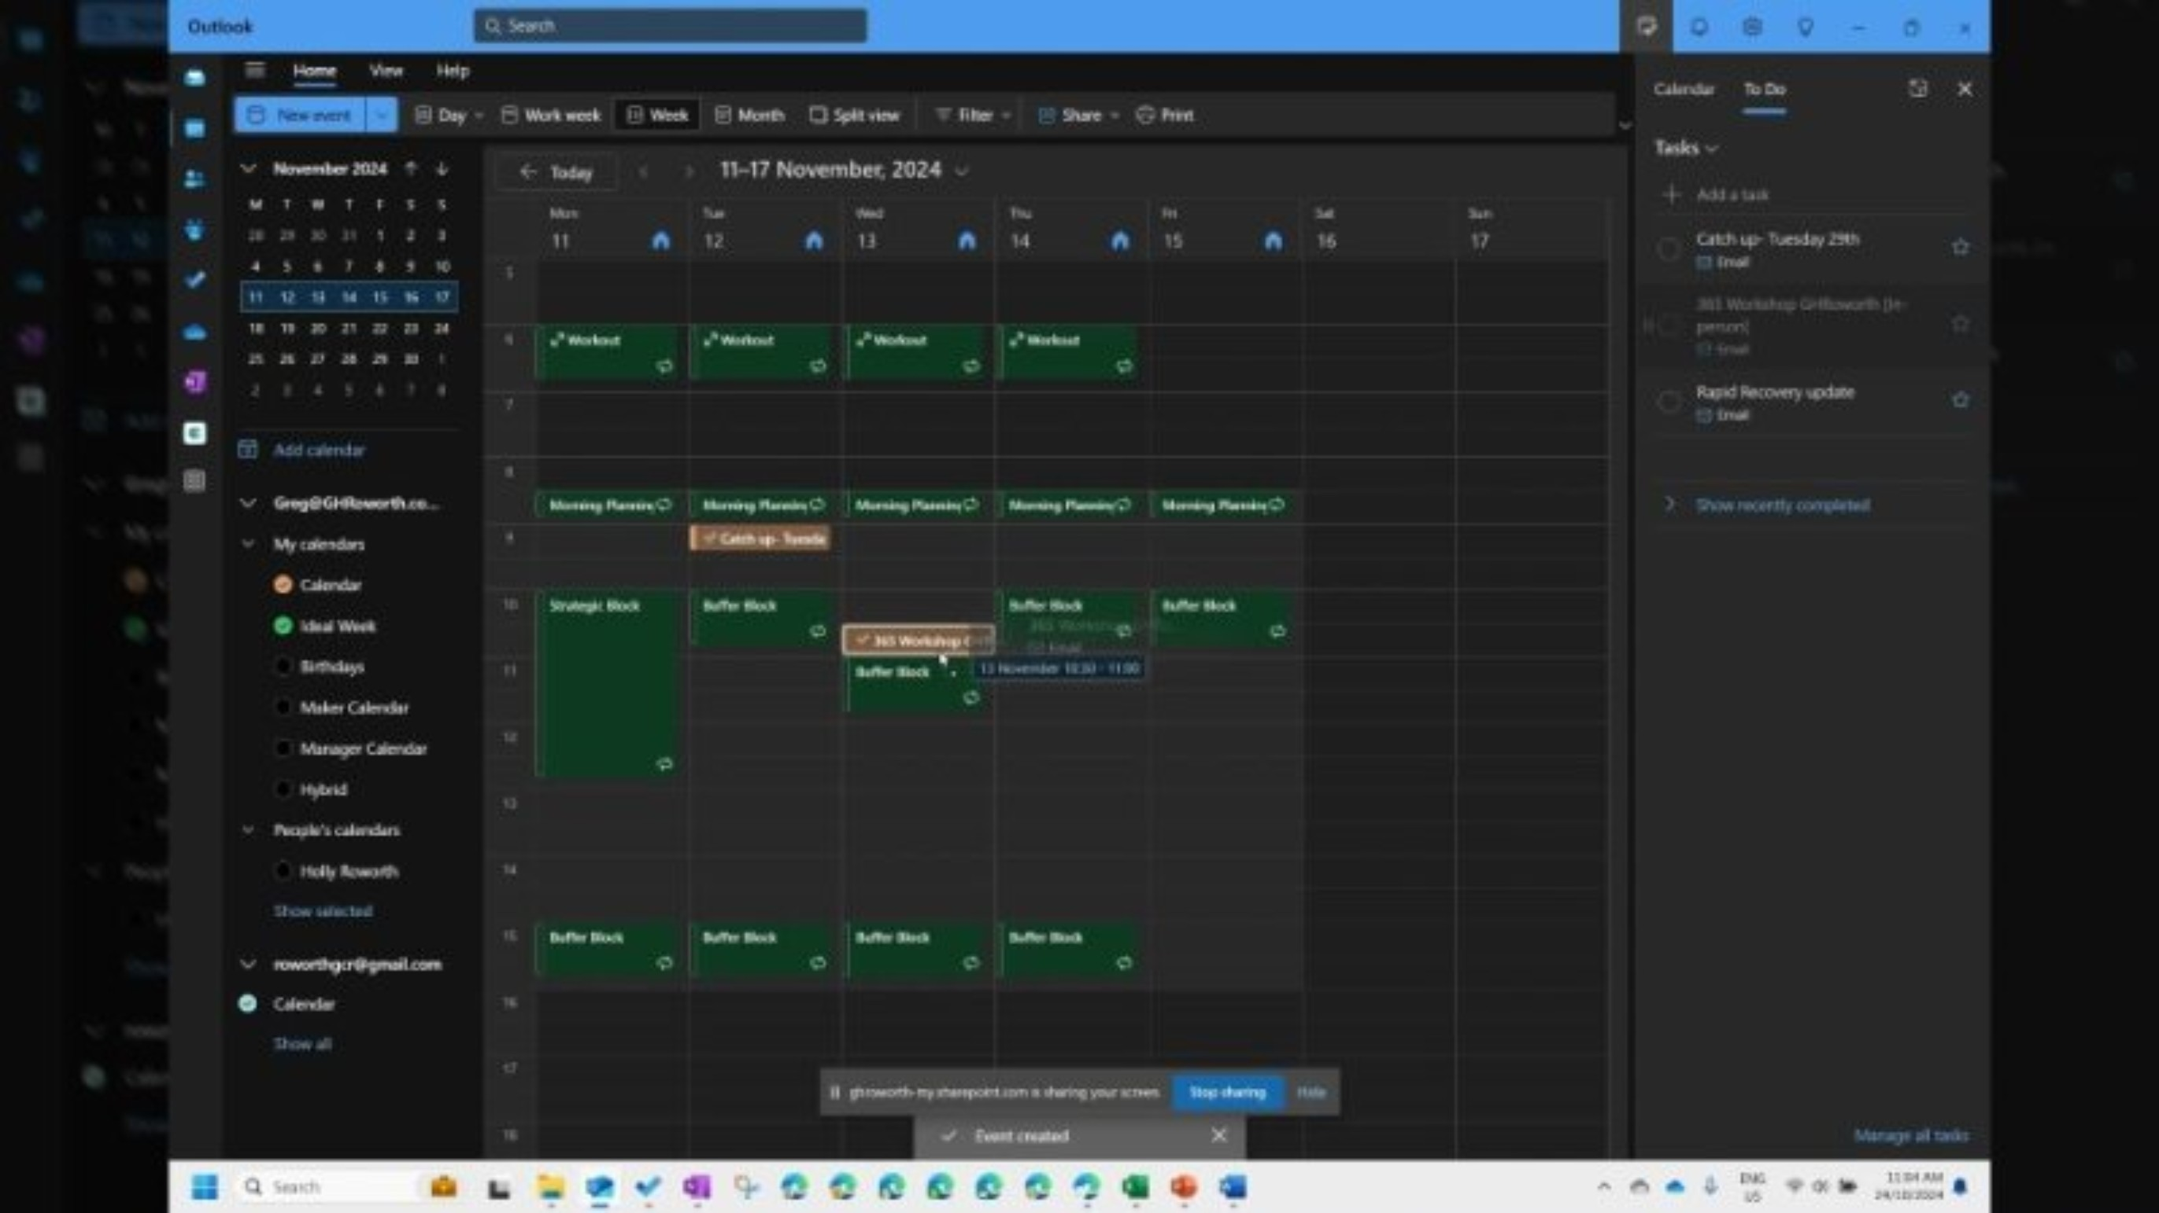

Slide 65
Any Questions about the TODO Process

Slide 66
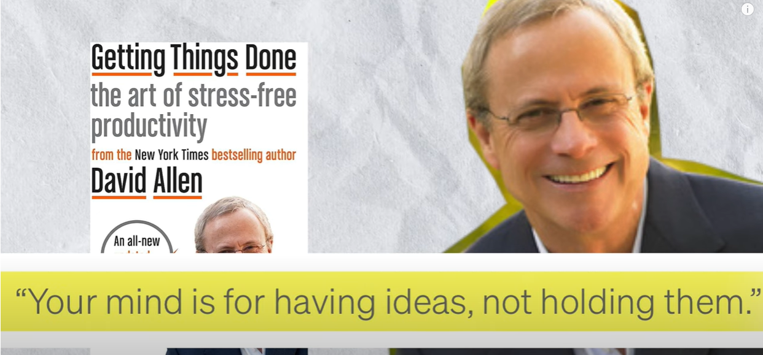
OneNote Second Brain - Capture All
Notes:
We have Now But out system together – and can execute on our work and task but what about taking it a step further and made it so that you keep all your throughs and Ideas, project notes and other detailed notes on any information you researched for you, life or role!

Slide 67

OneNote Second Brain - Capture All
Definition: Capture all tool! Or as I like to call it. “Your Second Brain”
GOAL: Store Ideal in a Searchable location. – but not just Ideas.
Benefits: Capture more detailed notes, meeting minutes, and reference materials. You can also use it to store ideas that need more context or elaboration
Notes:
OneNote Second Brain - Capture All (Individual note, team notes, Product note, Resources)
Definition: Capture all tool! Or as I like to call it. “Your Second Brain”
GOAL: Store Ideal in a Searchable location. – but not just Ideas.
Benefits: Capture more detailed notes, meeting minutes, and reference materials. You can also use it to store ideas that need more context or elaboration
Basically everything other than task - that is for ToDo - that being said you can create tasks in OneNote so you do lose flow if you're working while using OneNote you can make a note a task using outlook tasks and it will sync to your ToDo.
OneNote is for capturing and Creating in any format,

Slide 68
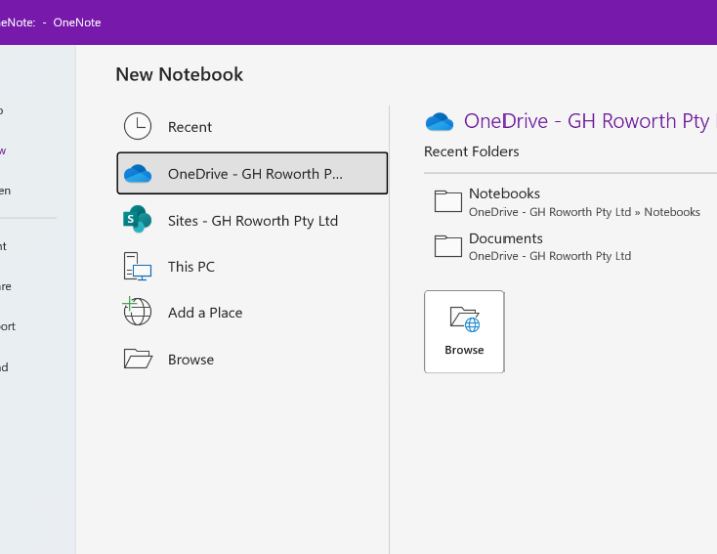
Create a OneNote Notebook
When Creating a New Person Notebook, head over to Files > NEW > Select OneDrive > Notebooks Folder.
If you Creating a team Notebook, Head over to Teams, and use the Notebook for that team and Channel.
If No Book is not yet attached to the team and Channel, go to the Channel and across the tabs at the top select the + icon and add the OneNote app
Notes:
Create a OneNote Notebook - .
When Creating a New Person Notebook, head over to Files > NEW > Select OneDrive > Notebooks Folder.
If you Creating a team Notebook, Head over to Teams, and use the Notebook for that team and Channel.
If No Book is not yet attached to the team and Channel, go to the Channel and across the tabs at the top select the + icon and add the OneNote app

Slide 69
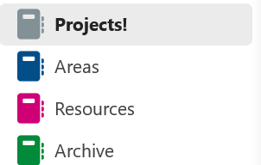
Create Folder Set
Notes:
Decide to Either have One Note book with Grouped sections or Multiple One note book for each category
Projects: These are specific, short-term efforts with a clear goal, like completing a report or planning a trip.
Areas: These are ongoing responsibilities or areas of focus, such as health, finances, or personal development. (
Resources: These include materials or information that might be useful for your projects and areas, like articles, books, or notes.
Archives: This category is for items from the other three categories that are no longer active but you want to keep for future reference
Never Create and Empty folder/ Section before you have something to put in it - avoid wasting time on empty section and to be disappointed letter.

Slide 70
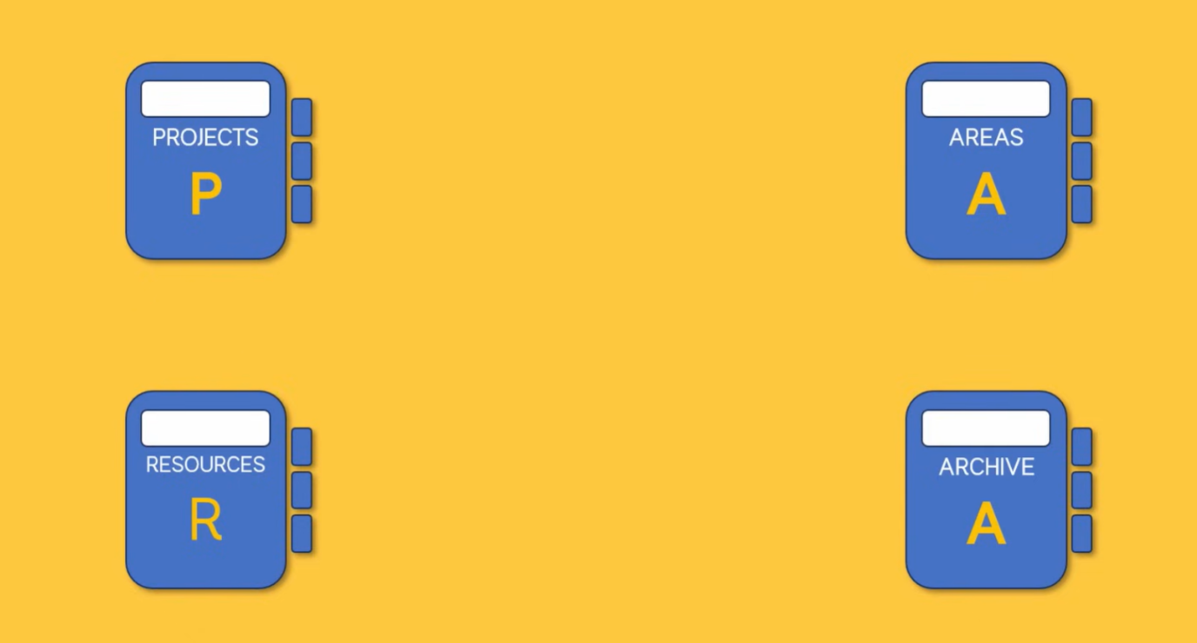
Move note Don’t Delete them
You have flexibility over where your notes sit within OneNote; this is very important as your note’s importance will change over time, so you need to be able to move them between any location as needed.
Notes:
You have flexibility over where your notes sit within OneNote; this is very important as your note’s importance will change over time, so you need to be able to move them between any location as needed.
What this means is that Notes are not static, is a project is finished then we move the Intier section over to archived. There is not need to delete your notes move them to Archive once you are done with them, and if you need to revisit them you can or if you need to reinstate an old project you can be moving it out of archive to Projects.

Slide 71
Capture Methods
Quick Notes: Use the Quick Note feature (press Win + N) to jot down ideas or tasks instantly. These notes are automatically saved in the “Unfiled Notes” section.
Email to OneNote: Forward important emails to OneNote by sending them to your unique OneNote email address. This is great for capturing actionable items from your inbox.
Web Clipper: Use the OneNote Web Clipper to save articles, web pages, or screenshots directly to your notebook. This is useful for research and reference material. - OneNote Web Clipper Installation Browser Extension
OneNote Mobile: using the App on iOS or Android you can use the quick notes Feature on a widget, or open up notes and start dictation your thoughts along with using the Share function in apps to send the contract from any app to OneNote
Notes:
Quick Notes: Use the Quick Note feature (press Win + N) to jot down ideas or tasks instantly. These notes are automatically saved in the “Unfiled Notes” section.
Email to OneNote: Forward important emails to OneNote by sending them to your unique OneNote email address. This is great for capturing actionable items from your inbox.
Web Clipper: Use the OneNote Web Clipper to save articles, web pages, or screenshots directly to your notebook. This is useful for research and reference material. - OneNote Web Clipper Installation Browser Extension
OneNote Mobile: using the App on iOS or Android you can use the quick notes Feature on a widget, or open up notes and start dictation your thoughts along with using the Share function in apps to send the contract from any app to OneNote

Slide 72
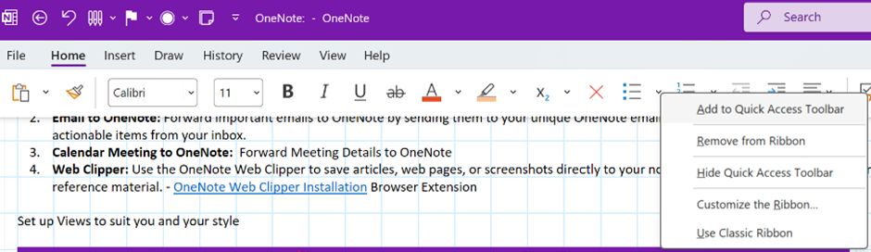
Setting up Quick access items - Right click on the tool you want quick access to

Slide 73
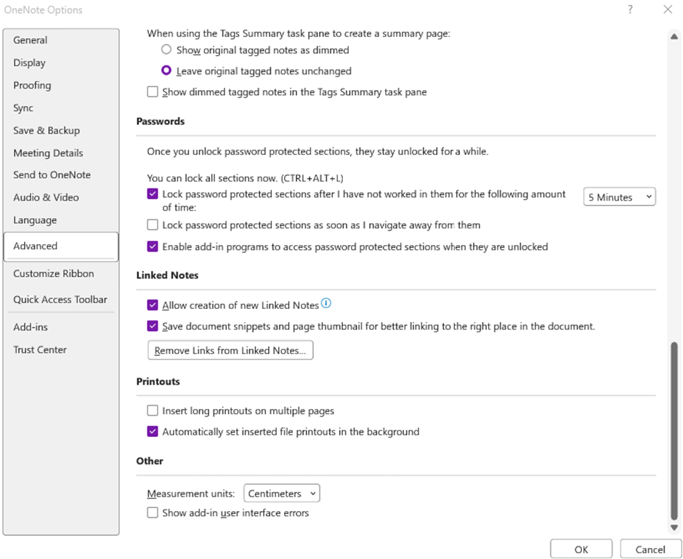
Set up print to OneNote:
ensure that Auto set print outs as backgrounds so they don’t move around on the canvas and you can take notes over them easly

Slide 74

Tips for Effective Capturing
Outlook: Use OneNote to take meeting notes directly from Outlook calendar events. This keeps all related information in one place.
Microsoft To Do: Sync tasks from OneNote to Microsoft To Do. You can create tasks in OneNote and have them appear in your To Do list.
Planner: For project management, link OneNote pages to Planner tasks. This provides detailed notes and context for each task.
Teams: Share OneNote pages in Teams channels for collaborative note-taking and project documentation.
ToDo: Create a Task that sync with ToDo use the outlook Tasks Button
Notes:
Tips for using OneNote with Integrating with Other Tools:
Outlook: Use OneNote to take meeting notes directly from Outlook calendar events. This keeps all related information in one place.
Microsoft To Do: Sync tasks from OneNote to Microsoft To Do. You can create tasks in OneNote and have them appear in your To Do list.
Planner: For project management, link OneNote pages to Planner tasks. This provides detailed notes and context for each task.
Teams: Share OneNote pages in Teams channels for collaborative note-taking and project documentation.
ToDo: Create a Task that sync with ToDo use the outlook Tasks Button
Tips for Effective Capturing
Use Embed an interactive link into OneNote - to capture YouTube video and watch them in OneNote
Using Tags to create important or highlight content
Create and Save Templates - great for meeting templates, employment questionaries or Journaling pages

Slide 75
Question about OneNote / Second Brain

Slide 76
Productivty Playbook System Overview
Creating a Year at a Glance
Create an Ideal week – Manager or Maker
Achieve Inbox Zero - Declutter
Convert Inputs to tasks
Assign time to complete the tasks
Capture - Store your thoughts, Ideas and reference material
Plan and Review - Power hour

Slide 77
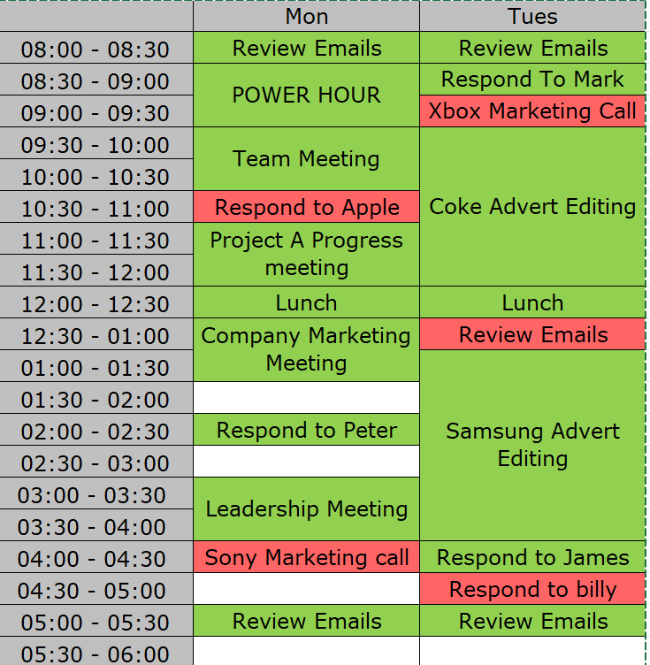








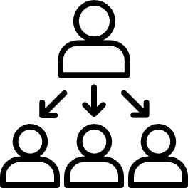

YEAR AT A GLANCE
YOUR IDEAL WEEK
EMAIL
Calendar
MANAGER / MAKER SCHEDULE
ENERGY
POWER HOUR
REVEIW
LOOK BACK / LOOK FORWARD
REVEIW
LOOK BACK / LOOK FORWARD
The Clarity Sprint
RULES / AUTO FILTER
🎬ACTION REQUIRED
⌚WAITING ON
📖READING
🗄️ARCHIVE
PROCESS RULES
SCHEDULE IT
DO IT
HIGH
Importance
DELETE IT
DELEGATE IT
LOW
✅COMPLETE
⛔DIDNT COMPLETE
LOW
HIGH
Urgency

Slide 78
Time Savings and Productivity Gains
Reduced Time in Outlook: Decrease from 2.6 hours per day to just 1 hour.
Enhanced Focus: Gain back 40% of your time through unbroken focus, translating to an additional 1.5 to 3 hours of productive time.
Boosted Productivity: Increase productivity from 2.53 hours to 8 hours per day, representing a 216.21% improvement.
More Time for What You Love: Increase your time spent on tasks you are passionate about, allowing you to “fill your cup” and maintain a healthy work-life balance

Slide 79
Action Items
Build an Ideal Week Calendar (Maker/Manager)
Create a balanced schedule that separates maker time (focused work) and manager time (meetings and administrative tasks).
Set Up Recurring Events
Schedule regular events such as meetings, email management sessions, power hours, buffer blocks, and lunch breaks.
Open Outlook and Set Up Productivity Method
Configure Outlook to support your productivity system, including rules, folders, and categories.
Open Microsoft To Do and Review Lists
Review and update your task lists. Only create lists for items that need to be tracked to avoid unnecessary clutter.
Open OneNote and Set Up Notebooks and Sections
Follow the settings guide to organise your notebooks and sections. Only create notebooks and sections for items that need to be documented to keep it streamlined.
Extra points!
Share Calendar with Your Organisation (Team)
Ensure transparency and alignment by sharing your calendar with your team.
Discuss Maker and Manager Days
Coordinate with your organisation to designate specific days for internal meetings to avoid calendar clashes.

Slide 80
Thank you 👏🙏

