Slide 1

Security & Compliance M365
Stacy L. Deere, MVP
Focal Point Solutions

Slide 2
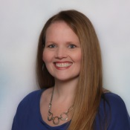

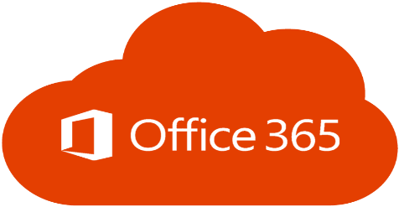

Stacy L. Deere-Strole
Microsoft Office Services & Apps MVP
Focal Point Solutions
Founder & CEO
Solutions Architect
Contact Information
Email: sdeere@focalpointsolutions.co
Phone: 513-687-4154
Social
Twitter: @sldeere
LinkedIn: /in/stacydeere
Facebook: /stacydeere
http://spmindmelt.focalpointsolutions.co
http://focalpointsolutions.co
Content
Author
Managed Metadata 2010, 2013

Slide 3
Agenda
Risks
Getting Started
Areas
Taking Action
Getting Secure & Compliant
Maintaining
Wrap-Up

Slide 4
Risks
Data Breach
Malware Attack
PUPs (Potentially Unwanted Programs)
Environment Lockout
Reputation
HUGE Expense
Backup Management

Slide 5
Getting Started
Security Center
Compliance Center
Area to configure, monitor & manage security across your Microsoft identities, data, devices, apps, and infrastructure. Here you can easily view the security health of your organization, act to configure devices, users, apps, and get alerts for suspicious activity. The Microsoft 365 security center is intended to help security admins and security operations teams manage and protect their organization.
Is a specialized workspace designed to meet the needs of security and compliance teams. These solutions are integrated across Microsoft 365 services and provide monitoring dashboard and actionable insights to help reduce risks and safeguard your digital estate.

Slide 6
Areas
Security
Compliance
Secure Score
Sensitivity
Including Types
Retention
Data Loss Protection (DLP)
Records Management
Information Governance
Threat Management
Advanced Hunting
General Data Protection Regulation (GDPR)
eDiscovery
Service Assurance
Compliance Manager
Assessment
Solutions
Corrective Action
Data Classification
Policies
Alerts
Microsoft Defender for Endpoint
Options vary per plan:
Security & Compliance Center - Service Descriptions | Microsoft Docs

Slide 7

Improvement Actions

Slide 8
Getting Secure
Improvement Actions
Points
Assign
Implementation
Status
Date
Notes

Slide 9
Maintaining
Repeating Processes
Reports
Dashboards
Governance Site
Yes, I typed it!!

Slide 10
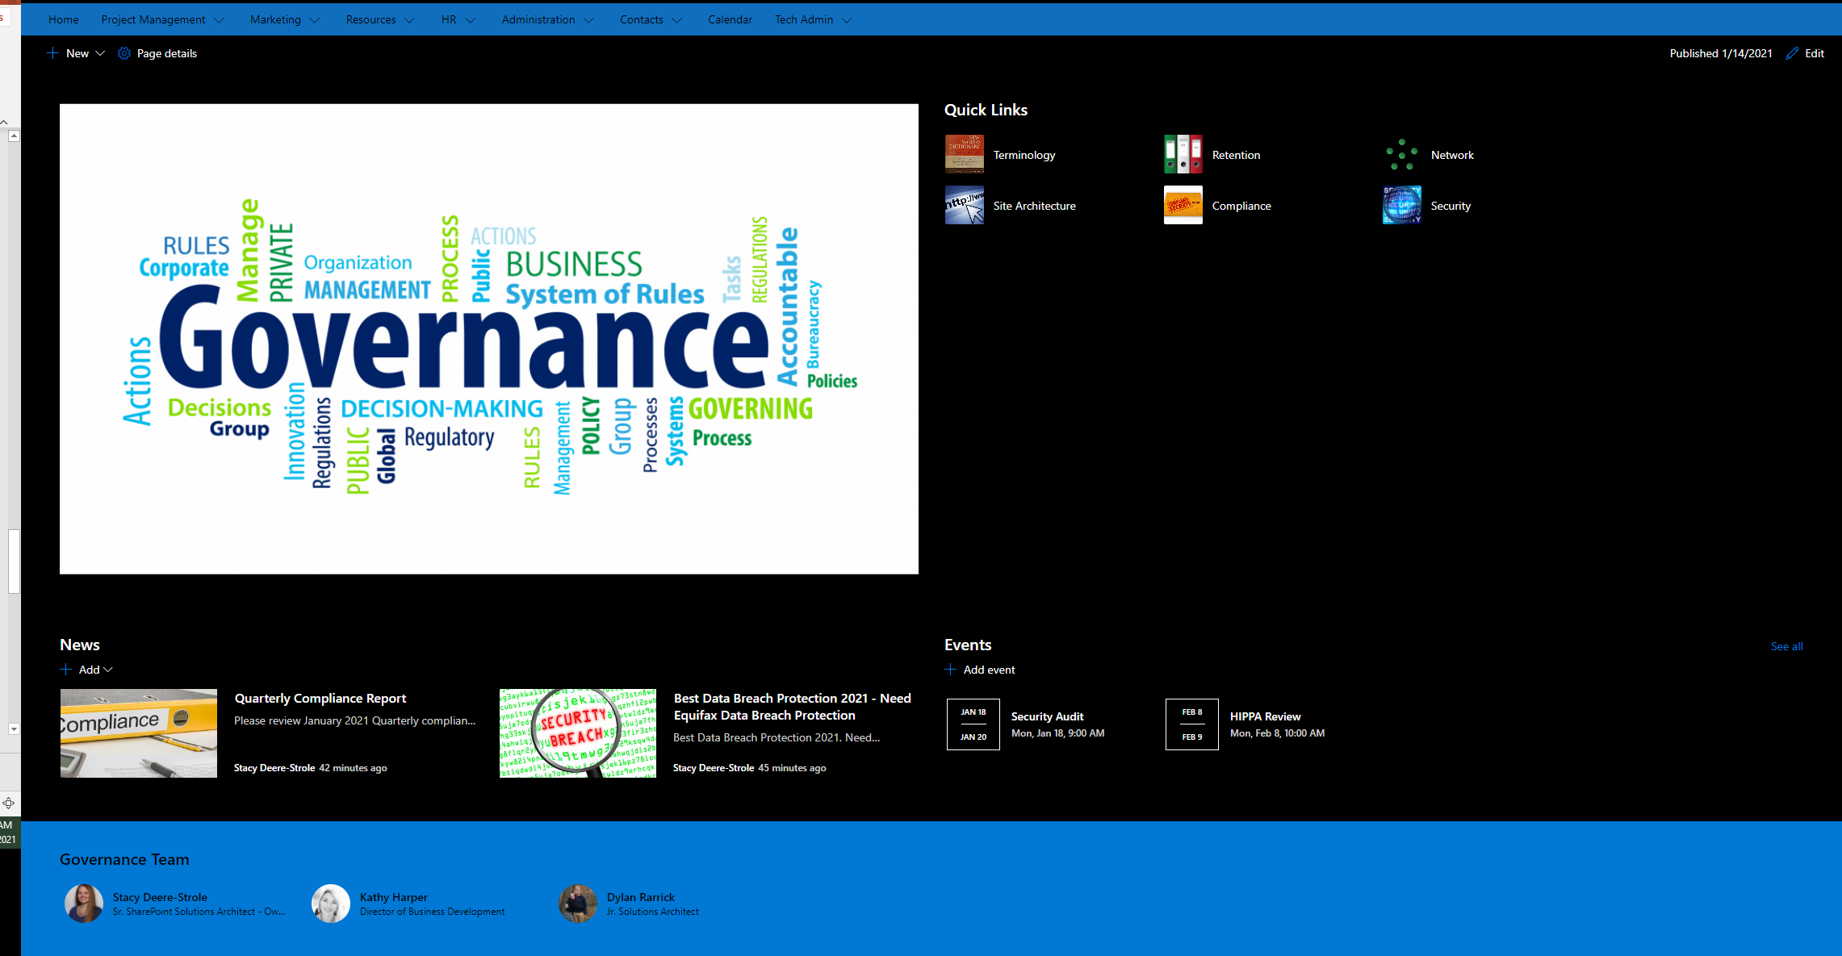

Slide 11




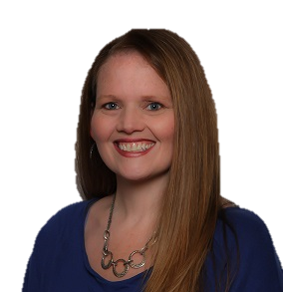

@sldeere
www.linkedin.com/in/stacydeere
sdeere@focalpointsolutions.co
Stacy Deere-Strole MVP

