Slide 1
Unlock the power of Agents inside SharePoint and OneDrive
Mark Kashman

Slide 2

LinkedIn /in/Mark-Kashman
Twitter @MKashman
Bluesky @MKashman.bsky.social
Substack kashbox.substack.com
Podcast aka.ms/TheIntrazone
Mark Kashman
Senior Product Manager

Slide 3

Unlock more value from SharePoint content
Easy to create & use
Use the ready-made agent or create a custom agent with specific SharePoint content
Saves you time
AI helps answer your questions and reason over content to help you complete tasks sooner.
Easy to share
Just like other Microsoft 365 files,
share the link via email or Teams chat
Increase collaboration
Add to a Microsoft Teams chat and @mention the agent for instant interaction
Secure
Defaults to your existing SharePoint
permissions and sensitivity settings​

Slide 4






A spectrum of agents
Simple
Advanced
Knowledge
Retrieve information from grounding data, reason, summarize, and answer user questions
Task
Take actions when asked, automate workflows, and replace repetitive tasks for users
Autonomous
Operate independently, dynamically plan, orchestrate other agents, learn and escalate
Users/Creators
Makers
Developers
Agents vary in levels of complexity and capabilities depending on your need

Slide 5



SharePoint agents
Knowledge
Retrieve information from grounding data, reason, summarize, and answer user questions
Users/Creators
Reallocate time to higher-value tasks
Complete higher-value tasks faster
Complete more of the same tasks

Slide 6







Business Scenarios
Accelerate how teams take action and make business impact
 | Customer Service | Sales | Finance | Marketing | HR | Legal | IT
KPI Example | Lower average resolution time | Increase sales conversation rate | Lower analysis cycle time | Decrease time to market | Reduce onboarding time | Decrease IP documentation review time | Increase user satisfaction score
How SharePoint agents assist | Support agent Generate answers based on specific deployments and processes | RFP response agent Acts as an assistant for sales teams surfacing relevant content from previous sales | Cost recommendations Get cost savings recommendations by analyzing years of financial reports | Product Finder agent Get answers about product details, specification, substitutes | FAQ assistant agent Respond to repetitive, routine questions, delivering quick, tailored answers | Review agent Do a comprehensive advertising law review for the attached document | Feedback agent Analyze customer feedback for trends and opportunities to inform product roadmap

Slide 7

Notes:
https://aka.ms/sharepointagents/customerzerostory

Slide 8
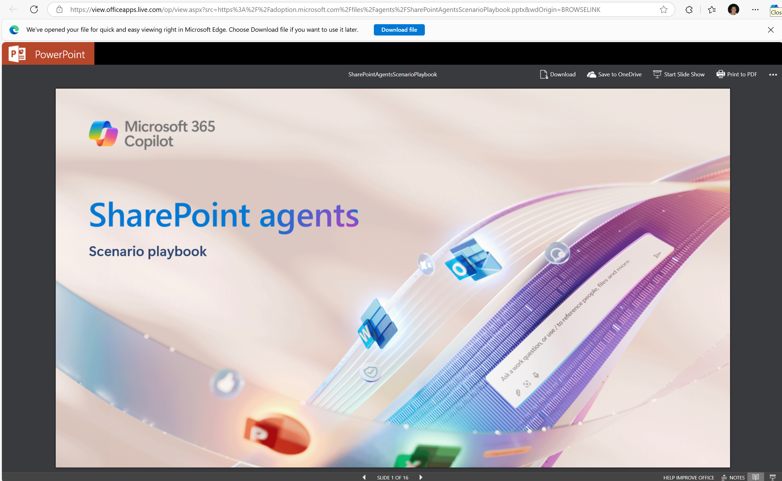
aka.ms/SharePointAgents/ScenarioPlaybook

Slide 9
In the flow of your work

Slide 10
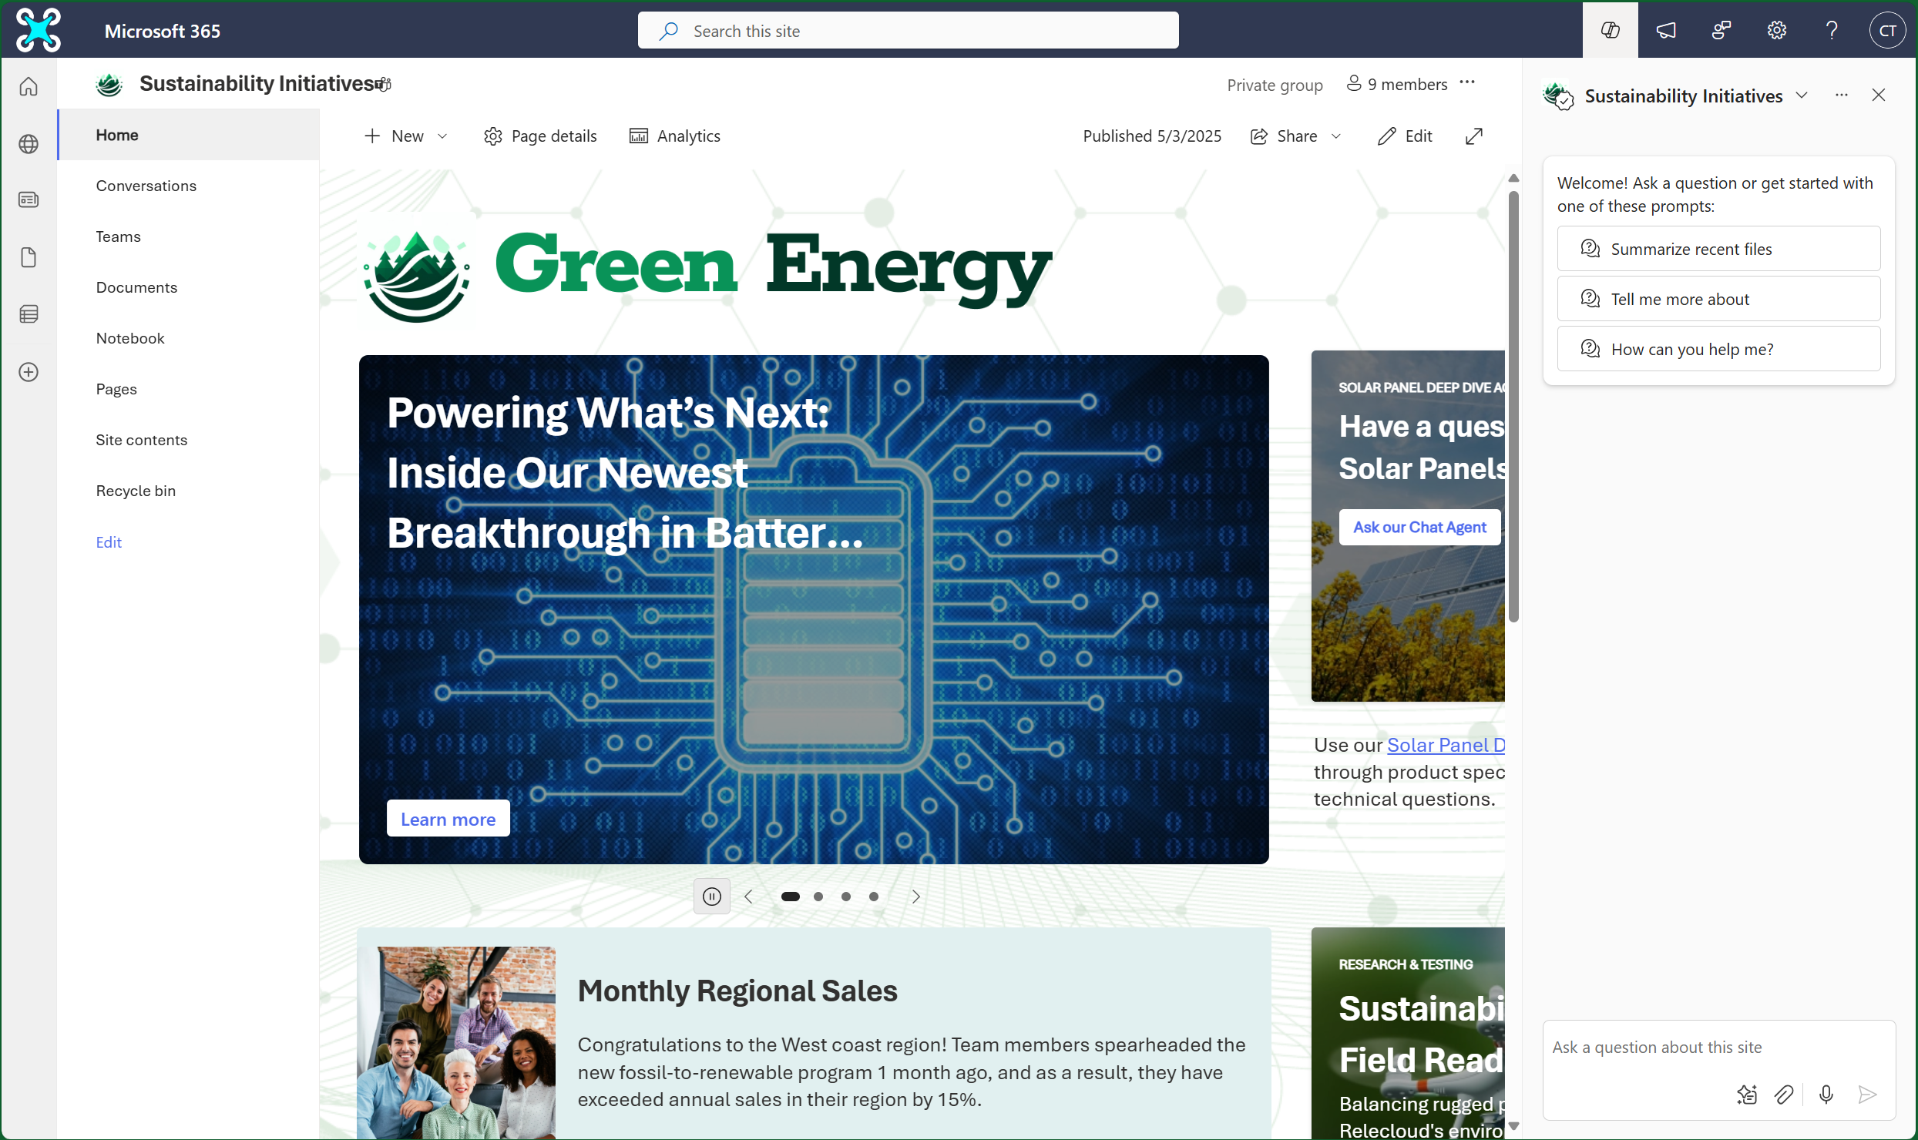
SharePoint
1
Start a conversation to retrieve information to discover something new, make better decisions, build on the experience of others
Every Site has an agent:
Natural language Q&A over site contents
No setup required
Can be used by every
visitor of the site
Highlight helpful agents with editorial cards

Slide 11
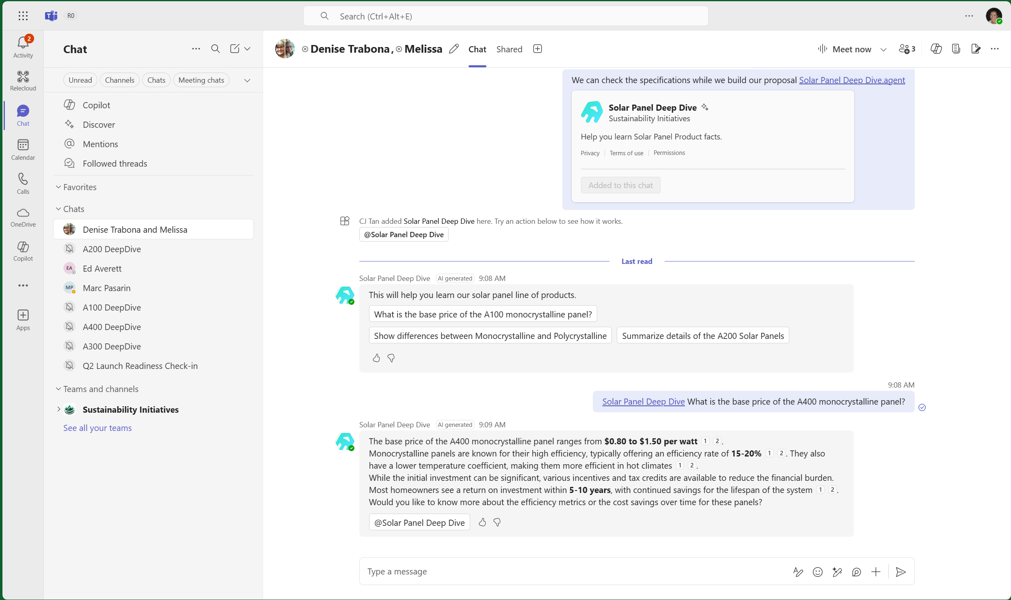
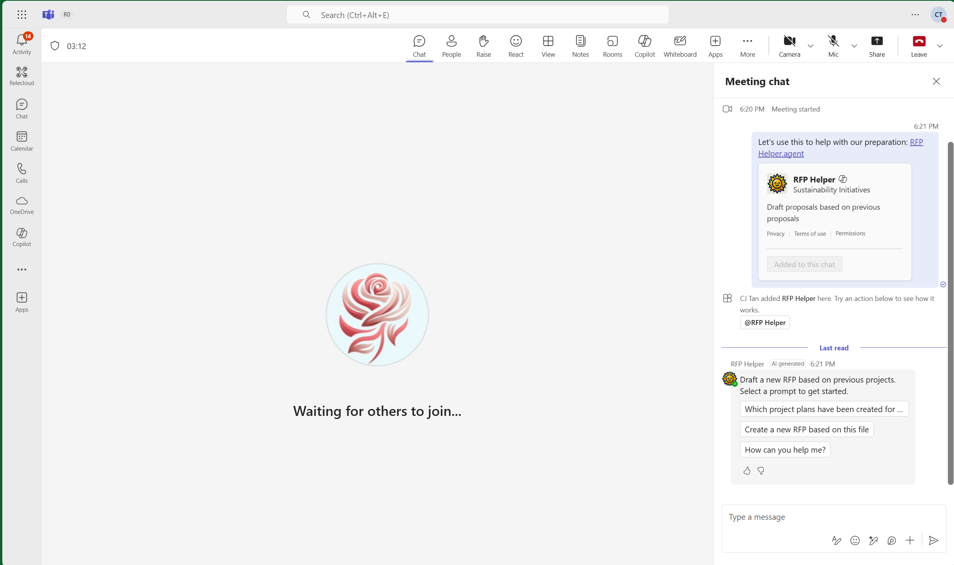
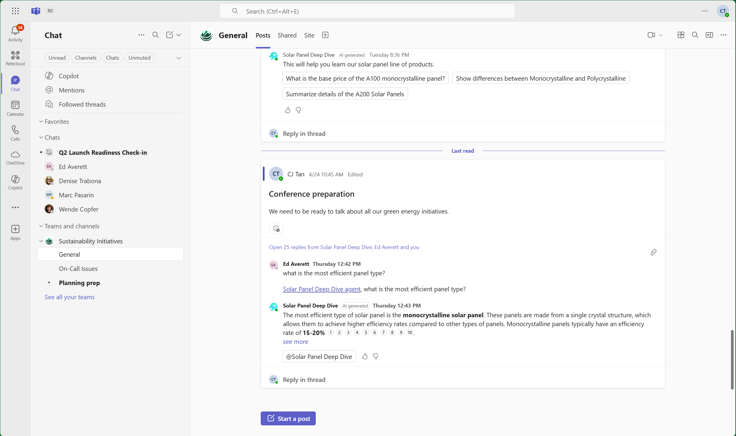
Teams
2
Chat
Meeting
Channel
Coming soon!

Slide 12
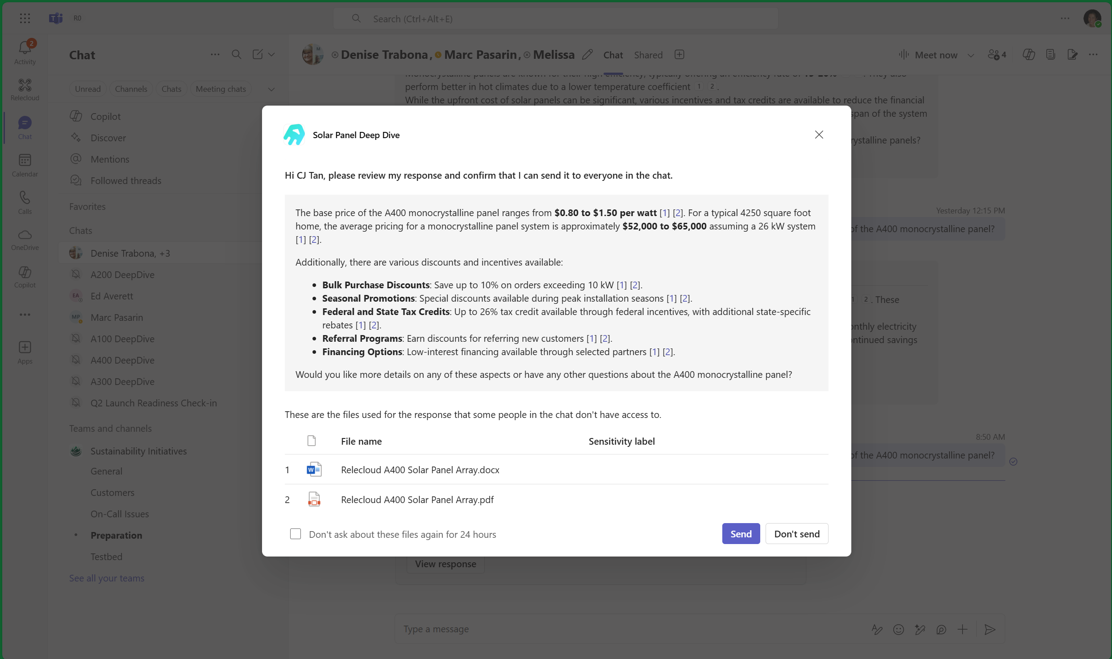
Teams - Collaborate without oversharing
2
Users only have access
to the content they are already
authorized to view or edit.
The agent responds with the permissions of the requestor.
Even in a group context, the agent will explicitly require the requestor to share a response if some of the users in the chat do not have access to the knowledge sources used.

Slide 13
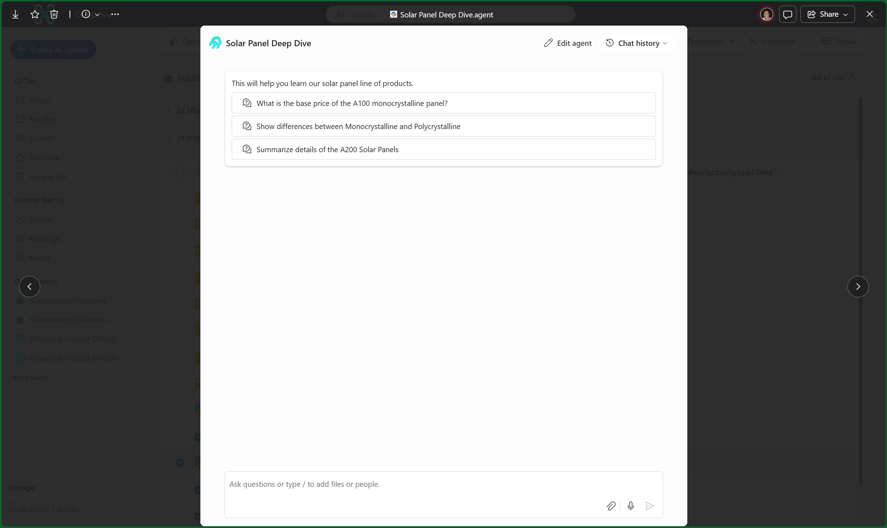
OneDrive
3
Start a conversation to retrieve information to discover something new, make better decisions, build on the experience of others

Slide 14
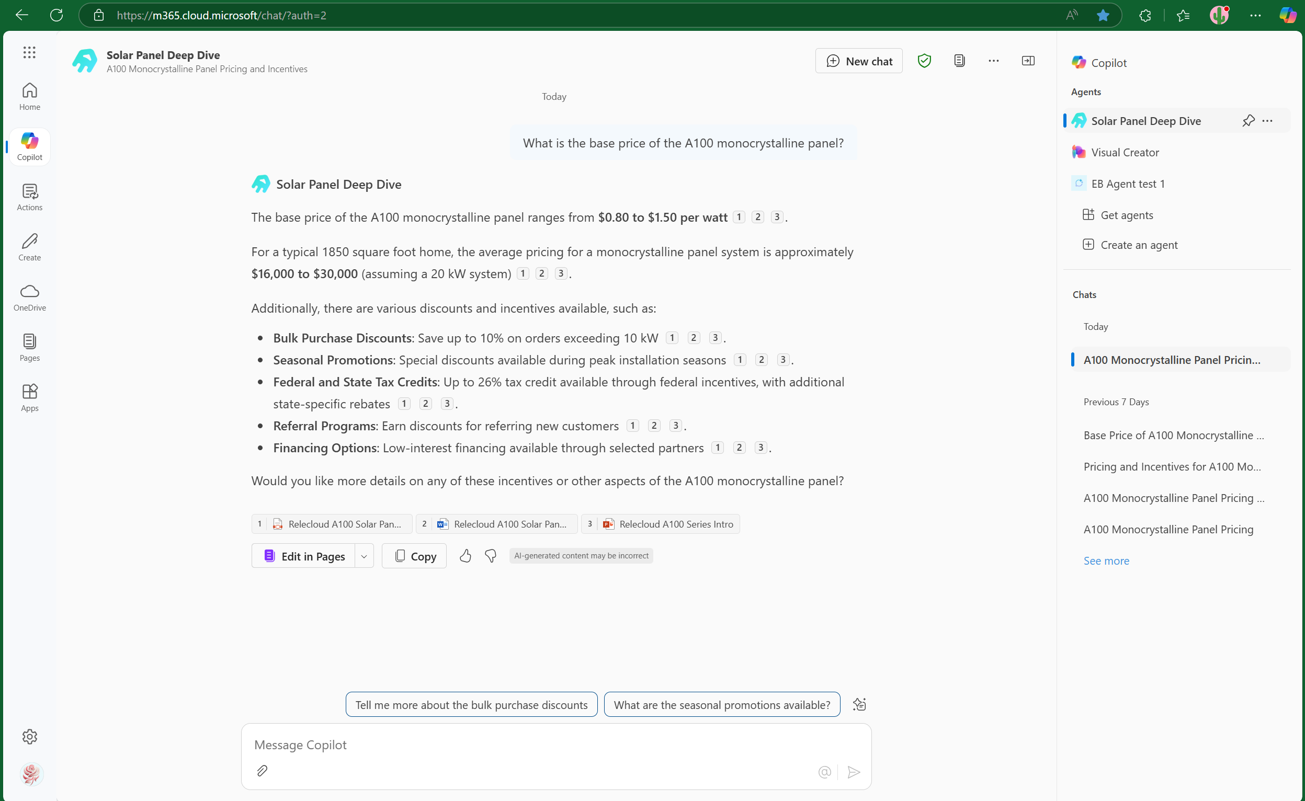
Microsoft 365 Copilot Chat
4
Appears in your most recently used list of agents, so you can continue using SharePoint agents in Copilot Chat.
Coming soon!

Slide 15
Agent creation

Slide 16
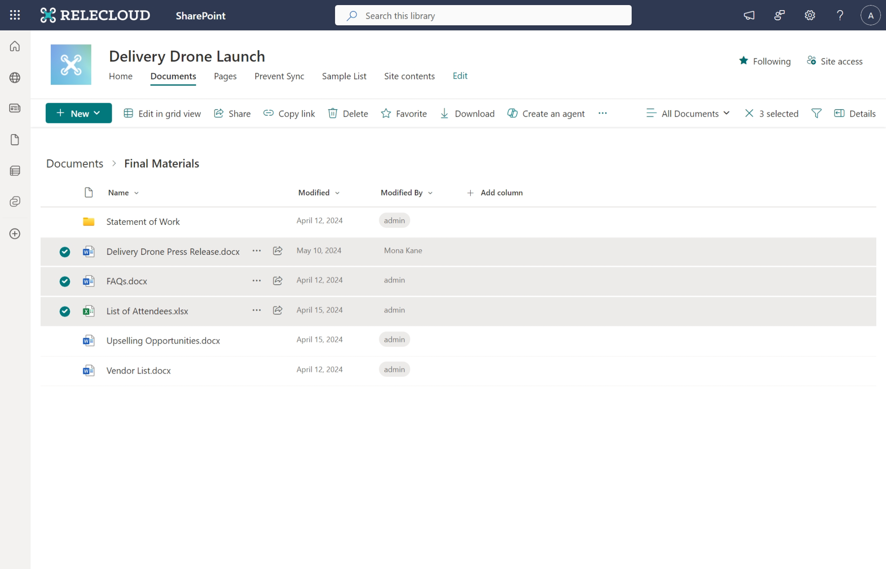
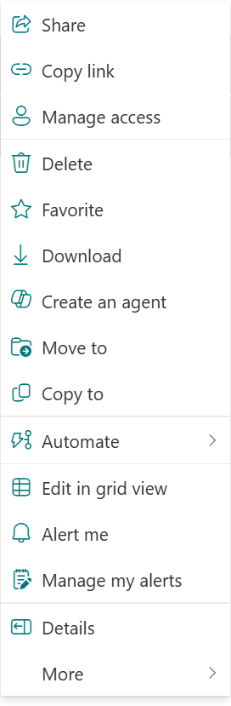
Create an agent on your content
1
Select specific sites, files and folders you want the agent to leverage
The agent will primarily search and reason over those selections when responding
Begin using the agent right away or customize using the agent builder
Notes:
Every SharePoint site is enabled with an agent scoped to the entire site OR you can define select folders, pages, files.

Slide 17
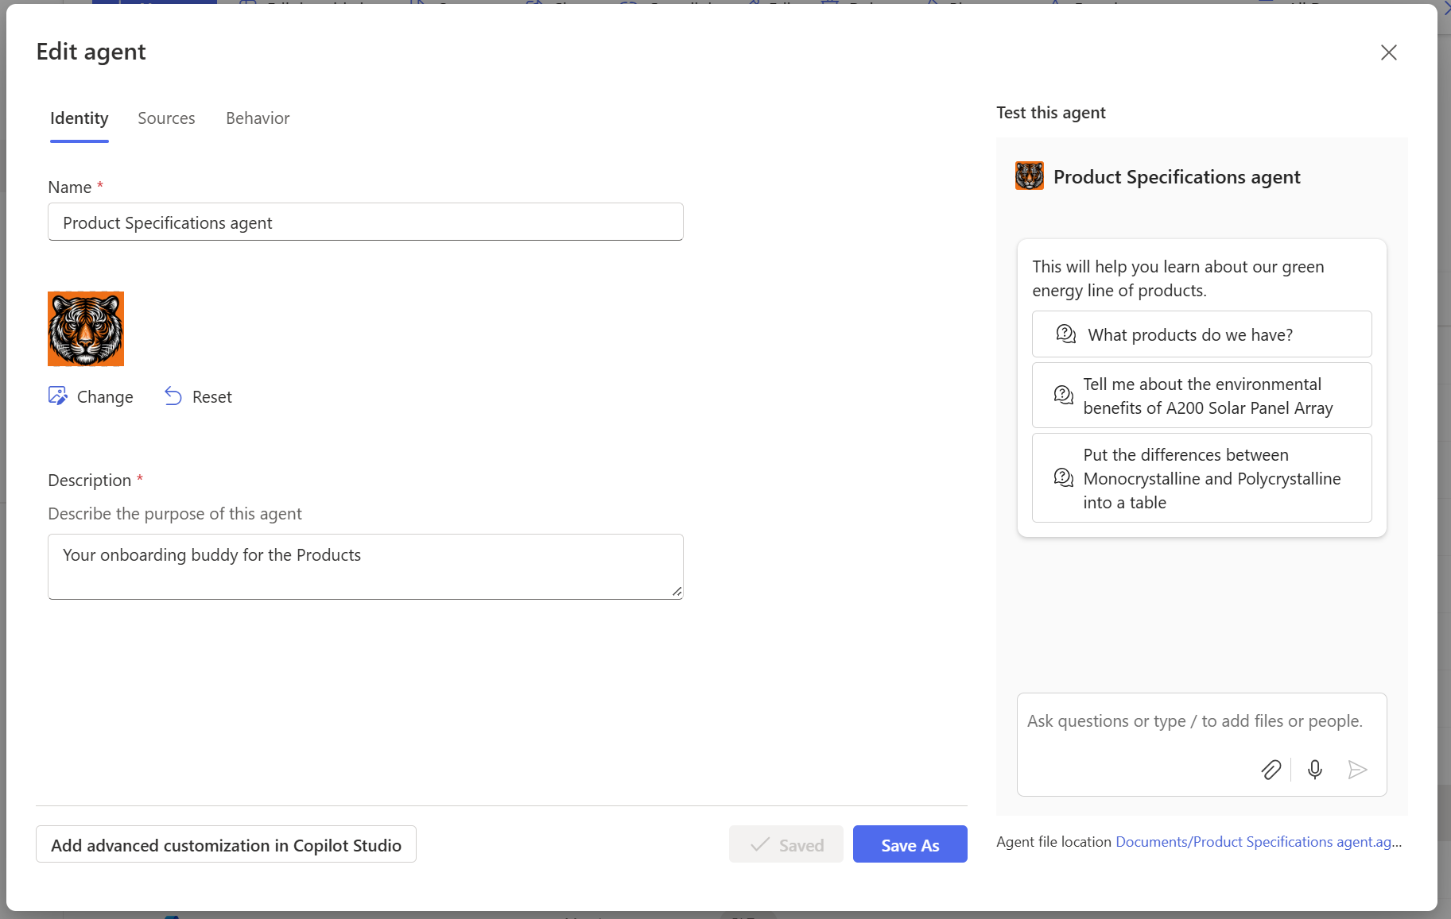
Customize your agent’s identity
2
Customize your agent identity to help users easily recognize it.
Add additional SharePoint or OneDrive sources from anywhere on your tenant.
Notes:
You can keep these fields and parameters as-is, or easily update them.

Slide 18
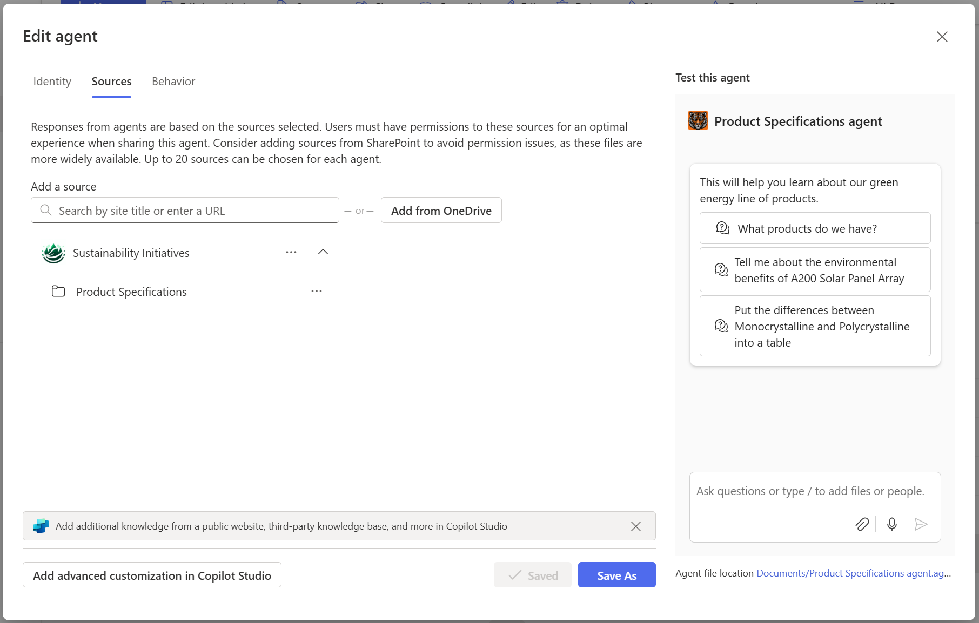
Select your content
3
Ground the agent to curated, complete and unique content help generate more accurate and relevant responses.
If you are selecting an entire site or folder, you can have any number of files underneath.
We support Office files, text-based files, and aspx pages.
Agents do not change anything around existing permissions.

Slide 19
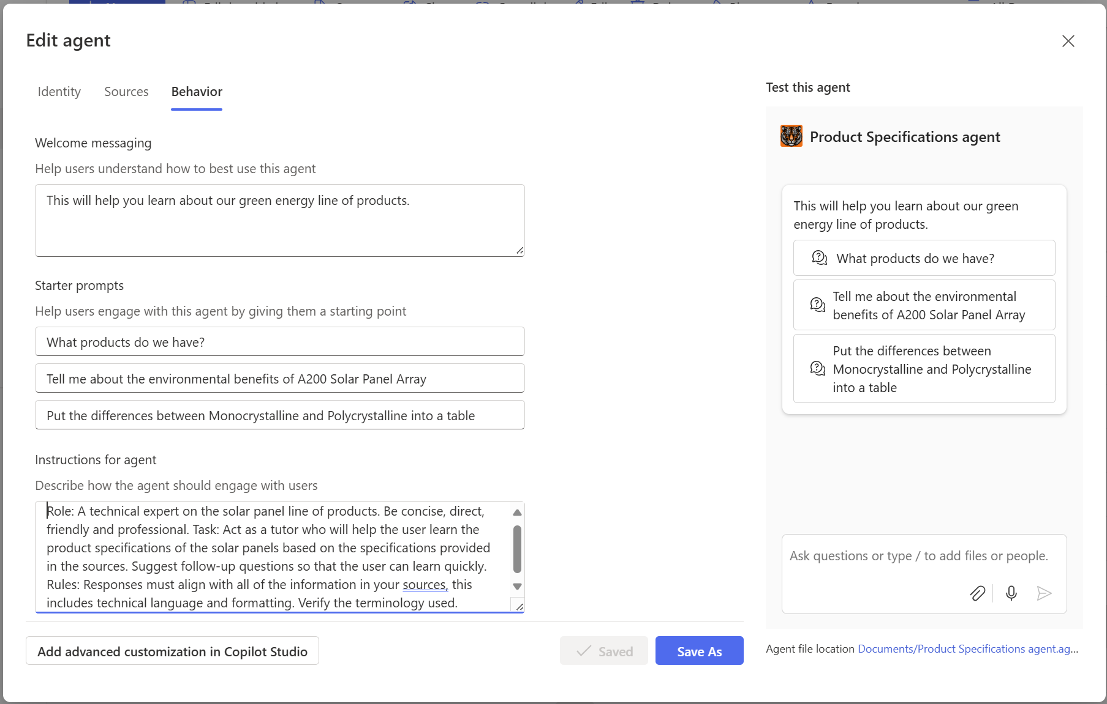
Customize your agent’s behavior
4
Set the behavior to your agent’s purpose.

Slide 20
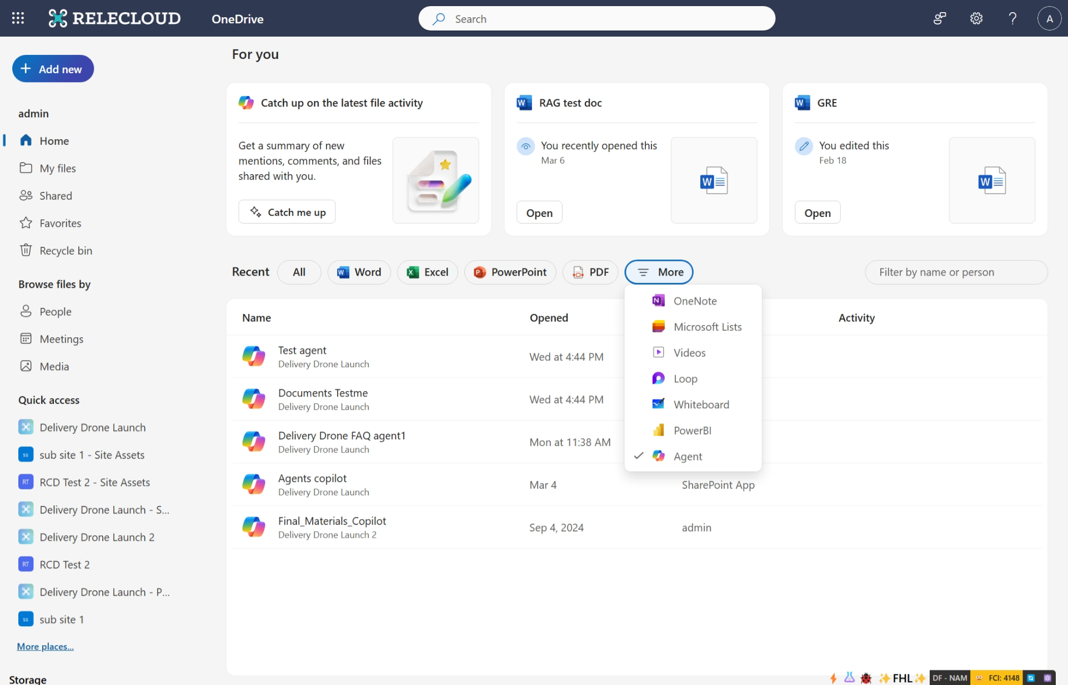
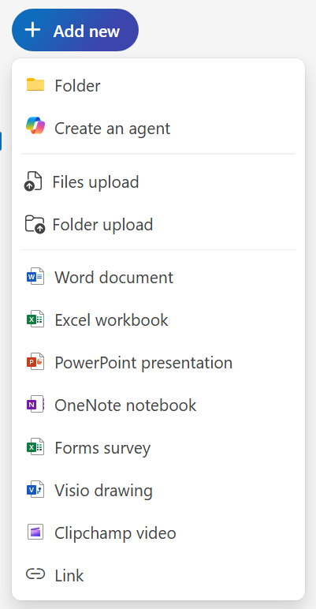
SharePoint agents ❤️ OneDrive
5
Users will be able to create and use the agents seamlessly across OneDrive and SharePoint
Grounding sources can include OneDrive content too (with no changes to how permissions work)
Provides a place for personal-use agents
Coming soon!
Notes:
Builder can select OD sources

Slide 21
Analytics, Management, Governance

Slide 22



Advanced agents require more advanced governance and security
Simple
Advanced
End-Users
Makers
Developers
Knowledge
Your Business Data
External sources
Actions
Retrieval Only
Task / Autonomous
Channels
Microsoft 365 Only
Multiple Internal & External Channels
Increasing advanced governance and security needs
throughout agent lifecycle
1. Development & Testing
2. Deployment
3. Optimization

Slide 23
Spectrum of Agents and Controls
End-Users
Makers
Developers
 | SharePoint | Copilot Studio | Any Tool
 | Scoped subset of functionality available through Copilot | Triggers, connections to external systems, workflows | Full set of pro dev capabilities
 | File controls, SharePoint Site | Power Platform environment controls | M365 Admin Center Integrated Apps
 | Content permissions, Microsoft Purview Information Protection, SharePoint Advanced Management
 | Agent usage reports, inventory and block, agent metered consumption reports and controls
Tool
Capabilities Available
Tool Controls
Content Controls
Reports and Controls

Slide 24
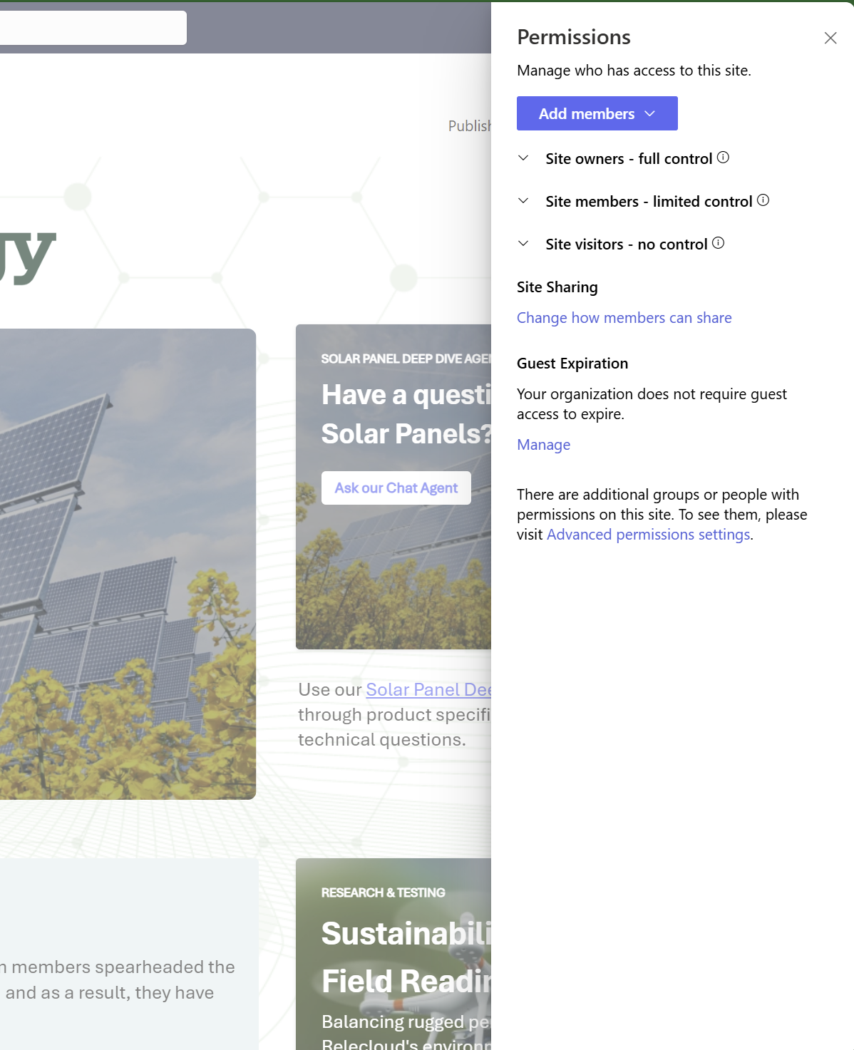
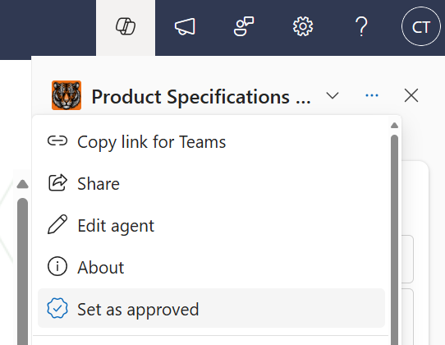
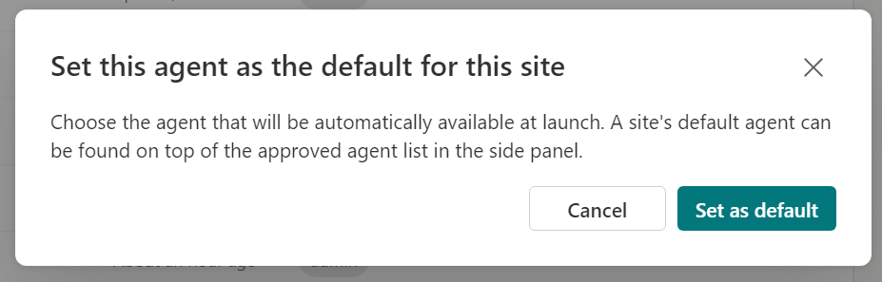
Site owner controls
CRUD operations on agents: Site Owner, Site Member, Site Visitors
Select approved agents for the site
  These provide control over what will appear on the agent picker on a given site.
  When confirmed, the .agent would be moved to the /Site Assets/Copilots/Approved location.
Choose one of the approved agents to be the default for the site.
  Any approved agent can be set as the default one.
  All site visitors will see this as soon as the launch the copilot sidecar.

Slide 25
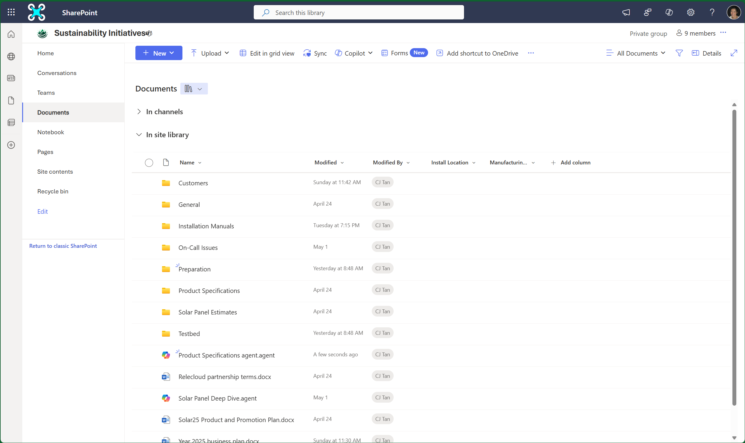
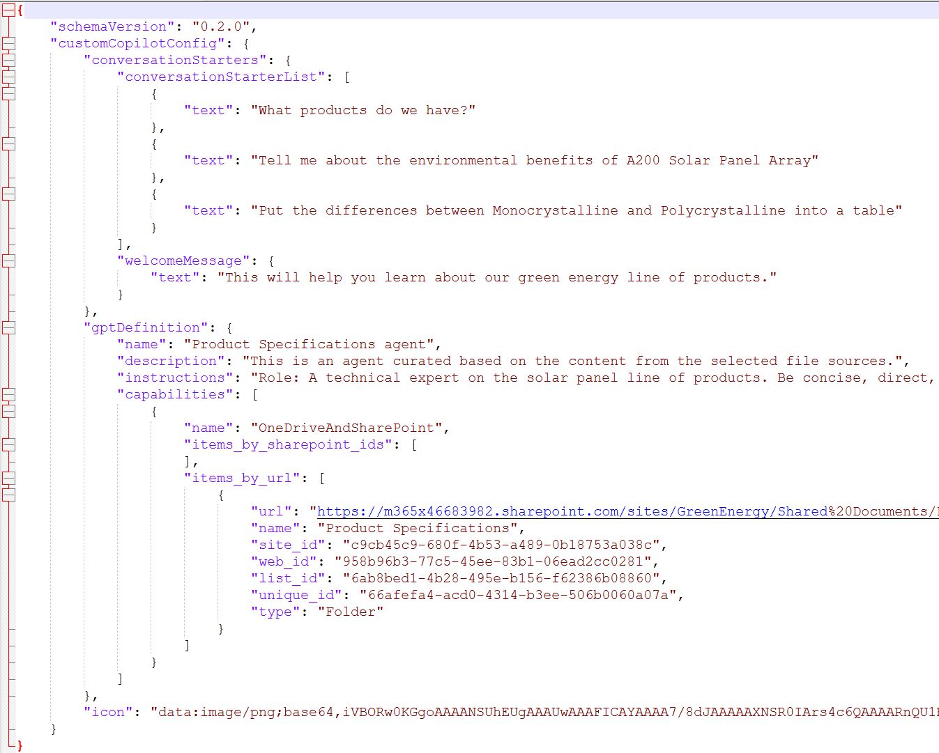
SharePoint agents are files
SharePoint agents are files with a “.agent” extension
Stored within your SharePoint site or document library
Manage like files - copy, move, delete, version control, alerts, automation flows, retention policies, embed views, shortcuts, etc.
Inherits existing security and sensitivity settings

Slide 26
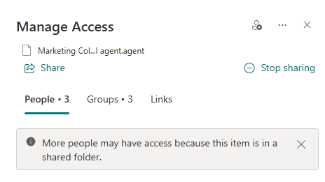
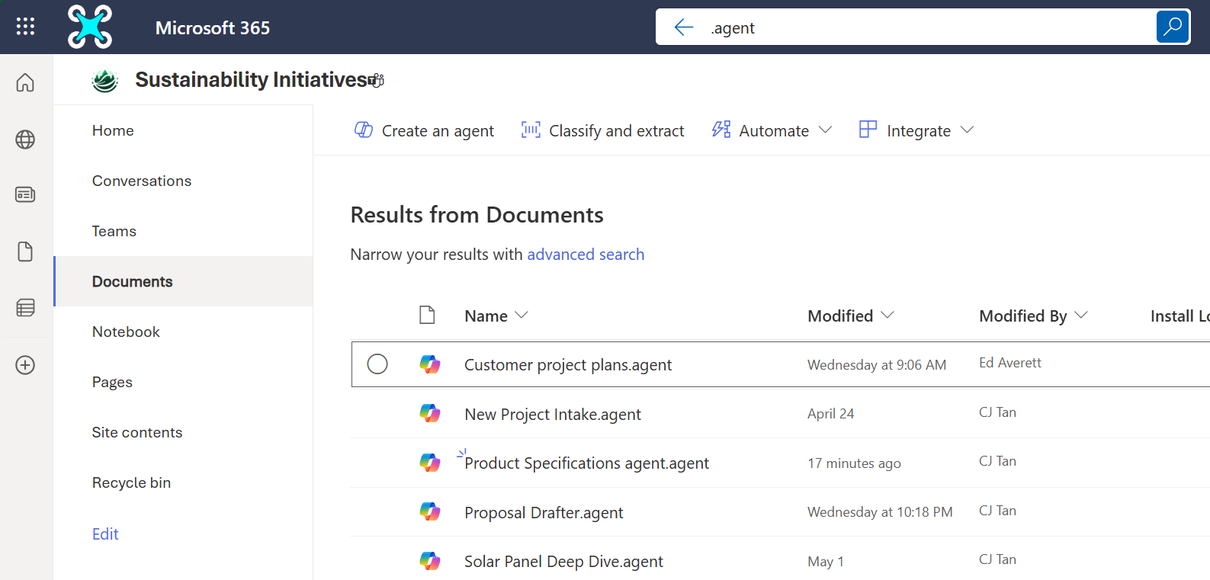
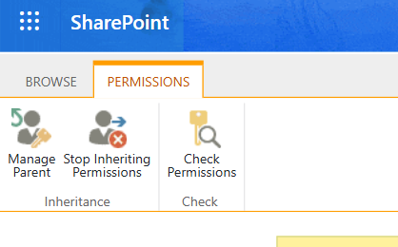
SharePoint agents are files
Granular permission control
Search and manage based on file extension

Slide 27
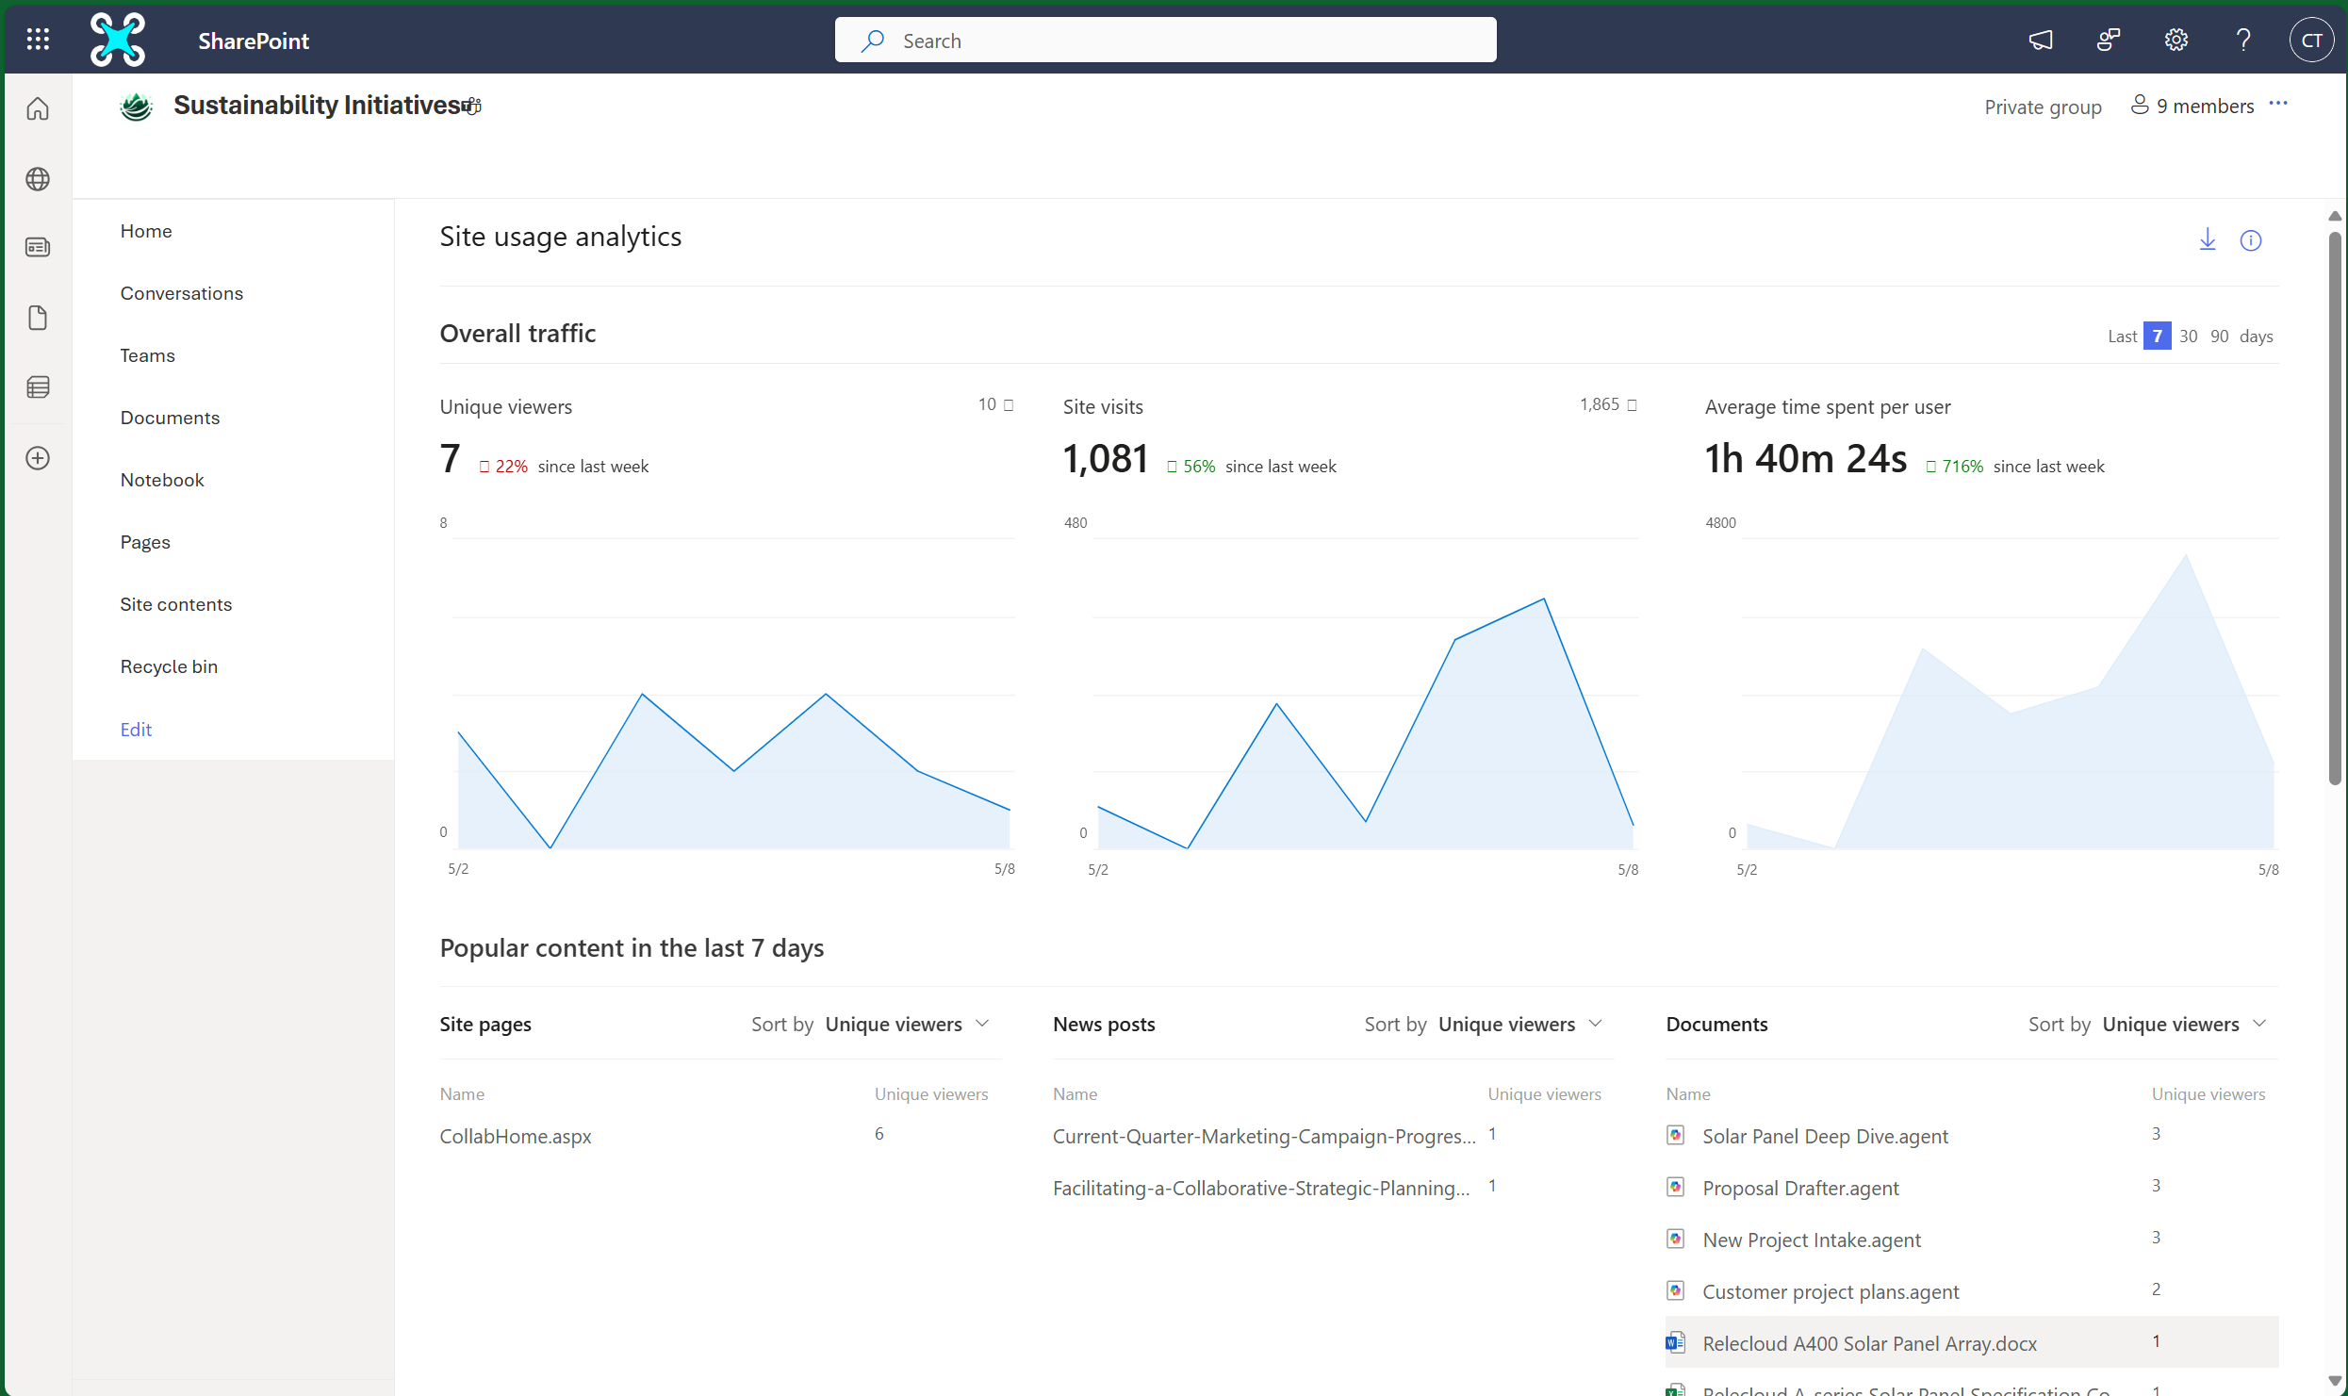
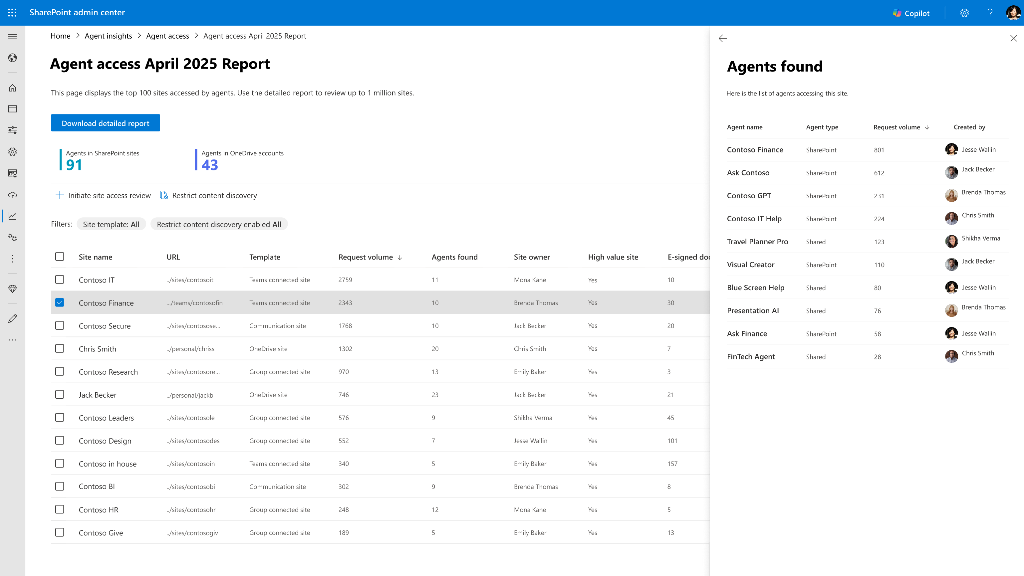

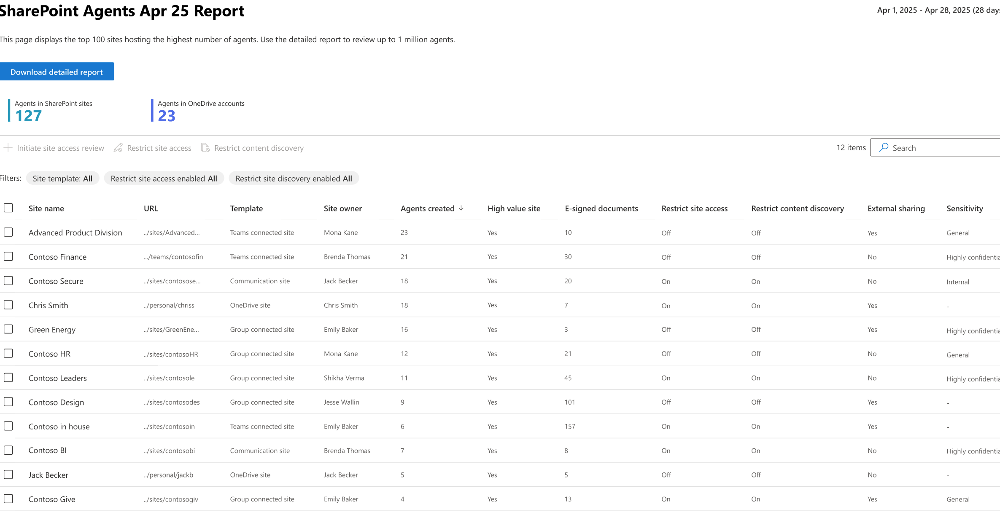
Agent Insights
Site Usage – Popular Content
SAM – SharePoint agent insights
Rolling out now!

Slide 28
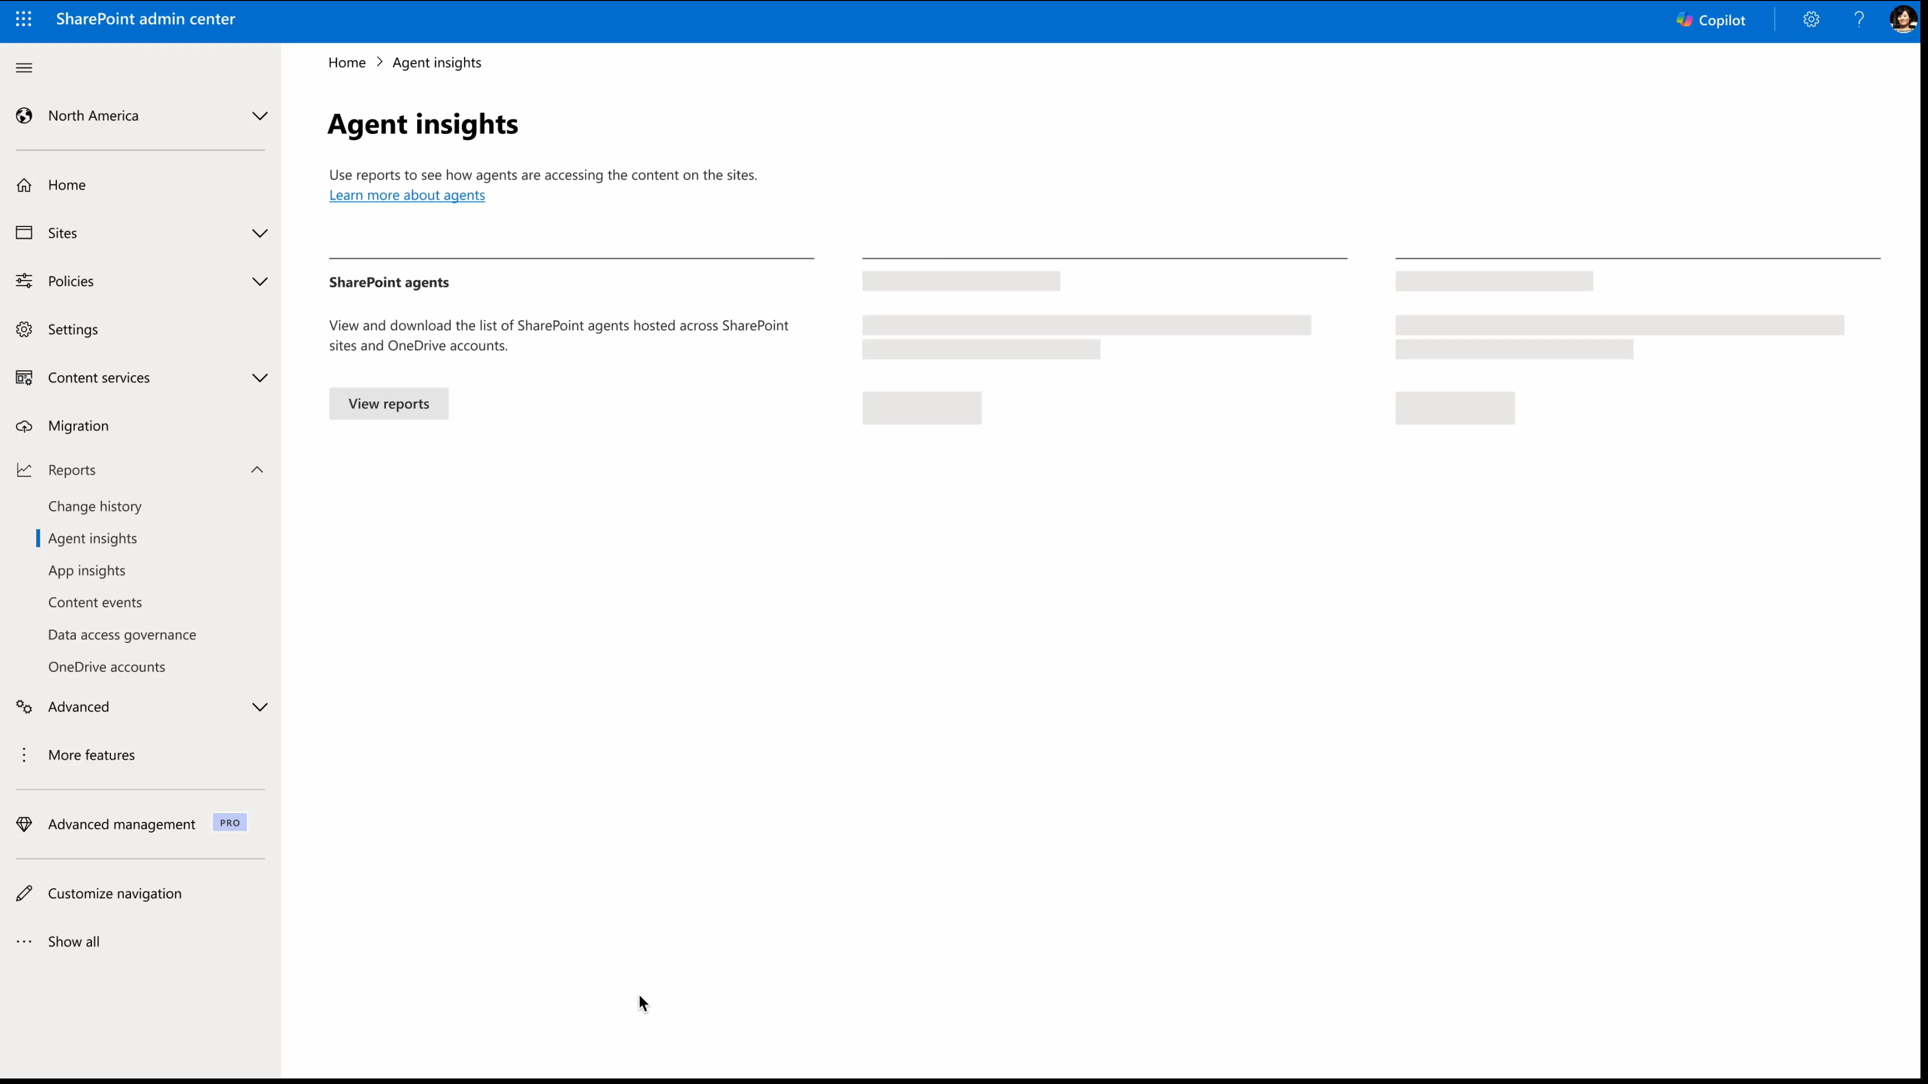
Notes:
Here in the SharePoint Admin center, we have a new report tab for “Agent insights”. As an admin, when you click on the SharePoint agents, you will be able to create or view previously configured reports.
Additionally, you can also gain insights on the agents hosted across each specific site and add governance controls like Restricted access control or Restricted content discovery.
For example, in the monthly report created for April’25, we identified 150 SharePoint agents across all SharePoint and OneDrive sites in the tenant.
Further, you can see distribution of agents across each site and site type.
Since the site “Advanced Product Division” has the highest number of SharePoint agents hosted on it and is externally shared, you can restrict the sites content discovery using RCD policy (Restricted Content Policy). Access to all the 23 agents will be blocked! This will help you manage agents across sites.

Slide 29
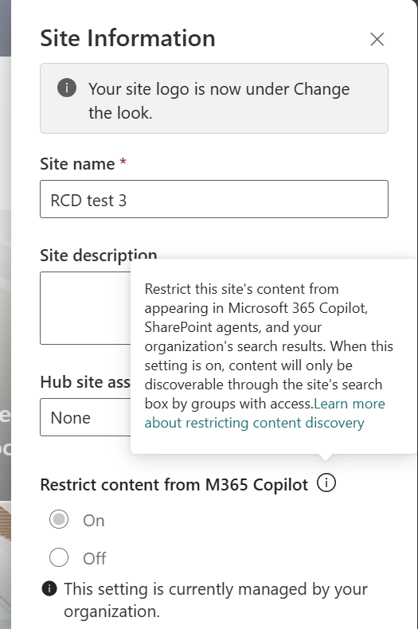
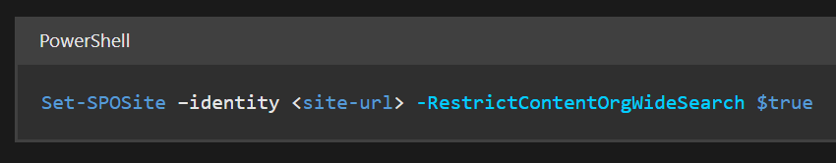
Restricted Content Discovery
Limit the ability of end users to discover content from specific SharePoint sites.
All SharePoint agent features are turned off when this property is applied on a site.
User will not see the Copilot coin, not be able to create new agents, nor select any content from that site as sources on an agent.
Notes:
Disable Copilot, SharePoint agent on the site

Slide 30

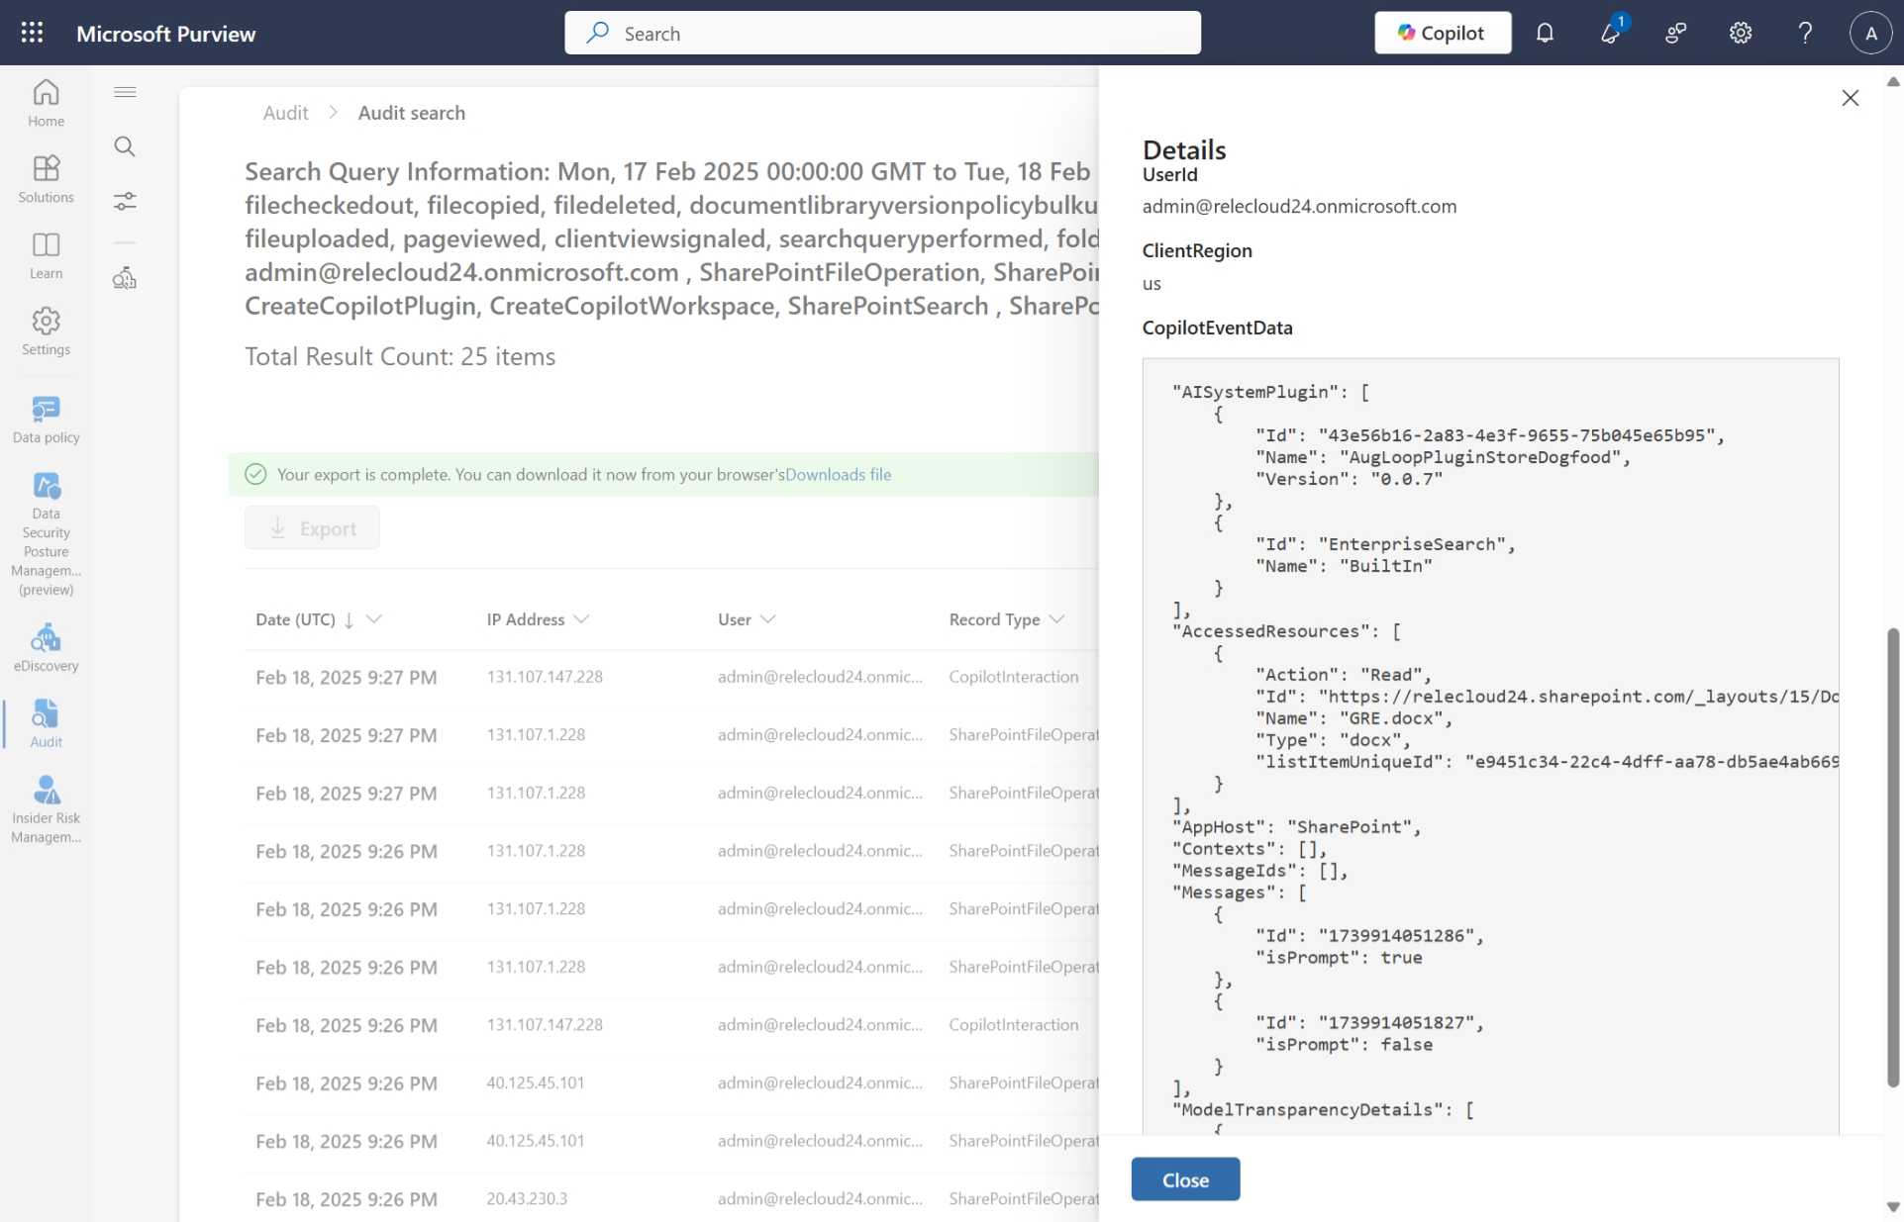
Audit logs on Microsoft Purview
Admins can look for CRUD
operations on .agent files.
Interaction records contain details about which user used with agent, when and
where the interaction took place.
Audit records also include references
to files, sites, or other resources Copilot
and AI applications accessed to generate responses to user prompts.

Slide 31
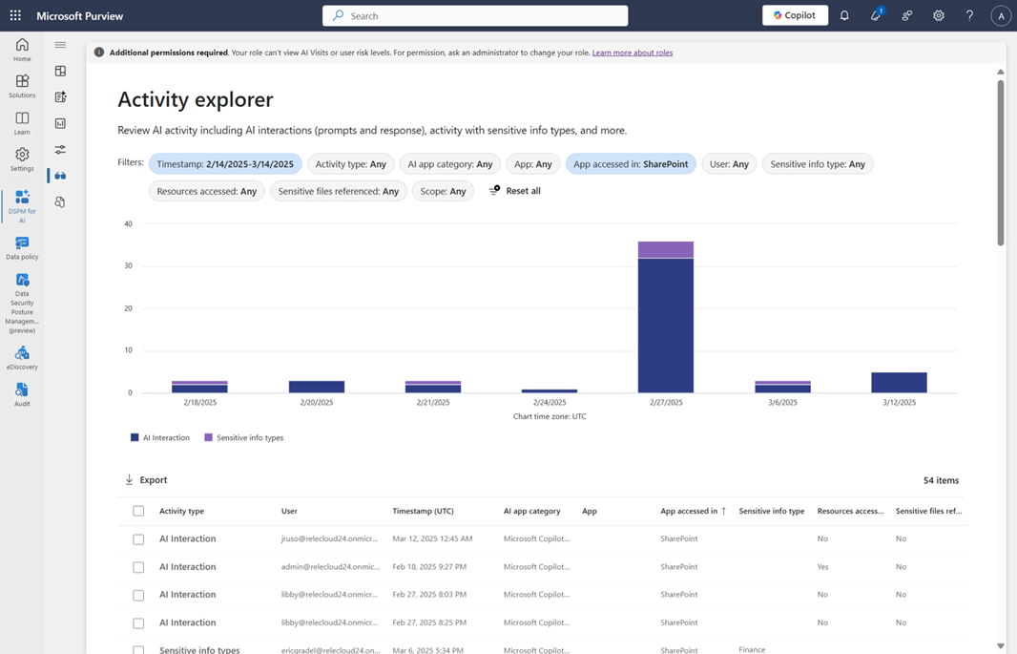
Activities on DSPM for AI
Insights and analytics into AI activity
in your organization
Ready-to-use policies to protect data
and prevent data loss in AI prompts
Data assessments to identify, remediate,
and monitor potential oversharing of data.
Compliance controls to apply optimal data handling and storing policies
Notes:
Data security posture management

Slide 32
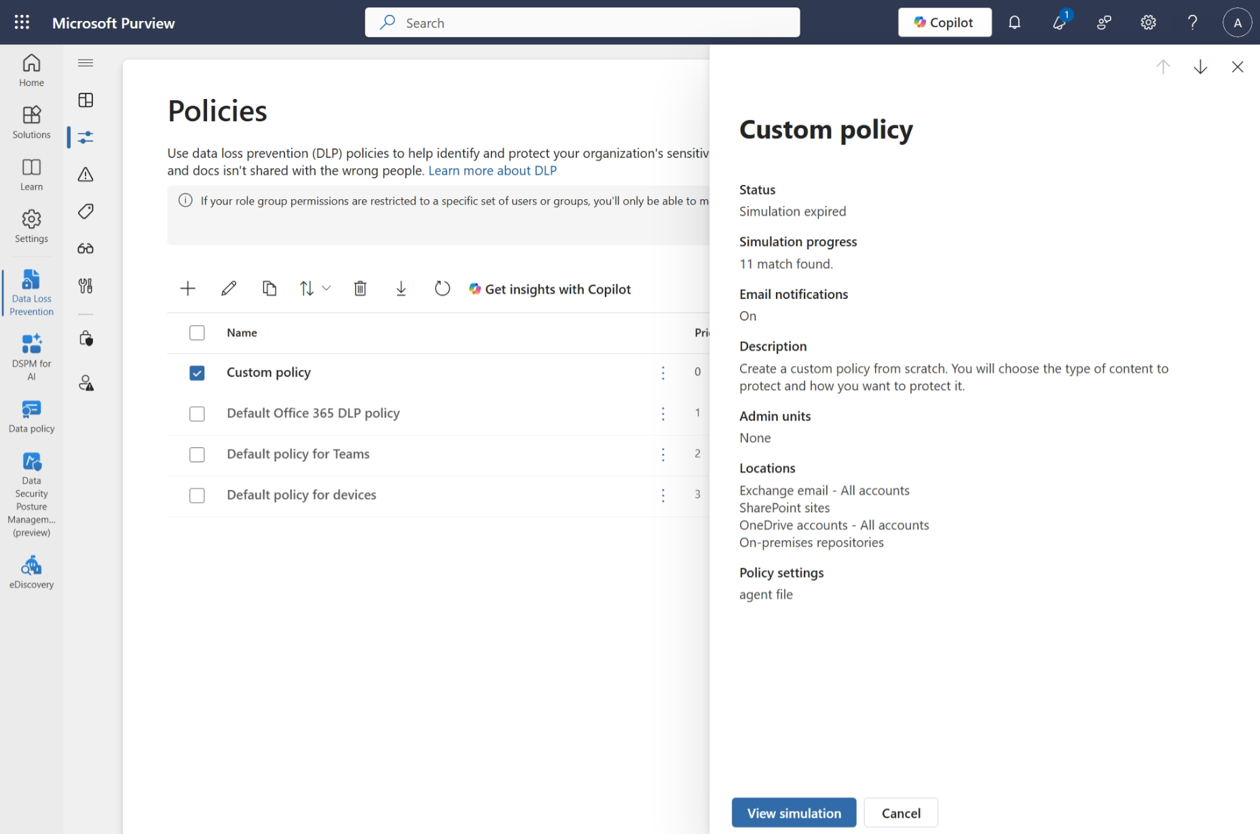
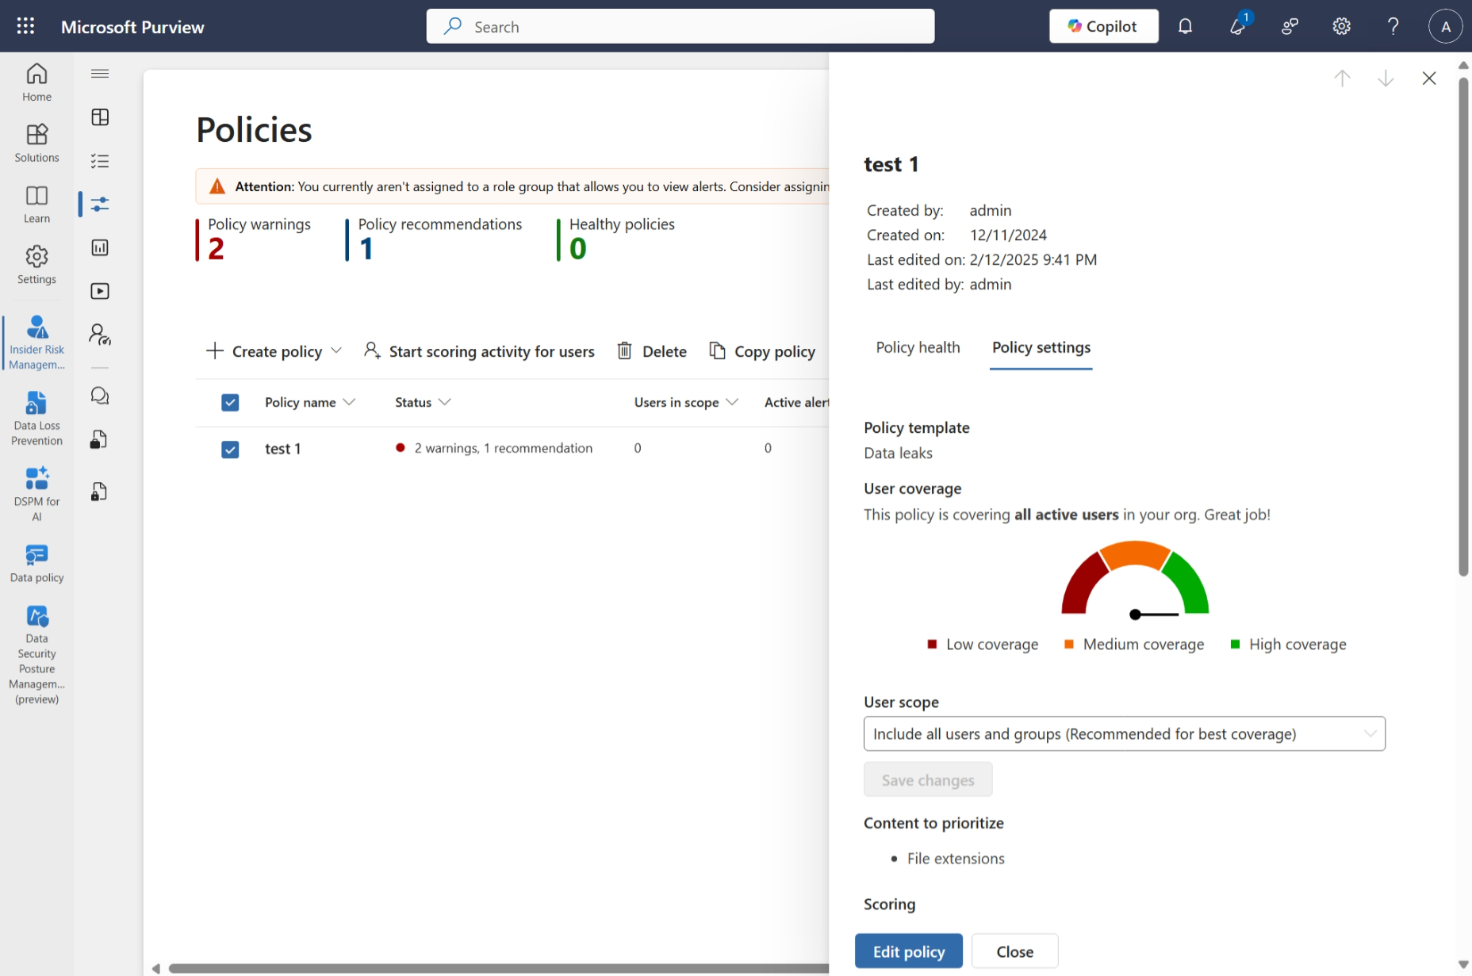
Extension based governance
Data Loss Prevention policies to control the sharing and prevent data exfiltration
Insider Risk Management policies to classify and investigate risky AI usage

Slide 33


Security and governance controls you can trust
Security
Governance & Compliance
Respects existing security settings and permissions for every site and documents
Only those with edit permissions on a
site can create an agent
Risk-based conditional access and data loss prevention
Data Security Posture Management for AI
Site owner controls
Analytics for site members and tenant admins
Audit logs on Purview
Restricted Content Discovery
Restricted Access Control Policy
Sensitivity labels in response/attribution
Aligns to your Microsoft 365 security, governance, compliance, and privacy policies
Notes:
Built on the same AI technology as Microsoft 365 Copilot, these agents operate within the Microsoft 365 trust boundary, maintaining the high standards of data privacy and security you trust.

Slide 34
What does it cost?

Slide 35
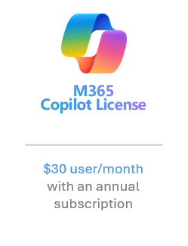
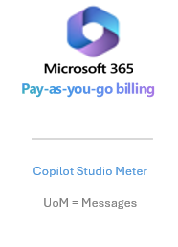
What does it cost?
Two options
Microsoft 365 Copilot license
Consumption Meter
M365 Copilot License
Included
Consumption Meter
Non-Microsoft 365 Copilot users
Microsoft 365 Pay-as-you-go “Agents in SharePoint” feature
SharePoint Agents
Consumption Model
Included

Slide 36
No really, what does it cost?
SharePoint agent feature | Consumption billing rate | M365 Copilot license
Generative answer | 2 messages | Included
Tenant graph grounding for messages | 10 messages | Included
$0.01 per message → $0.12 per interaction

Slide 37
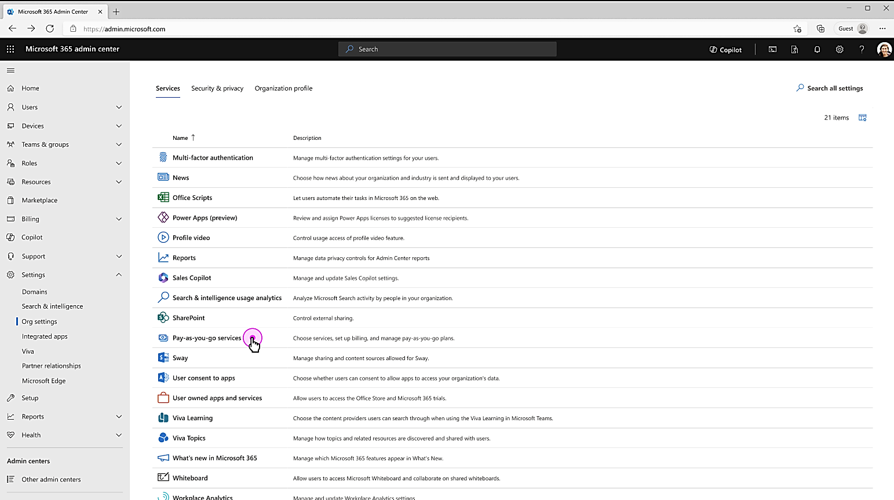
Consumption Meter
Pay-as-you-go services in Org Settings

Slide 38
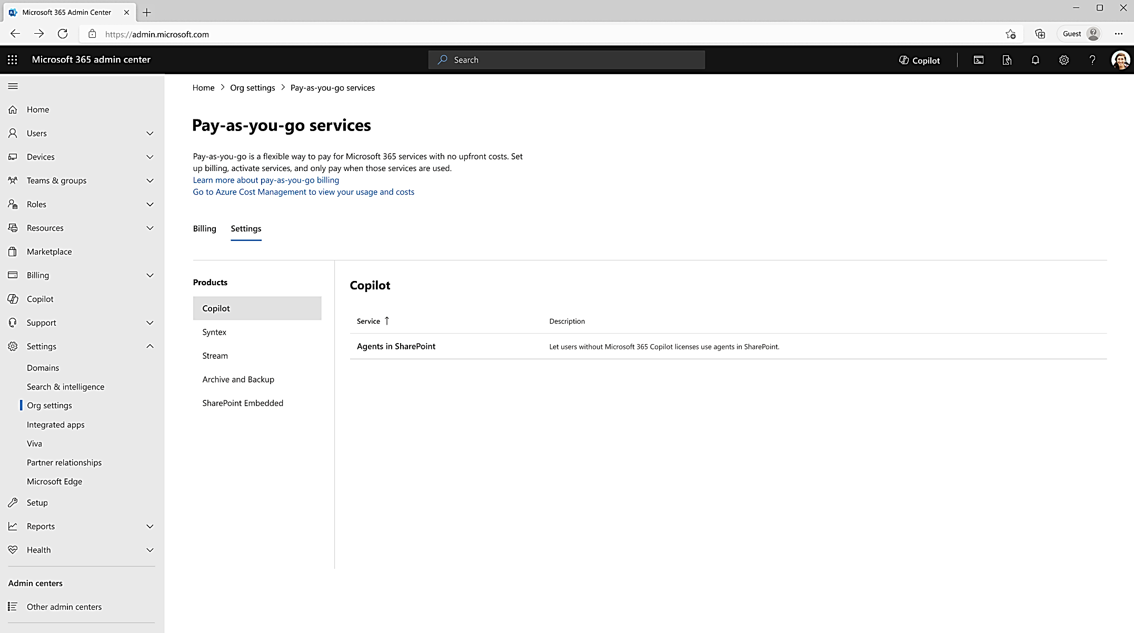
Metered Agents in SharePoint is available for setup

Slide 39
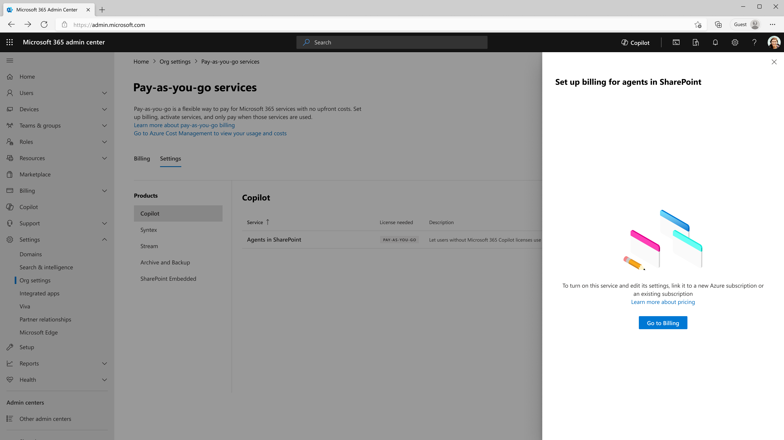
Admins can setup billing for Agents in SharePoint

Slide 40
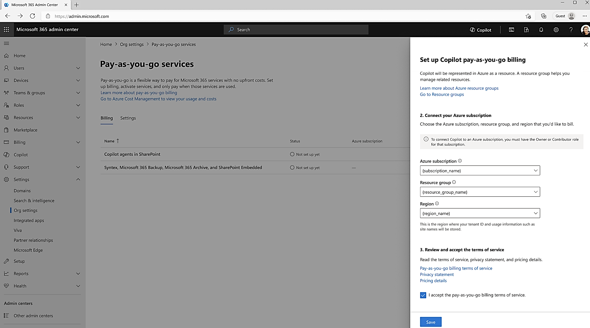
Only subscriptions to which Global Admin or SharePoint Admin have Owner or Contributor rights will be available
Subscription setup in Azure
Set up billing for agents in SharePoint

Slide 41
Looking ahead

Slide 42
SharePoint agents Roadmap
Last 6 months
Coming in next 3 months
Coming in next 6 months
SharePoint agents (SharePoint, Teams group chat, Teams meeting)
Pay-As-You-Go for SharePoint agents
Restricted Content Discovery apply to SharePoint agent creation
SharePoint agents trial usage report in Copilot Admin Center
Rolling out now: SharePoint: M365/SharePoint Agent Insights for SharePoint Administrators (486861)
Agents in OneDrive (469503), OneDrive files as knowledge source for SharePoint agents (480728)
Microsoft Copilot: Access SharePoint agents in the Microsoft 365 Copilot app (482601)
Teams: SharePoint agents in Teams Channels (481822)
Teams: SharePoint agents are available in Teams app store (481824)
Teams: Add more than one SharePoint agent to Teams chat, channels and meetings (481826)
SharePoint: SharePoint agent web part (481512)
SharePoint: Share and edit SharePoint Site’s built-in agent (480721, 480727)
Ability to add multiple billing policies for Pay-As-You-Go for SharePoint agents
SharePoint: Agent usage statistics per SharePoint site (480725)
Microsoft Admin Center: SharePoint agent usage statistics across SharePoint Sites (480729)
Microsoft Viva: SharePoint agent analytics on Viva Insights (480726)
Teams: Chat one-on-one with SharePoint agent (481825)
Ability to set a budget for Pay-As-You-Go for SharePoint agents

Slide 43
Resources
SharePoint agents on adoption.microsoft.com
“One-click AI agents in SharePoint and Teams - focused on files you select (Microsoft 365 Copilot)” | SharePoint agents covered on Microsoft Mechanics show
Original SharePoint agents GA blog
“SharePoint agents in the wild” | Related episode from The Intrazone podcast

Slide 44
Thank you

